Slide 1
Wormington MCPD
Wormington Parish Council meeting
Monday 3 June 2024
National Gas Transmission |
Private & Confidential

Slide 2
What we will be covering
About National Gas
What is the Wormington MCPD project?
Current Project Status
Working with communities
How to contact us
Opportunity to ask questions

Slide 3
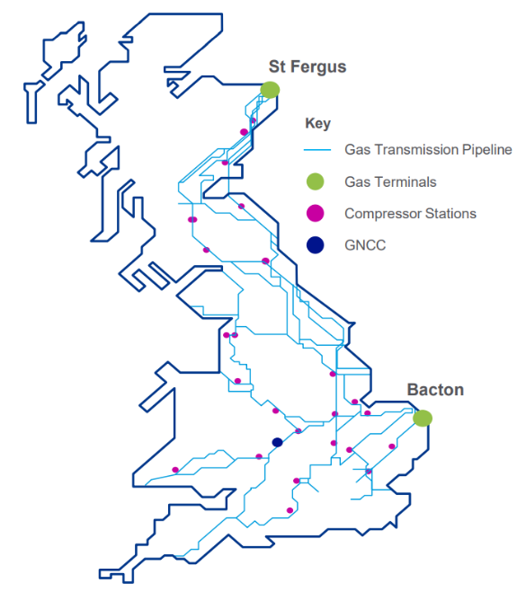
Our essential role in keeping Britain’s homes warm and its industry moving
National Gas overview
In 2021…
About
25%
National Gas Transmission owns, manages, and operates the National Transmission System (NTS) in Great Britain, making gas available when and where it's needed.
National Gas Metering is the largest equipment manager of industrial, commercial and residential gas meters in Great Britain - providing metering and reading services on behalf of National Gas Transmission.
42%
of the country’s energy generated by gas
23 compressor stations
~530 above-ground installations (AGIs)
23m
~7.3m meters
British homes used gas for heating
7,660km network length
Gas National Control Centre (GNCC)
~95% domestic meters
25%
8 connected distribution networks
National Gas Services (NGS)
of industry used gas to power manufacturing operations
~5% industrial meters
Source: Digest of UK Energy Statistics

Slide 4
What is the Wormington MPCD Project?
National Gas Transmission (NGT) owns and runs the compressor station to the east of Wormington village.
Plan to install a new compressor as part of a wider programme to invest in network ahead of environmental compressor emissions legislation which comes into effect from 1 January 2030.
Replacement of an old compressor with a brand new highly efficient and low emission compressor unit.
Work requires planning permission from Tewkesbury Borough Council - planning application to be submitted in 2025.
Environmental surveys will be carried out in the coming weeks and months
Notes:
The work, collectively known as the Western Gas Network Project, involves:
9km of new pipeline between Wormington (Gloucestershire) and Honeybourne (Worcestershire) and 2km of new pipeline in Churchover (Warwickshire)
Pressure uprating of the existing pipeline between Milford Haven (Pembrokeshire) and Three Cocks (Powys)
Related works at existing National Gas sites in South Wales and England to facilitate the pressure uprating, connection of new pipelines and effective compression at existing station

Slide 5
Wormington MPCD Project: Scope
INSERT SITE MAP

Slide 6
Current project status: Development
INSERT PROJECT TIMELINE

Slide 7
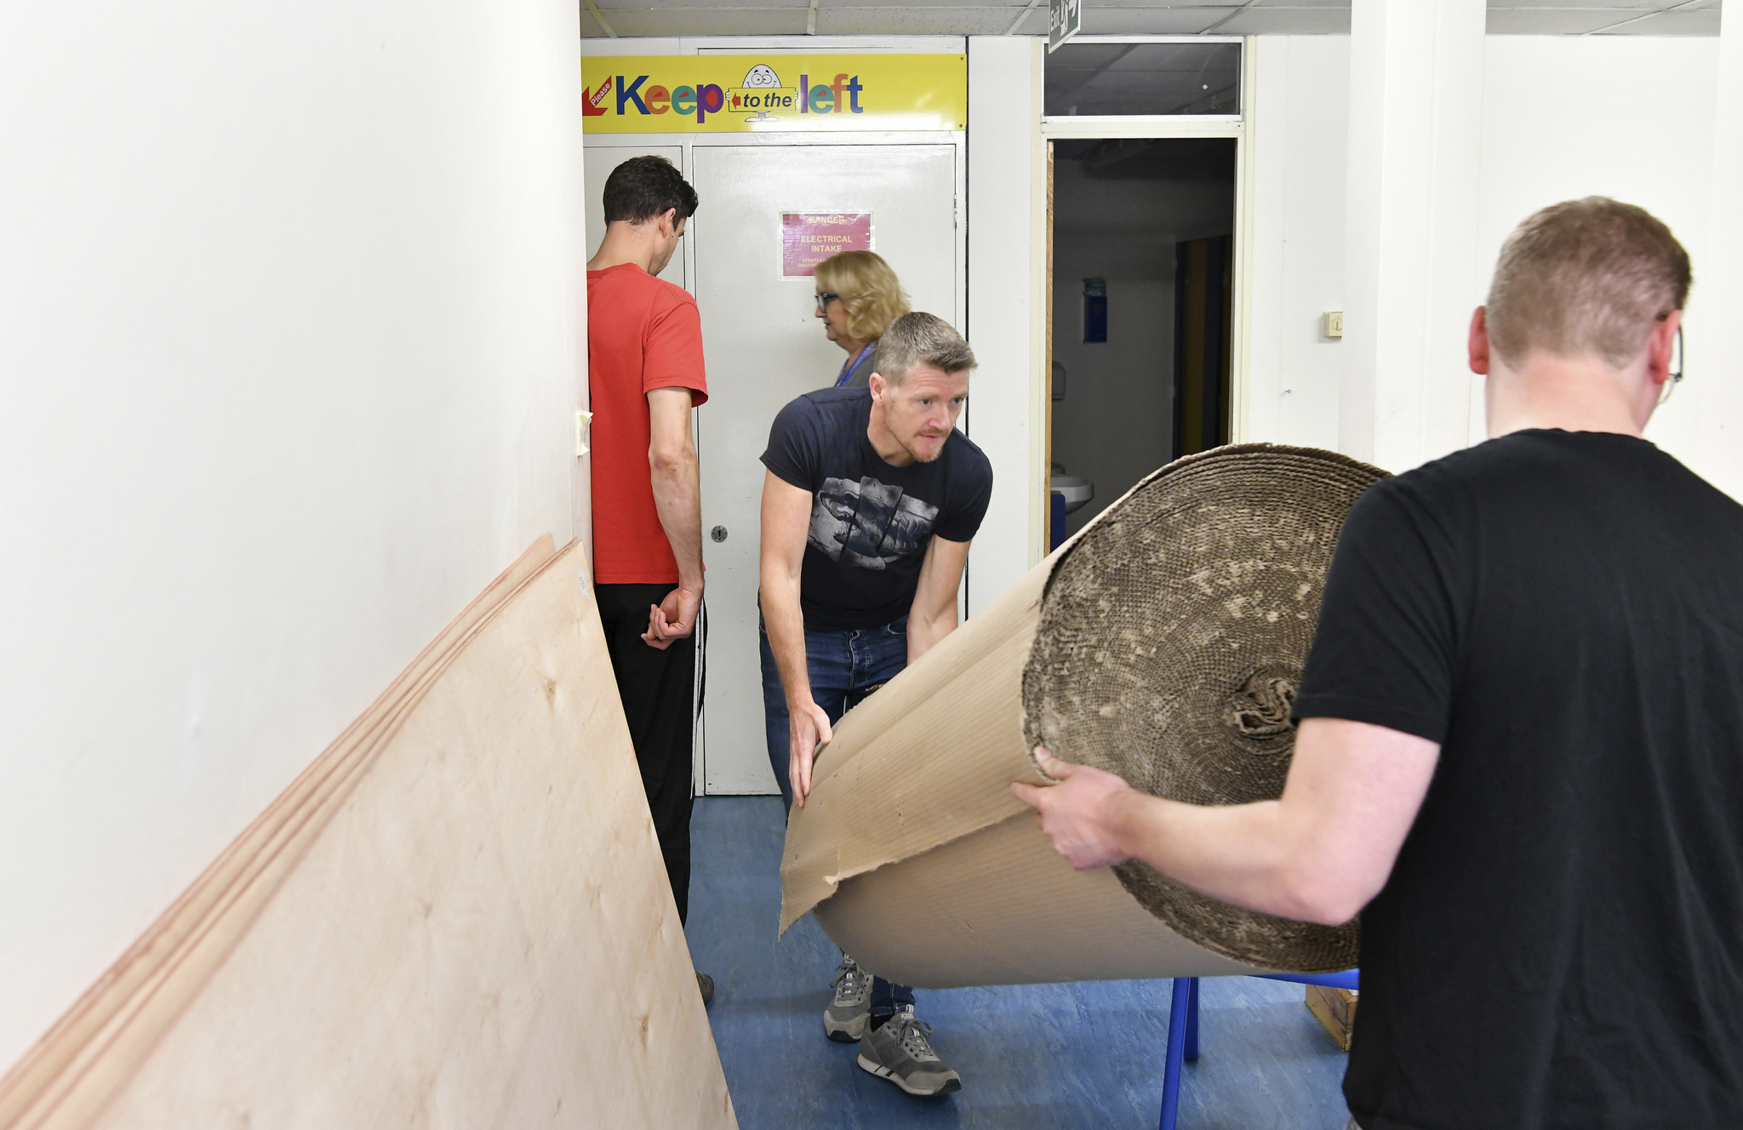
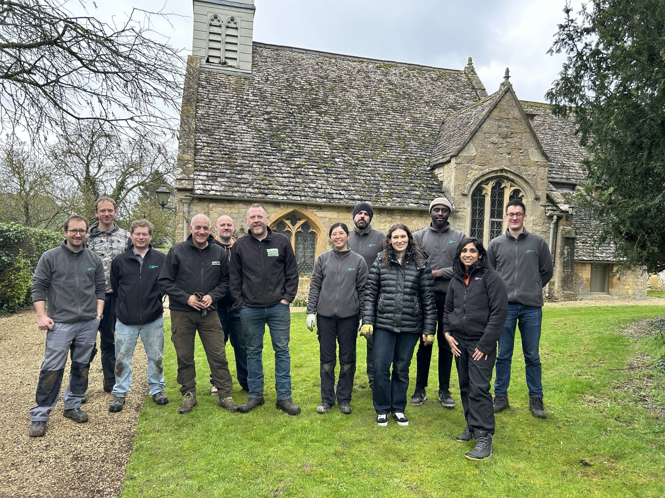
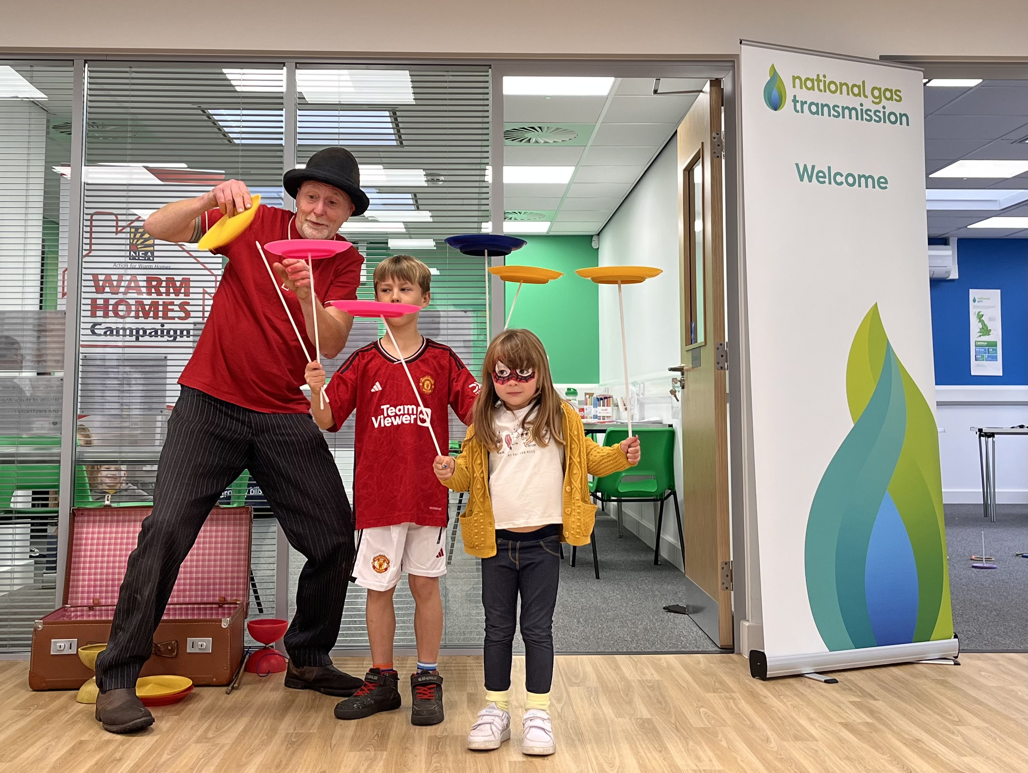
Community Initiatives
We have partnered with National Energy Action (NEA) to offer free training and information for communities
Above: National Gas volunteering at St Egwin’s School, Evesham
Above: Our colleagues volunteering
Day at St Katharine’s
Church, Wormington
Community Grant Fund
Above: NEA Family Fun Day

Slide 8
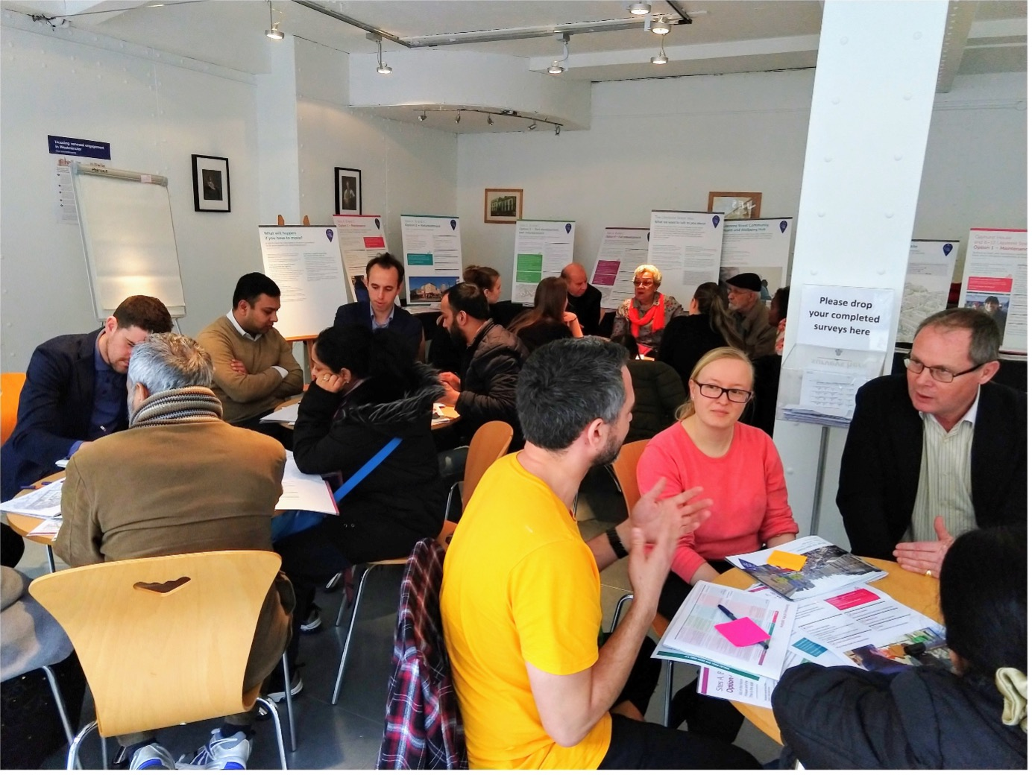
How we will communicate with you
| te]

Slide 9
How to find out more
You can visit our project website at https://www.nationalgas.com/mpcd
We will be reaching out at various points on the project with updates
Contact us
Telephone 0800 319 6185 (our team are available 9am-5pm Mon - Fri)
Email wormington@nationalgas.com
| [

Slide 10
Questions Thank you

