Slide 1


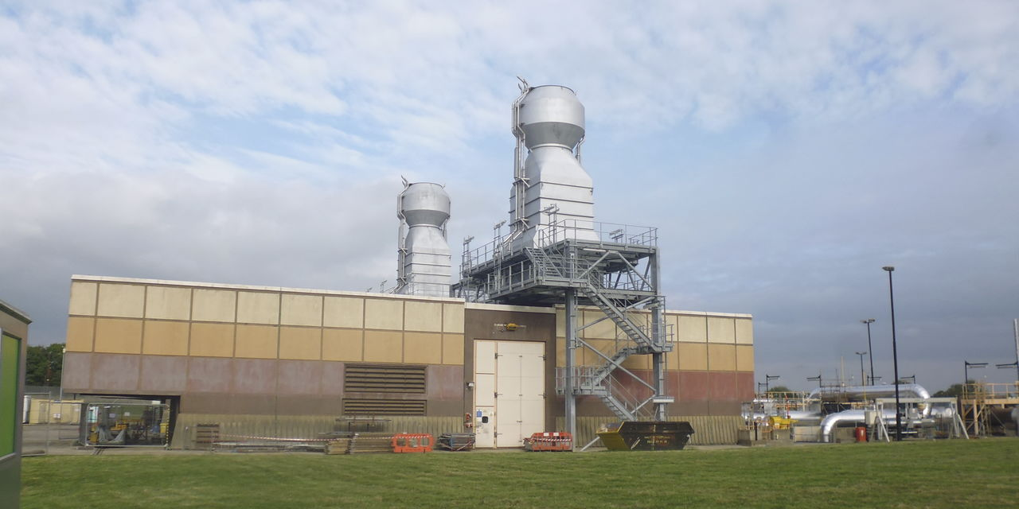
Incentives:
- RIIO-2 proposals
Tuesday 8th October 2019

Slide 2




Who we are…
Mike
Wassell
RIIO-2 Incentives Manager
Carol
Carlin
GSO RIIO-2 Commercial Strategy Manager
Jeni
Ray
Head of
Customer Insight
Jenny Pemberton
RIIO 2 Stakeholder Engagement Manager
Notes:
Thank you for joining us today. I am Phil Sheppard, Director of Gas Transmission for NGG. We will spend the next hour talking through and answering any questions you might have on our draft RIIO2 business plan
We’ve done our biggest ever listening exercise and are pleased to be able to share the result of that with you today in the form of our draft business plan
I want to start by saying thanks so much for working with us to build this plan. It’s so important it meets your needs and its only through your engagement with us that we can be confident of this
We are still listening. I will tell you more at the end of how you can continue to get involved over the coming weeks, but the first step is joining us today
A few of the team are going to join me today in presenting to you the content of our draft business plan, but I’ve got the whole team with me to answer any questions you might have. So please as we go along send anything that comes to mind through and we will endeavour to respond them during our Q&A session at the end.
I will now handover to Carole who is going to start by talking you through how we have built our plan and the key things contained within it.

Slide 3
Logistics
Should last for approximately an hour
Polling via Webex
Your questions are welcomed throughout via chat function
All callers will be placed on mute
Slides will be circulated after the call
Notes:
Jenny Pem

Slide 4
Quick Poll – Getting to know you
Please tell us your name
2. Which of the following best describes you / your organisation?
3. On a scale of A to E, where A is know nothing and E is know a great deal, how much would you say you know about National Grid Gas Transmission’s operational activities?
              Know nothing
              Know a great deal
Notes:
Jenny P

Slide 5
Quick Poll – Impact and Interest
On a scale of A to E, where A is not impacted at all and E is impacted a great deal, how impacted are you or those you represent) by Incentives?
              Not impacted at all
              Impacted a great deal
On a scale of A to E, where A is not interested at all and E is interested a great deal, how interested are you (or those you represent) by Incentives?
              Not interested at all
              Interested a great deal

Slide 6
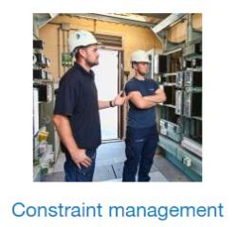
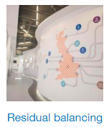
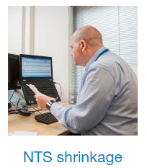




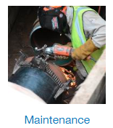
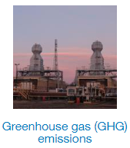
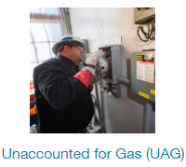

RIIO-2 Incentives proposals-what we have heard to date
Environmental
Stakeholder Satisfaction
Customer Satisfaction
Community Engagement
Reputational
Notes:
Recognising that not every person or every organisation has the same views but generally we have heard from multiple people that:
We are focussing on areas which are viewed as important
There is broad support for incentives in these areas to drive performance in RIIO2
We need to make clearer what is BAU performance and what goes beyond that.
Target setting and reward caps and collars – we need to explain what we propose and why that is appropriate.
Caveat – that we will explain CCM in principle but cannot yet share all the detail.

Slide 7
RIIO2 Incentives Summary – initial view
Incentive
Purpose
RIIO1 Cap Collar
RIIO2 Initial View
Minimise the cost of actions to prevent constraints.
Maximise capacity availability.
Capacity Constraint Management
_{+£26million to -£78 million}
_{tbc}
Shrinkage
_{+£7 million to -£7 million}
_{+£5million to -£5 million}
Minimise the energy cost of operating the network.
Demand forecast
Provide accurate day ahead and D2 to D5 demand forecasts
_{+£20 million to -£2.5 million}
_{+£16 million to -£2.5 million}
Residual balancing
_{+£2 million to -£3.5 million}
_{+£1.6 million to -£2.8 million}
Minimise the energy cost of operating the network.
Maintenance
Minimise use of maintenance days and changes to scheduled maintenance.
_{+£0.7 million to -£1 million}
_{+£1.2 million to -£1.5 million}
GHG venting
_{Zero to unlimited penalty}
_{+£1.5 million to -£1.5 million}
Minimise Greenhouse Gas emissions
Potential EAP Scorecard
Maximise environmental ambition and performance
_{n/a}
_{tbc}
CSAT
Maximise ambition and performance on how we……
_{1% of revenue}
_{tbc}

Slide 8



RIIO-2 Incentives
- one by one

Slide 9
Capacity Constraint Management
Retain & review
We are obligated to release Entry and Exit capacity at around double peak demand (top down regime). Flows of gas at these levels cannot be physically accommodated concurrently meaning there is an inherent risk to be managed as part of the regime.
RIIO-1 Incentive
RIIO-2 Initial position
Target cost (Revenue – Costs) of £22m (in 09/10 prices) based on expected constraint costs
Cap and Collar on incentive reward +£20m/-£60m (in 2009/10 prices)
Encourages us to take on risk, minimise commercial actions and ensure investment decisions are balanced against risk
Retaining the cap, collar, and target principles of the operational buy back scheme.
Retaining the existing cost and revenue components of the scheme.
Retaining the incremental buy back element of the scheme as-is.
Retaining the accelerated release mechanism as-is.
Remove a proportion of interruptible / off-peak capacity revenue where we scale back.
Incorporating network capability outputs to inform constraint risk.
No Incentive (BAU) | Incentive (exceeding BAU) | Value for Consumers
Less likely to release non-obligated capacity Tend towards more risk aversion in NGG decision making More likely that commercial decisions are made closer to real time and more frequent actions (more risk averse) | More likely to take on risk in releasing capacity over and above obligations Realigning outages at cost to NGG to mitigate / manage potential constraints More likely to take on risk in key investment decisions Less risk averse in carrying out constraint management actions | Facilitates customers being able to bring gas on and off the network when and where they want, meaning the cheapest gas can be sourced with minimal disruption: Improved quality of service Lower consumer bills Improved safety and reliability
Notes:
We believe the incentive is integral to the capacity commercial and regulatory framework.

Slide 10
Capacity Constraint Management BAU
1
2
Operating the Network
Constraint Management
Run different compression
Release less non-obligated capacity
Take commercial actions earlier or later
Less incentive to try innovative operational solutions
Weaken contract negotiation position
Could disproportionally impact smaller shippers by the smearing of constraint costs.
Socialised cost > NG act differently > Shippers know this and may act accordingly
Ofgem decides how NG mitigate risk based on their funding of asset based solution > if NG get financed then we would likely invest to mitigate risk > if NG do not get funded then we would likely take out more contracts
Discourages temporary build/asset solution
3
4
CBAs
Asset management
Involve regulator more in decision making process > only act on strong evidence that Ofgem will remunerate
Increase stakeholder engagement > time & cost
Additional risk factor enters into CBA
Use commercial solutions closer to real time
Pass through to consumers increased job costs and time scales > greater uncertainty of project cost
Reputational damage only governing factor for NG > trade this off against project costs
Increased asset intervention if we are funded, use contracts if not funded adequately for asset investment > take less risk on asset performance
How have we performed?
Value (£m) | 13/14 (£m) | 14/15 (£m) | 15/16 (£m) | 16/17 (£m) | 17/18 (£m) | 18/19 (£m)
+25 to -76.4* | 12.6 | 12.6 | 12.6 | 13.3 | 14.2 | 13.8
*2018/19 values including RPI.

Slide 11
Quick poll
Should we be retain a financial incentive on Capacity Constraint Management?
Yes
Unsure
No
Have we explained what delivering beyond BAU looks like?
Yes
Somewhat
No
Do you agree with our RIIO-2 initial position?
Yes
Somewhat
No
Please add any comments

Slide 12
Residual Balancing
Retain & amend
We, as residual balancer, can enter the market and undertake trades to resolve any residual imbalance on the system. The net costs or revenues from our market balancing actions are ‘smeared’ back to shippers via balancing neutrality. The incentive is integral to our residual balancing role and framework.
RIIO-1 Incentive
RIIO-2 Initial position
The incentive comprises of:
Linepack Performance Measure (LPM): drives us to balance closing to opening linepack (± 2.8 mcm/d)
Price Performance Measure (PPM): drives us to minimise the price spread of our trades by measuring the price range of our trading actions compared to the System Average Price (SAP) (±1.5%) Cap and Collar +£2m to -£3.5m
Tougher to achieve due to reducing the performance gradient, against a backdrop of a changing and more challenging energy landscape
Amend LPM for shoulder months to 5.6 mcm/d to drive the right behaviour during seasonal transitions between winter and summer and vice versa
Cap and Collar +£1.6 to -£2.8m
No Incentive (BAU) | Incentive (exceeding BAU) | Value for Consumers
Increased likelihood of trading more often to minimise risk (risk averse) with less focus of cost and effect on market of residual balancing actions Trading strategies less likely to evolve and keep pace with a changing market | Trading activity is more strategic (less risk averse) and more likely to keep pace with a changing market Invest and innovate in commercial insight, analysis and supporting tools Less market intervention (we currently avoid entering the market roughly 250 days per year) | We enter the market in a measured way to avoid incurring unnecessary costs for consumers More efficient, transparent and predictable management of linepack – more informed market
Notes:
We believe the incentive is integral to the capacity commercial and regulatory framework.
T1 10 to 20% days need to balance , now its 30 to 40% of days.

Slide 13
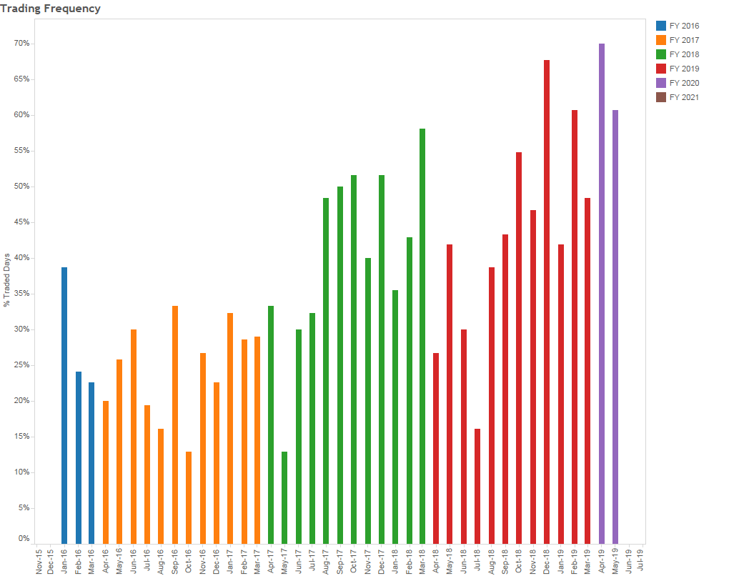
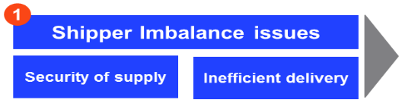
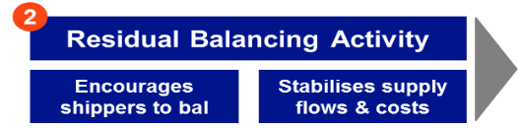
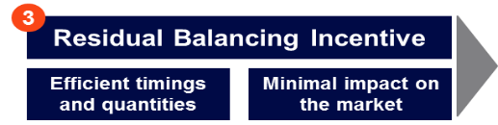
Residual Balancing
Increasing trading frequency
How have we performed?
Value (£m) | 13/14 (£m) | 14/15 (£m) | 15/16 (£m) | 16/17 (£m) | 17/18 (£m) | 18/19 (£m)
+2 to -3.5 | 1.0 | 1.1 | 1.2 | 1.1 | 0.6 | 1.0

Slide 14
Quick poll
Should we be financially incentivised to balance linepack and minimise the price spread of our actions?
Yes
Unsure
No
Have we explained what delivering beyond BAU looks like?
Yes
Somewhat
No
Do you agree with our RIIO-2 initial position?
Yes
Somewhat
No
Please add any comments

Slide 15
Maintenance
Retain & amend
We must periodically carry out maintenance on the NTS and publish a planned maintenance schedule. Where the work requires customers to cease or reduce offtake flows, we may ‘call’ one or more ‘maintenance days’.
RIIO-1 Incentive
RIIO-2 Initial position
Changes scheme – target maximum number of planned maintenance changes we initiate each year. Earned reward £50,000 per change below target number. Penalty £50k per change over target. Cap and collar +/-£0.5m p.a.
Use of days scheme - target of 11 maintenance days called for Remote valve Operations (RVOs). If maintenance days used is less than target, tiered reward to NGG between £15k and £25k per day, capped £0.215m. If maintenance days used exceeds the target, NGG penalty of £20k per day, collar of £0.5m
Cap and Collar +£0.7m to -£1 m
Retain existing scheme
Expand to cover wider range of maintenance activities
Add target no. of “maintenance days” (10% of plan) for asset replacement and reinforcement works
+/-£20k per day variance against target, capped & collar £0.5m
Cap and Collar +£1.2m to -£1.5m
No Incentive (BAU) | Incentive (exceeding BAU) | Value for Consumers
More likely to focus on UNC obligations (e.g. use our entitled maintenance days) More likely to reschedule planned maintenance activities as we focus on operational requirements | Volume of maintenance in RIIO-2 likely to increase from RIIO-1 levels (around 2 to 3 times). requiring increased focus on customer impacts and alignment of plans We continue to perform beyond our regulatory obligations | This incentive encourages alignment of maintenance plans with customers to minimise potential disruption to them and wider markets This ultimately reduces costs to end consumers
Notes:
We believe the incentive is integral to the capacity commercial and regulatory framework.

Slide 16

Maintenance Incentive – How we’ve performed
Incentive Year | Incentive Targets (days) |  | Incentive Performance (days) |  | Incentive performance
 | Changes initiated by NG To MD | Use of MD | Changes initiated by NG To MD | Use of MD
2013/14 | 6.24 | 72.30 | 0 | 31 | £1.138m
2014/15 | 1.02 | 44.65 | 0 | 4 | £0.864m
2015/16 | 3.99 | 11.00 | 0 | 2 | £0.364m
2016/17 | 16.82 | 11.00 | 0 | 1 | £0.690m
2017/18 | 20.37 | 11.00 | 0 | 1 | £0.690m

Slide 17
Quick poll
Should we be financially incentivised to minimise our impact of maintenance activities on customers?
Yes
Unsure
No
Have we explained what delivering beyond BAU looks like?
Yes
Somewhat
No
Do you agree with our RIIO-2 initial position?
Yes
Somewhat
No
Please add any comments

Slide 18
Demand Forecast
Retain & amend
We provide NTS demand forecasts over a range of timescales to help the industry make informed physical and commercial decisions.
RIIO-1 Incentive
RIIO-2 Initial position
D-1 incentive has an annual average absolute error forecasting accuracy target of 8.5 mcm/d in 2018/19
D-2 to D-5 the target is 13.7 mcm/d
Cap & collar +£20m to -£2.5m
Retain scheme
Make incentive tougher to achieve by reducing the performance gradient, recognising that demand forecasting is becoming increasingly challenging
Caps for each scheme reduced by 20%
Cap and Collar +£16m to -£2.5m
No Incentive (BAU) | Incentive (exceeding BAU) | Value for Consumers
Less likely to evolve and invest in our demand forecasting tools and processes Increasing demand volatility more likely to impact forecast accuracy | Invest in our demand forecasting models, processes, intelligence, tools and procured services Increased focus on forecasting demand volatility | Industry can make informed decisions enabling savings to be passed on to consumers Reduces barrier to entry for smaller industry participants Increased forecast accuracy likely to benefit wholesale market prices
Notes:
We believe the incentive is integral to the capacity commercial and regulatory framework.

Slide 19
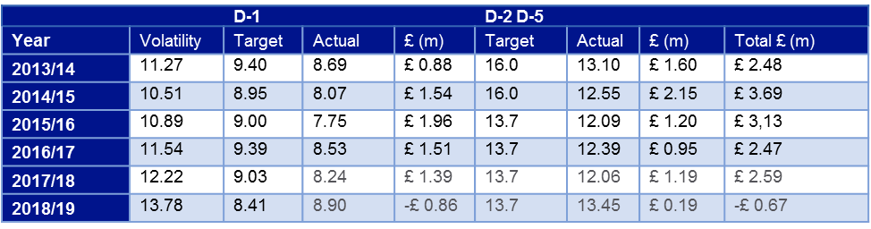
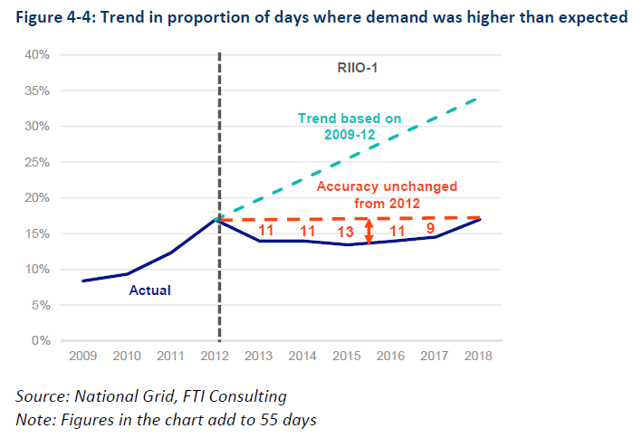
Demand Forecast Accuracy
Consumer Value Day Ahead Forecast
    Analysis demand higher than expected
      RIIO1 £44 million (to 2019)
      Incentive reward £6.2million

Slide 20
Quick poll
Should we be financially incentivised to improve Demand Forecast Accuracy?
Yes
Unsure
No
Have we explained what beyond BAU looks like?
Yes
Somewhat
No
Do you agree with our RIIO-2 initial position?
Yes
Somewhat
No
Please add any comments

Slide 21
Shrinkage
Retain & amend
As NTS Shrinkage Provider, NGG is responsible for managing the end-to-end service of forecasting, accounting for, procuring, and supplying energy to satisfy the daily NTS shrinkage components. The associated costs are collected from shippers via the commodity charge
RIIO-1 Incentive
RIIO-2 Initial position
We are incentivised to deliver shrinkage energy at a cost lower than an agreed annual Target Shrinkage Cost
There is a financial reward for delivering below target cost and penalty for exceeding
There is a cap and collar of +/-£7m p.a.
Retain the scheme
Add seasonal products to trading options to reduce trading costs (increased liquidity)
Subject to proposed changes to the electricity charging regime, remove the TNUoS element
Review Shrinkage Methodology
Reduce cap and collar to +/-£5m
No Incentive (BAU) | Incentive (exceeding BAU) | Value for Consumers
Greater focus on delivery of UNC obligations and less focus on delivery of Shrinkage below target cost | Procure shrinkage energy at prices better than the target price through innovative trading strategies Manage price risk by buying energy using forward contracts Minimise TNUoS charges by developing compressor running strategies, whilst still meeting customer needs Invest in market analysis to inform trading strategies | We manage shrinkage to minimise consumer cost exposure by procuring shrinkage energy at below average market price Reduced cost of shrinkage passed through to customers and ultimately consumers
Notes:
We believe the incentive is integral to the capacity commercial and regulatory framework.

Slide 22
Shrinkage cost -three categories of the shrinkage gas
NTS shrinkage, which is the energy required by NG to operate the NTS, falls into three categories:
Shrinkage gas is around £60-£80 million.
Cost
Price
Quantity
1
Compressor fuel use (CFU)
Price
Quantity
While NG has limited control over the quantity of most elements of shrinkage gas, it does have some control over the price paid to replace the gas:
CFU
Does not have control over general market price movements but actively trades in forward markets to minimise costs and hedge risk
Potential to influence through efficient use of compressors
CVS
NG can influence by blending low quality gas to improve standard
2
Calorific value shrinkage (CVS)
UAG
Limited control
Substantial control
Some control
Limited control
3
Unaccounted for gas (UAG)
How have we performed?
Value (£m) | 13/14 (£m) | 14/15 (£m) | 15/16 (£m) | 16/17 (£m) | 17/18 (£m) | 18/19 (£m)
+7 to -7 | 5.1 | 4.8 | 6.3 | 2.5 | 4.2 | 7.0

Slide 23
Quick poll
Should we be financially incentivised on Shrinkage energy procurement?
Yes
Unsure
No
Have we explained what beyond BAU looks like?
Yes
Somewhat
No
Do you agree with our RIIO-2 initial position?
Yes
Somewhat
No
Please add any comments

Slide 24
Greenhouse Gas
Retain & amend
Methane gas is vented as part of normal operation of compressor fleet from depressurisation for maintenance and stand-down, or natural loss while the compressor is pressurised (running and standby)
RIIO-1 Incentive
RIIO-2 Initial position
Currently penalised for each tonne of methane emitted per annum over a target of 2,897t (CO2 equivalent)
The current scheme has an unlimited financial downside, and no financial upside for emitting less than target
Retain scheme with more penal rates but include an upside and cap/collar to encourage investment and innovation to further reduce emissions
Potentially include within a broader environmental incentive package
Cap and collar +£1.5m to -£1.5m
No Incentive (BAU) | Incentive (exceeding BAU) | Value for Consumers
Venting levels driven primarily by operational requirement Environmental consideration becomes more focussed on compliance | Continual review of GHG impacts of our maintenance planning and compressor strategies to focus on evolving and adapting to changing requirements Investing in innovation of processes and technology to reduce frequency of maintenance based depressurisation | We’ve heard that improving the environment (air quality, carbon emissions, local community and the environment) is very important for domestic consumers This incentive will help drive progress in this area over and above our baseline
Notes:
Incentive has driven many special initiatives to target performance.
More penal rates?

Slide 25


Greenhouse Gas – How have we performed?
Incentive Costs | 2013/14 | 2014/15 | 2015/16 | 2016/17 | 2017/18 | 2018/19
Total vent (tonnes) | 3332 | 2857 | 2882 | 3590 | 3928 | 2870
Allowance (tonnes) | 2917 | 2829 | 2744 | 2897 | 2897 | 2897
Difference (tonnes) | 327 | -25 | 77 | 693 | 1031 | -27
NTCC | £ 1,302 | £ 1,364 | £ 1,417 | £ 1,348 | £ 1,368 | £1,447
Incentive Cost | -£425,754 | £ - | -£109,109 | -£934,164 | -£1,410,408 | £ -

Slide 26
Quick poll
Should we be financially incentivised on Greenhouse Gas?
Yes
Unsure
No
Have we explained what beyond BAU looks like?
Yes
Somewhat
No
Do you agree with our RIIO-2 initial position?
Yes
Somewhat
No
Please add any comments

Slide 27
Potential Environmental Action Plan Scorecard Incentive
Potential New ODI
A potential new ODI to incentivise additional performance above and beyond our baseline commitments in our Environmental Action Plan. This is in development and we will share potential areas, metrics and targets when available.
RIIO-2 Initial position
Still devising the areas and challenge levels
Scorecard approach
Should it include GHG?
Example for illustration purpose only
No Incentive (BAU) | Incentive (exceeding BAU) | Value for Consumers
Environmental considerations focussed on achieving corporate aims and compliance | Driving performance across a number of environmental areas within the business Investing in achieving swifter or more challenging change | Reduced environmental impact We’ve heard that air quality, carbon emissions and our role in the local community are very important for domestic consumers This incentive will help drive progress in this area over and above our baseline
Notes:
This is sharing the principle- not the detail.
Setting the baseline in the beginning
Later years would be incentivised

Slide 28
Quick poll
Should we be incentivised on a wider suite of environmental metrics in principle?
Yes
Unsure
No
Do you think greenhouse gas should be included in this wider environmental action plan scorecard measure?
Yes
Unsure
No
Please add any comments

Slide 29
RIIO 1 Customer Satisfaction Lessons Learnt
Retain & Update
Is your score solely based on your interactions with this service area or event?
What we have learnt :
Improving one or two areas is not enough – We need to provide a consistently great experience across all our touchpoints and therefore all our NGG service areas should continue to be the focus for the Customer Satisfaction measurement.
43% of customer contacts responding take more than one NGG ‘service’ area into account when scoring – their average score was 7.55 last year
In contrast the remaining 57% who only experienced one NGG service area or event, scored 8.00

Slide 30
Customer Satisfaction (of Experience)
Retain & Update
How we operate our day to day services has an impact on our customers time, effort and ability to make informed decisions which in turn impacts their operating costs.
RIIO-2 What
RIIO-2 How
Retain penalty/reward incentive to push going above and beyond
Update baseline, cap and collar using delta between where NGG started at beginning of RIIO 1 (7.15) to average of last 3 years performance (c7.81) – pushing baseline from 6.9 to 7.6 and the cap TBC
To survey customer contacts when they have passed through key touchpoints in all NGG core service areas
Avoid surveying any customer contact twice within a 90 day period (survey fatigue)
Asks satisfaction question of that touchpoint and NGG overall, and open question on what improvements need to be made
Service Areas | Nos
Network Capability and Operations | >140
Emergency Planning
Balancing
Capacity
Connections Offer
Connections Design and Build
Maintenance
Mods
Control Centre
Metering
Diversions
Disconnections
Future Markets | 65
Customer Liaison and Events | >185
Forums
Account Management
RIIO-2 Why
Re invest in necessary continual improvement to meet change in demand –people, systems etc
Re invest in adapting service proposition based on varying customer segment needs
Continue to perform beyond our regulatory obligations
Positive impact on the operating costs of the businesses directly serving consumers
Notes:
We believe the incentive is integral to the capacity commercial and regulatory framework.

Slide 31
Quick poll
Should we be financially incentivised to continually improve the experience we provide our broad spectrum of customers?
Yes
Unsure
No
Have we explained what beyond BAU looks like?
Yes
Somewhat
No
Do you agree with our RIIO-2 initial position?
Yes
Somewhat
No
Please add any comments

Slide 32
Stakeholder Satisfaction (of Experience)
New
We recognise that how we proactively or reactively engage and interact and with all stakeholders is as important as what the interaction is about
RIIO-2 How
RIIO-2 What
To survey all stakeholder contacts (non customer) passing through all core NGG interaction and engagement touchpoints throughout the year
Avoid surveying any stakeholder contact twice within a 90 day period (survey fatigue)
Asks satisfaction question of that touchpoint and NGG overall, and open question on what improvements need to be made
Continuing current method used to gather Stakeholder satisfaction
Annual reporting of average Stakeholder Satisfaction of quality of experience across the year on a 10 point scale
Reputation Measure | Value for Consumers
Ensuring all our touchpoints with customers, stakeholders and communities are measured in a similar way so that we can have a holistic view of where we need to prioritise efforts Recognises that the experience we provide is vitally important | Listening to all stakeholders, including customers and communities helps us to streamline our processes and communications so that they deliver what is needed, first time This in turn helps us to keep our costs as low as possible in future
RIIO-2 Why
Notes:
We believe the incentive is integral to the capacity commercial and regulatory framework.

Slide 33
Community Satisfaction (of Engagement)
New
We recognise that how we proactively or reactively engage with those affected by our construction work – the communities and their representatives, before during and after the work has completed is extremely important to those involved
RIIO-2 How
RIIO-2 What
Community contacts asked if they’d like to participate via a 3rd party market research agency
Option of online or call - asking satisfaction of quality of engagement and satisfaction overall, with feedback
Aimed at local consumers not just their representatives and following the communication path before, during and after to ensure quality is there throughout and continual improvement made
Replacing current local manual survey process with existing stakeholder and customer approach
Data gathered at particular points of engagements, feedback provided back to Project team at time of gathering so that action can be taken
Annual reporting of average Community Satisfaction of quality of engagement across the year using a 10 point scale
Reputation Measure | Value for Consumers
Ensuring all our touchpoints with customers, stakeholders and communities are measured in a similar way so that we can have a holistic view of where we need to prioritise efforts Recognises that the experience we provide is vitally important | Listening to all stakeholders, including customers and communities helps us to streamline our processes and communications so that they deliver what is needed, first time This in turn helps us to keep our costs as low as possible in future
RIIO-2 Why
Notes:
We believe the incentive is integral to the capacity commercial and regulatory framework.

Slide 34
Quick poll
Do you agree with our RIIO-2 initial position on a reputational incentive for Stakeholder satisfaction?
Yes
Unsure
No
Do you agree with our RIIO-2 initial position on a reputational incentive for community engagement?
Yes
Unsure
No
Please add any comments

Slide 35
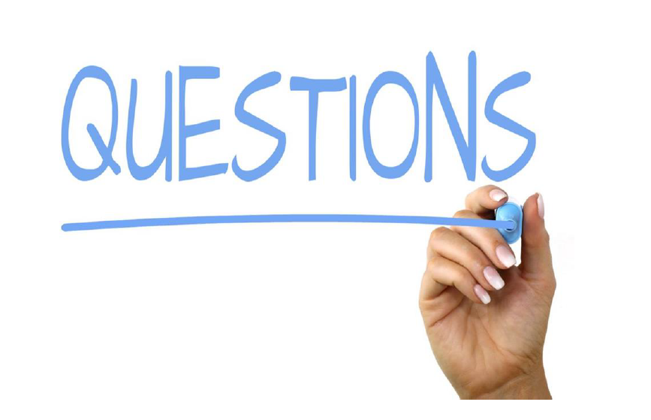

Slide 36
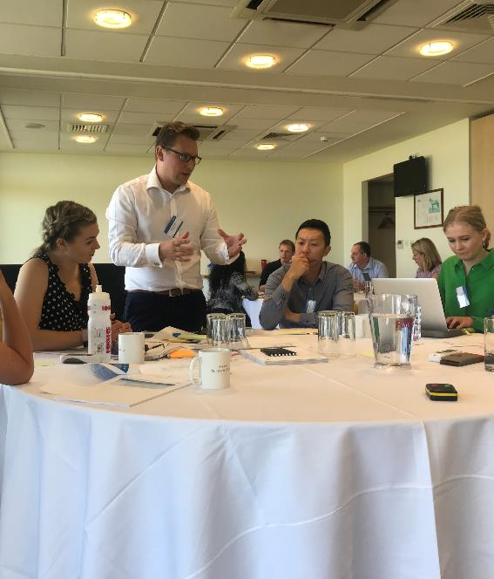
Upcoming Webinars
Network capability baseline capacity review
14th October
Understanding the capability of the network in an uncertain world
16th October
To register, please contact Jennifer.Pemberton@nationalgrid.com

Slide 37

Thank You

