Slide 1

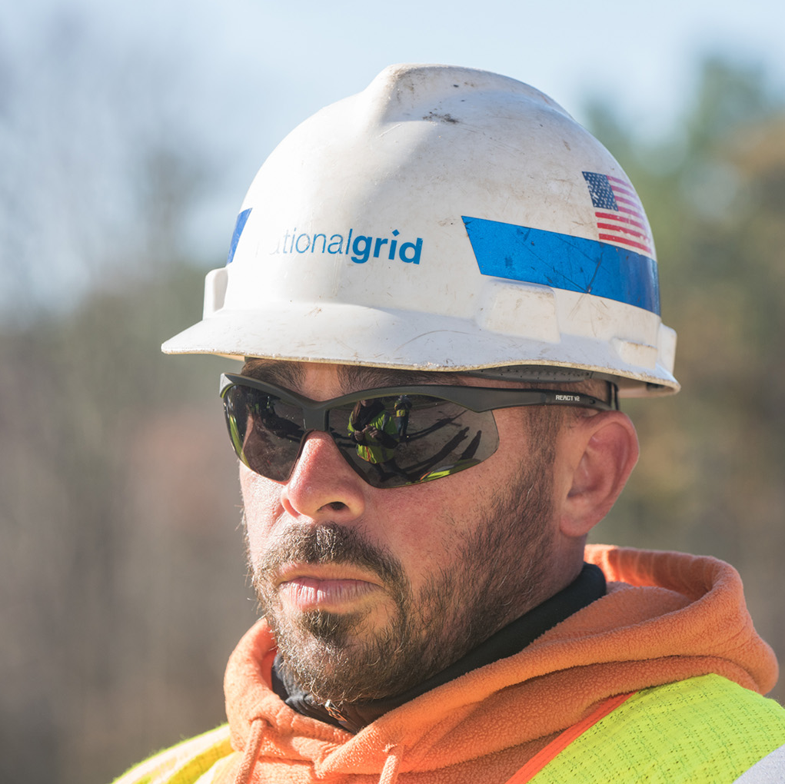
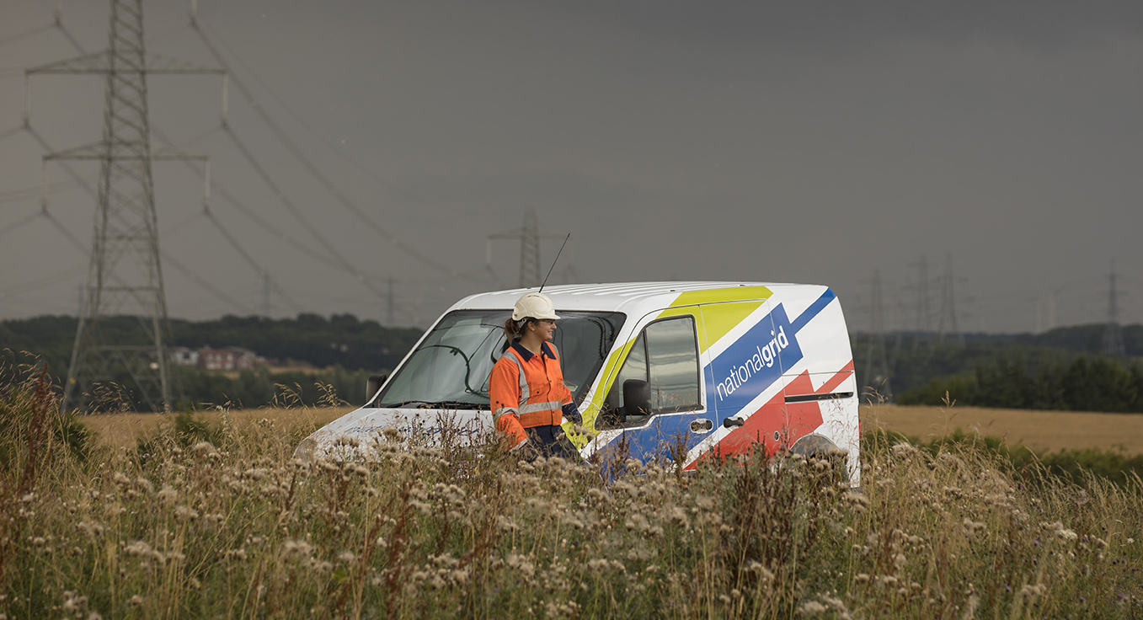
National Grid Gas Transmission draft RIIO2 business plan
  16 July 2019

Slide 2
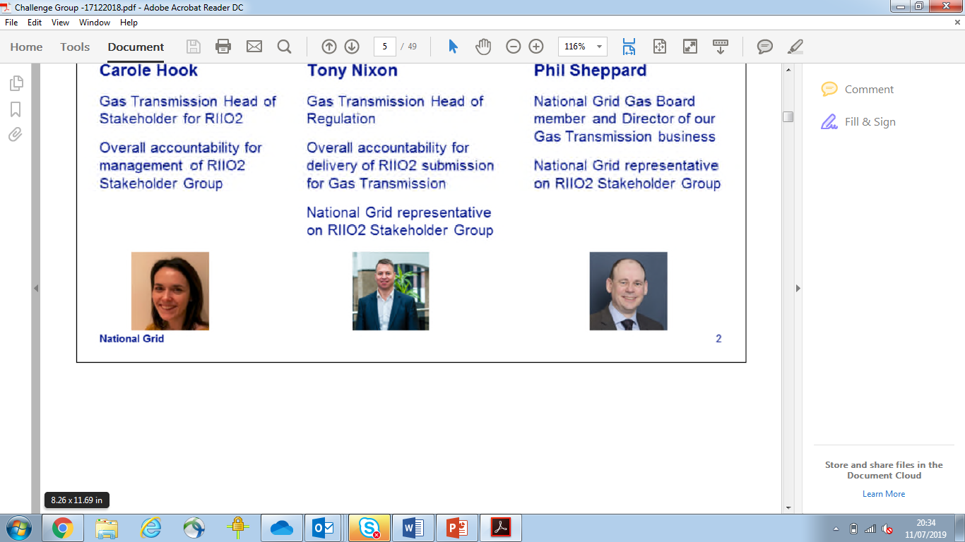
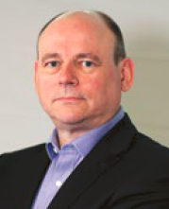
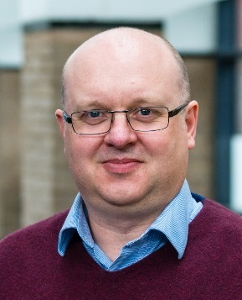
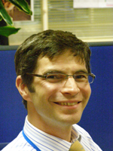

Welcome
Phil Sheppard
Carole Hook
John Perkins
Jonny Hosford
John Brookes
Logistics:
Should last for approximately one hour
We welcome your questions throughout via the chat function
We will have a Q&A session at the end
Notes:
Thank you for joining us today. I am Phil Sheppard, Director of Gas Transmission for NGG. We will spend the next hour talking through and answering any questions you might have on our draft RIIO2 business plan
We’ve done our biggest ever listening exercise and are pleased to be able to share the result of that with you today in the form of our draft business plan
I want to start by saying thanks so much for working with us to build this plan. It’s so important it meets your needs and its only through your engagement with us that we can be confident of this
We are still listening. I will tell you more at the end of how you can continue to get involved over the coming weeks, but the first step is joining us today
A few of the team are going to join me today in presenting to you the content of our draft business plan, but I’ve got the whole team with me to answer any questions you might have. So please as we go along send anything that comes to mind through and we will endeavour to respond them during our Q&A session at the end.
I will now handover to Carole who is going to start by talking you through how we have built our plan and the key things contained within it.

Slide 3
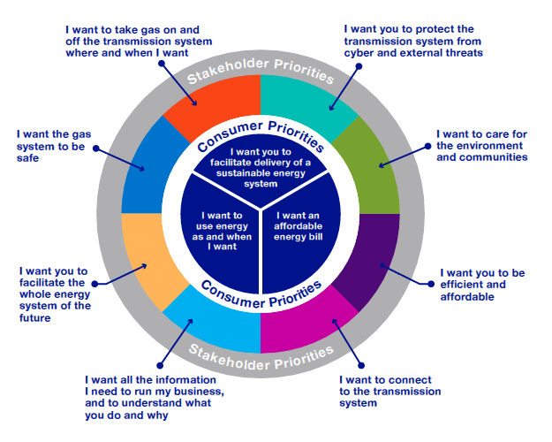
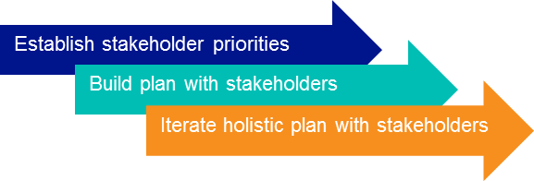
We have used our largest-ever engagement exercise to create a stakeholder-led draft business plan
Over 500 stakeholders
Over 3000 domestic consumers
Over 1000 major energy users
We have also received robust challenge from our independent stakeholder user group
Notes:
Thanks Phil.
We wanted to start the overview of our business plan today by covering the key components used to build our plan that give us confidence it is built on solid foundations.
We know you, our customers, stakeholders and consumers, have high expectations of us, and have listened to you in detail to understand and build a plan then delivers what is important to you. In a time of significant uncertainty over the future energy landscape it is vital that we work together to make sure our business plan meets your needs today and into the future.
We have carried out our most extensive engagement exercise ever. We have engaged with more than 500 individuals, more than 3000 domestic consumers and more than 1000 major energy users.
We began by establishing what are the priorities for both consumers and stakeholders, in order to use these as the foundation for building our plan. Through this we have identified 8 stakeholder priorities on which our plan is built – and these 8 priorities form the structure of our business plan itself. We worked with you to develop options and identify preferred solutions across key topics. Then in February this year we launched our holistic playback consultation, in order to bring together our emerging plan for each priority into one place and give you the opportunity to comment on how we have reflected your input to date. Finally we have now published our first draft plan, to allow you to continue to work with us to shape the final iteration we will submit to Ofgem in December.
In addition to our direct engagement, we have embraced the opportunity to improve our business plan through the new enhanced engagement arrangements. In the 12 months since our independent Stakeholder User Group was established to challenge our RIIO2 plan we have received extensive challenge to our activities and our proposals. We have also have maximised the opportunities for dialogue with the Ofgem independently chaired RIIO2 Challenge Group.
We believe this has brought many of the improvements to the business plan we present to you today. From how we frame our asset health strategy; to how we articulate our RIIO1 performance and apply this to our RIIO2 proposals, through our innovation proposals. And finally how we have undertaken our programme of direct engagement with you our stakeholders; and our step change in our ambition for our direct end consumer engagement.
Through our work we have built confidence in the robustness of our proposals. Using techniques such as external benchmarking, justification reports and Cost benefit analysis. We have built in efficiencies and benefits from innovation realised in RIIO1. We have modelled key financial assumptions. We have developed a 10 year plan to test the deliverability of our plan across RIIO2 and RIIO3, and have aligned the plan with business strategies and internal policies.
We’ve used our existing processes to come up with a business plan that meets the needs of our stakeholders now & puts us on the right footing for RIIO3 and beyond. We are mindful that we must get the right balance between network reliability and the cost to consumers today and into the future. The decisions we make today have lasting impact on cost, risk and the level of network capability we offer to stakeholders. We have linked our plan to the network capability our stakeholders need and will continue to work with you to ensure the trade-offs are understood.

Slide 4
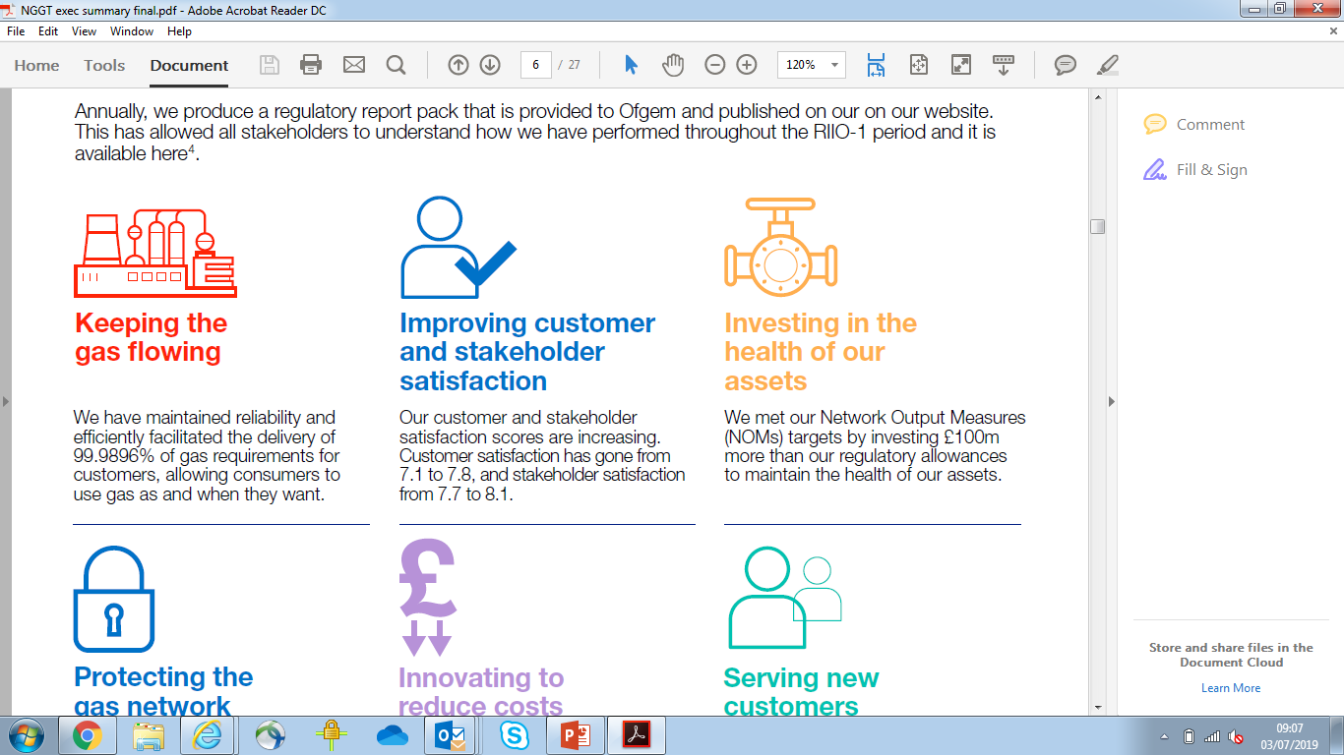
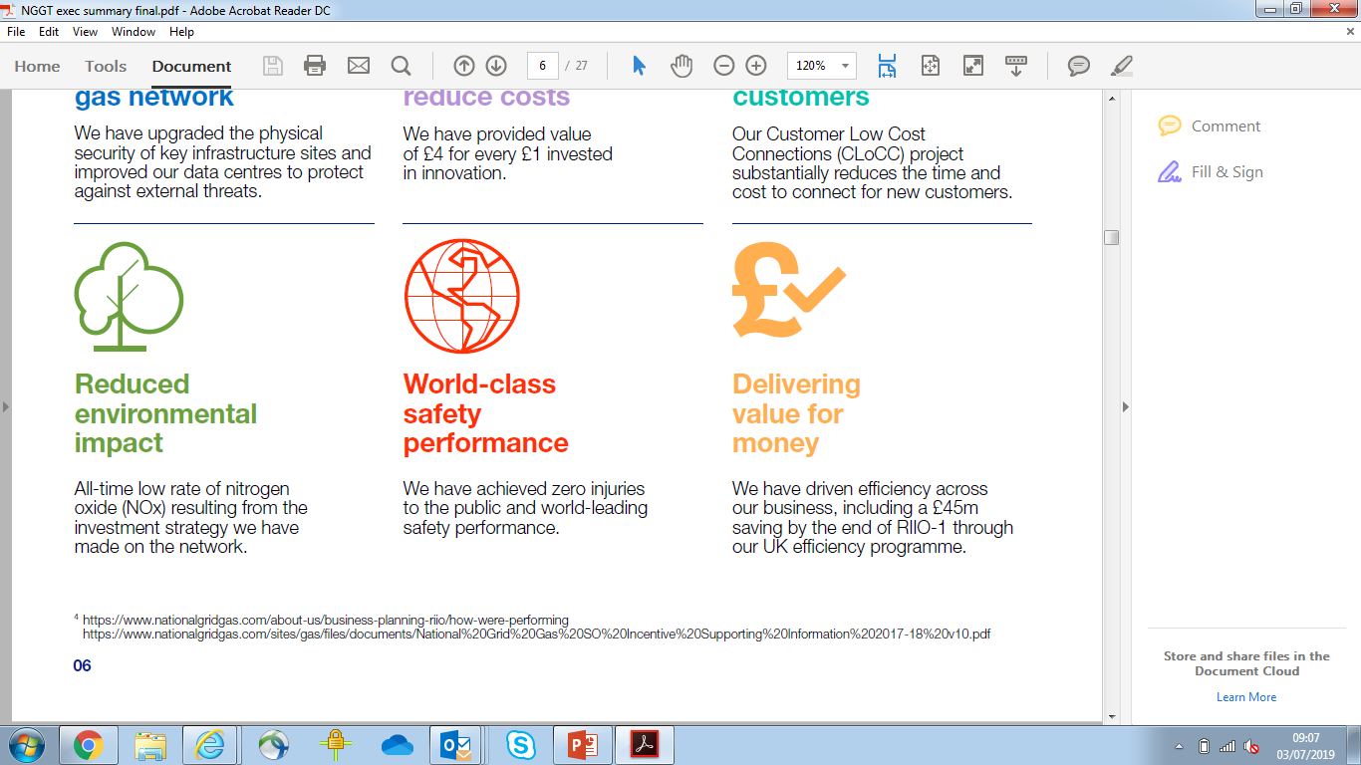

Our plan will continue to provide safe, reliable, resilient and affordable energy for current and future consumers
Maintain a safe and resilient network
Deliver the network capability our stakeholders need now and into the future, keeping options open to move to Net Zero carbon by 2050
Invest in our ageing infrastructure to maintain our current level of reliability and availability
Maintain our world class level of safety, pursuing our zero harm goal
Deliver the cyber resilience and physical security hardening mandated by Government
Deliver an environmentally sustainable network
Deliver the most efficient solution to ensure our compressor fleet complies with emissions legislation – limiting new compressor installations to 2 in RIIO2 and 5 in RIIO3, exploring decommissioning or derogation for the remaining 21
Play a leading role in the whole energy and decarbonisation debate
Make clear our climate change commitments, including activities to reduce emissions from other assets and activities
Meet the needs of consumers and network users
Be more responsive to the needs of connection customers
Drive efficiencies across our activities
Enable competition and foster innovation by sharing our data openly
Drive affordability by facilitating the effective functioning of the gas market
Notes:
The plan we present to you today is necessary, ambitious and innovative, shaped by what is important to our stakeholders
This draft plan covers a period of significant uncertainty. The gas supply and demand landscape in RIIO2 and beyond is uncertain. It will be impacted by key policy decisions on the future of heat as well as broader decarbonisation. Against this backdrop our plan will continue to deliver the safety, reliability and resilience needed by current and future consumers. It will keep options open for the pathway to move to net zero by 2050.
Within the changing energy landscape we are managing an ageing network with many assets at the end of their design life, resulting in more condition related issues. Our draft plan will deliver the network capability our stakeholders need. We will make important decisions on replacing, maintaining or decommissioning our assets, whilst recognising where we need to defer decisions on account of the uncertainty.
We will pursue our zero harm goal by maintaining our world class safety performance, as well as increasing our resilience to a range of external threats to cyber and physical security.
We will reduce our impact on the environment. Focusing on delivering a programme to reduce the emissions from our compressor fleet, as well as emissions from our other assets and activities and making clear sustainability commitments. We will enable the decarbonisation of the whole energy system by playing a leading role in the whole energy and decarbonisation debate. And we will lead innovation to drive the solutions for decarbonisation for the industry.
And we will strive to meet the needs of consumers and network users by being more responsive to the needs of connection customers, improving the overall satisfaction of our customers. Underpinning all our activities is a strong focus on efficiency, striving to keep the impact on consumer bills low and working with our customers to keep energy affordable.

Slide 5
A summary of our spend to meet our stakeholder requirements
£0.3bn
£72m
Key cost drivers
Managing an ageing network with many assets at the end of their design life, informed by new NARMs methodology agreed with Ofgem
Protecting the transmission system from cyber security threats in line with new legislation
Timely delivery of emissions legislation compliance
We have challenged ourselves to drive efficiencies across our activities
£64m
£12m
£0.1bn
£0.4bn
£1.4bn
£0.6bn
Safety
Whole Energy System
Gas on and off the NTS
Information Provision
Cyber and External Threats
Connections
Environment
Business support costs
Notes:
So what does our plan look like in numbers?
You see here our RIIO2 expenditure broken down by our 8 stakeholder priorities. Through the remainder of this webinar we will cover each of the individual stakeholder priorities presented here – what we commit to deliver in them, the value this brings and the associated cost. Our overall totex for RIIO2 is approximately £3b.
The key drivers of change from the RIIO1 to RIOI2 period are:
That we are managing an ageing network with many assets at the end of their design life, resulting in us observing more condition related issues. For RIIO2 this means an increase in expenditure to maintain the health of our assets, to deliver the same level of reliability alongside more fundamental interventions
An increase in expenditure to deliver emissions legislation compliance from our compressor fleet, both within RIIO2 and to maintain the trajectory into RIIO3
And an increase in expenditure to protecting the transmission system from cyber security threats in line with new legislation
We will cover more of this as we continue with our walkthrough.
Across our activities we have challenged ourselves to maximise our efficiency. We have built in future benefits from our stretching UK efficiency programme, saving £150m over the full RIIO2 period; we have made an ambitious commitment to further reduce our operating costs by £22m. We have committed to a 4% efficiency on our total capex in RIIO2, saving £80m. And we will continue to benchmark, market test and use native competition throughout RIIO2.
The impact of our plan on the domestic end consumer bill will remain at or below £10 per year, before inflation. We achieve this through embedding the efficiencies I have just mentioned, as well as accepting a lower rate of return from day 1 of the next price control period. We will be undertaking a programme of acceptability testing directly with domestic consumers based on this first draft iteration of our plan to test if our proposals hit the mark, and we will work with our customers and major consumers so they can understand the potential implications of the plan on them. In addition we will be consulting further to understand how we manage the risk to future consumers, considering the life over which assets should be depreciated.
I am now going to handover to John Perkins who will start by explaining how our draft plan is built around understanding the network capability you need.

Slide 6
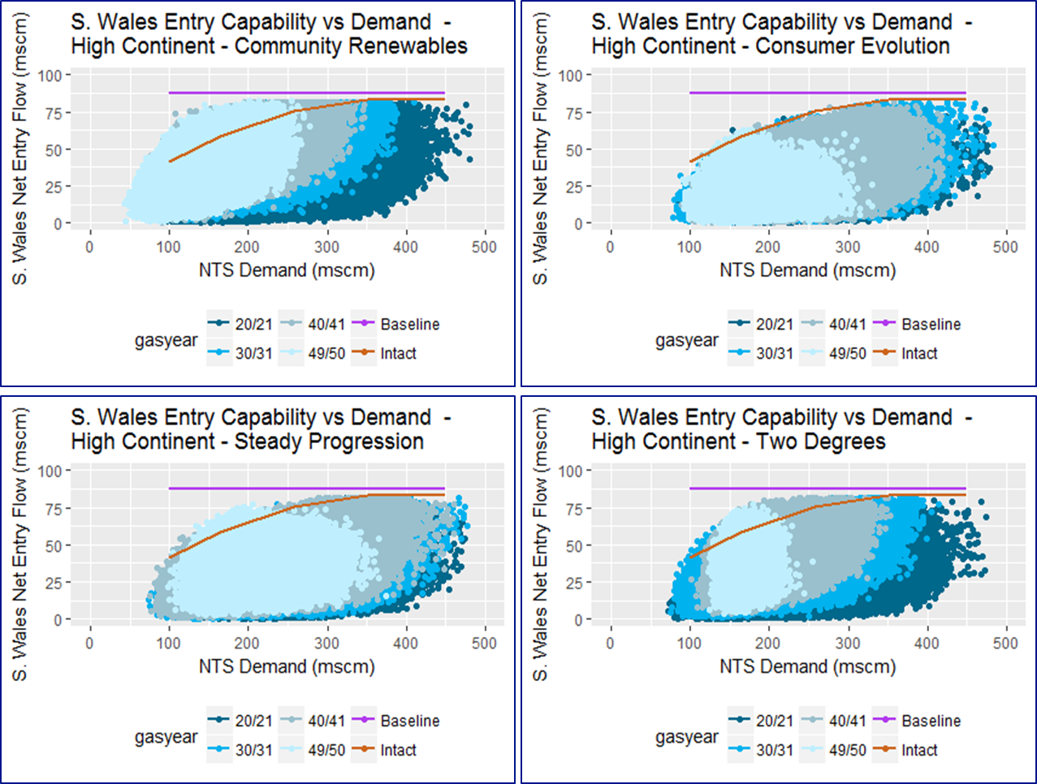
Understanding the capability of the network
The capability of the network can be measured by its ability to accommodate levels of gas flows onto and off the network. The capability at any entry or exit point that can be delivered in any day will differ depending on the specific situation on the day.
The July draft business plan is informed by:
  Stakeholder engagement
  Network analysis tools – used in RIIO-1
Visual metrics compare physical capability with stakeholder needs now and into the future
Ongoing engagement will inform our
October draft business plan
Notes:
A foundational element to our draft business plan has been an assessment of the capability of the network, how that compares with stakeholder needs and how our business plan will continue to meet those needs now and into the future.
It’s important to recognise that the capability of the network changes with different combinations of supply, demand and asset availability. Our existing processes and tools take these combinations into account.
For our RIIO-2 business plan, we’re bringing these tools together in a new way to prompt conversations with our stakeholders about what the capability of the network should be during RIIO-2 and beyond. We’ve created a new visualisation to help us explain this clearly.
The new metrics allow us to compare the capability of the intact network with the range of supply and demand combination in each of the four Future Energy Scenarios. It provides a framework by which we can see where future changes to stakeholder needs could lead to changes in the level of capability required, and therefore we can show how decisions we’re proposing to make in the July business plan will meet these potential future needs.
This capability assessment has, and will continue to inform all areas of our business plan.
The assets required to deliver customer capability needs drive our overall asset health, cyber and environmental proposals. The risks that we manage with this network, and the investment decisions needed for the future will inform our constraint management incentives proposals.

Slide 7
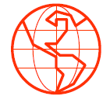
I want the gas system to be safe
We will pursue our goal of zero harm
Maintain a safe and resilient network
Our draft proposals
We will maintain our world class level of safety to protect the public, our assets and people
We will comply with legislation through routine and preventive safety activities including protection from accidental threats
We will ensure we have 24/7 emergency response processes and training in place to respond to incidents
We will carry out our Network Emergency Coordinator responsibilities
RIIO-2 total
£70m
Per annum
£14m
Consumer benefits
Our focus on zero harm protects society from potential major disruption and damage to public health, business, transport and the natural environment
Our commitment to safety-related inspections, maintenance and asset replacement avoids unplanned downtime of the network, which could disrupt continuity of gas supply
Notes:
The first priority we want to talk to you about today is “I want the gas system to be safe”. At National Grid, safety is paramount. We continue to pursue our goal of zero harm to the public, our employees, and other people who work on or around our assets from the safety risks associated with our activities. Stakeholders have consistently said safety is a top priority and that they appreciate the crucial role of the gas transmission system and the safety risks associated with our operational activities and assets.
We have obligations to comply with relevant health and safety legislation and we are also committed to drive efficiencies in the activities we undertake and also seek innovative ways to continually improve our safety performance. We will invest to protect against accidental threats to our assets for example through regular visual checks of our pipelines through helicopter patrols.
We will ensure we have 24/7 emergency response processes and training in place to respond to incidents and will carry out our Network Emergency Coordinator responsibilities.
We will invest in our people, developing the skills and behaviours required to support and improve safety in everything we do. We also recognise that effectively managing for health and safety is not just about having a safety management system. The success of this system still hinges on the attitudes and behaviours of people in the organisation (the ‘safety culture’). To further improve our safety performance, we are aiming for a ‘pro-active’ safety culture.
The costs associated with these activities are £70m for the RIIO-2 5 year period which is a similar level to RIIO-1. Our focus on safety cuts across all of our activities and as such there are activities which result in safety benefits in other priorities for example asset health and cyber resilience. These costs are not reflected in this priority.
These proposals provide critical consumer value by protecting consumers from the potential cost, damage and disruption associated with the interruption of gas supply.
I will hand back to John Perkins now to cover the next priority.

Slide 8
I want to take gas on and off the transmission system where and when I want
We will ensure we have the right gas transmission system, maintained to the right level alongside a complimentary commercial framework to meet stakeholder and consumer needs
Maintain a safe and resilient network
Our draft proposals
Invest £888m in our asset health programme to maintain the current level of reliability and availability
Maintain efficient system operation and asset management activities
RIIO-2 total
£1440m
Consumer benefits
It is in consumers’ interests to keep future options open which we will deliver by determining the network capability our stakeholders need today and into the future
We enable access to a wide range of gas supplies ensuring lowest cost gas is readily available.
Per annum
£288m
Notes:
Intro
Reliable supplies are essential for domestic users, power generation and for continued operation of industrial processes
We know customers want to be able to alter their mind over location, volume and profile of flows at short notice in response to the energy markets. And they need a network that can facilitate this
Which topics make up this chapter?
£888 of Asset health investment to maintain the network, this includes specific projects at Bacton and Kings Lynn
Efficient System Operation and Asset Management – which includes the costs of people, IT systems, tools, equipment, vehicles, the control room.
Small investments to increase resilience of the network and to allow maintenance to be carried out without disrupting flows
A risk based approach to environmental risks
How we have engaged stakeholders?
Comprehensive engagement, from October 17 (and ongoing). Includes geographical workshops surveys, webinars, bilaterals, consumer listening and to allow maintenance to be carried out without disrupting flows
A risk based approach to environmental risks
What have stakeholders told us?
Reliability and flexibility are important
Some parties can’t tolerate any disruption to taking gas off the network
What are we proposing?
Asset Health – against a background of increased defects, maintain risk levels as per RIIO-1
Specific asset health projects at Bacton and Kings Lynn
Network Resilience – small investments to increase resilience/facilitate access
Environmental Resilience – risk based approach
CONSUMER VALUE

Slide 9
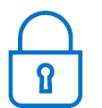
I want you to protect the transmission system from cyber and external threats
We will deliver the security hardening required by Government to protect the transmission system from external threats
Maintain a safe and resilient network
Our draft proposals
Deliver new, and maintain and replace existing, enhanced physical security measures at designated sites
Deliver a strategic programme of enhanced cyber resilience for our information technology and operational technology assets in keeping with new Network and Information Systems (NIS) Regulations
Draft plan is under discussion with NIS Competent Authority. Expect their feedback and guidance to result in updated scope and costs for inclusion in our final RIIO-2 business plan
RIIO-2 total
£617m
Per annum
£123m
Consumer benefits
Improving the resilience of our network to ride through and recover from malicious events will support maintaining the continuity of GB energy supplies
Notes:
Good morning, it is Jonny Hosford speaking. And now we turn to the stakeholder priority about protecting the transmission system from cyber and external threats.
The Gas National Transmission System is part of Great Britain’s Critical National Infrastructure providing an essential service for society. Government sets the requirements for the appropriate levels of protection to be achieved in the national interest. [We work with the department for Business Energy and Industrial Strategy and its security agencies CPNI (the Centre for Protection of National Infrastructure) and the NCSC (National Cyber Security Centre) to understand the threats and the appropriate response.]
The scope of activities and costs in this part of out plan covers both physical security and cyber resilience. I will talk about these in turn:
For Physical Security
A rolling Physical Security Upgrade Programme has been underway since 2008 to enhance security at certain sites across the industry identified by BEIS. Our plan includes capital expenditure to complete the relevant upgrade work at all our relevant sites during the RIIO-2 period. In addition we will commence a co-ordinated programme of replacement of our oldest enhanced security assets (eg. CCTV, lighting, IT hardware etc). These assets have lives of 7 or 15 years and at our oldest installations that replacement is now due because of age and obsolescence. [This will enable us to continue to comply with the high level security principles laid down by CPNI]
For Cyber Resilience
Like other operators of essential services we are subject to new regulations in the form of the Network and Information Systems Regulations (NIS). The aim of these is to co-ordinate and raise the level of cyber resilience across the sector.
Our proposed scope includes investment in our industrial control and safety systems used at compressor stations and terminals. We will replace or upgrade these assets as part of a strategic programme that will run through RIIO-2 and RIIO-3. These assets need replaced on grounds of age and obsolescence as well as because of enhanced cyber resilience. We have consciously included all the relevant costs (replacement + cyber resilience) in this part of our plan to aid transparency and because we expect specific RIIO-2 outputs to be attached to delivery (ie separate outputs to the general asset health metrics).
The NIS Regulations are quite new, Our cyber resilience proposals are under ongoing discussion with the NIS Competent Authority (a joint role between Ofgem and BEIS). We expect to receive further guidance from them this summer and we expect this will result in refinements to our scope and costs for inclusion in our final RIIO-2 business plan later this year
[Uncertainty
This is an area where our plan may need to flex to accommodate changes in government requirements eg changes in the level of threat or the required response. Uncertainty mechanisms are proposed to cope with such changes. Our view is that, in relation to the above work, to the extent that the scope is known and defined ahead of RIIO-2 with agreed outputs then base revenue funding should be provided with a strong performance incentive.]
In summary these investments benefit consumers because they improve the safety and resilience of the system to ride through and recover from malicious events which otherwise threaten to disrupt continuity of GB energy supply.
I will now hand back to John

Slide 10
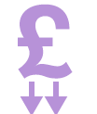
I want you to facilitate the whole energy system of the future – innovating to meet the challenges ahead
We will lead the gas industry through the energy transition in a way that delivers benefits to consumers
Deliver an environmentally sustainable network
Our draft proposals
Play a key role in facilitating the whole energy and decarbonisation debate
Invest in capabilities and systems to understand the most efficient options for whole energy system
Lead innovation across the industry, working with other networks and industry partners to explore solutions in whole energy assets and markets.
RIIO-2 total
£105m
Consumer benefits
Defining options for decarbonising heat, and providing the costs and implications, will support a pathway that minimises disruption to consumers
Whole energy system collaboration offers networks the potential to respond to changing needs and reduce consumer costs holistically
Focusing on delivering and embedding innovation to deliver the energy transition ensures the most effective long-term solutions are taken forward
Per annum
£21m
Notes:
Intro:
We know the energy system is changing and that we will need to adapt to deliver what consumers want.
We are uniquely placed to lead the gas industry through this energy transition.
From our engagement with stakeholders, they have said we should take a leading role in driving and enabling the energy transition. However we feel there are only certain aspects where we are best placed to do this. With other aspects, we feel we have a more facilitative and collaborative role. This is reflected within our proposals for RIIO-2.
Proposals:
We do not have all the solutions for the future, however during RIIO-2 we will play our part in facilitating the whole energy system and decarbonization debate. We will also lead on determining what the options are for Gas Transmission. We will lead innovation across the industry, investing more in BAU innovation. We need to continue to invest in our capability and systems to ensure we can respond effectively to regulatory change, and ensure are systems are fit for purpose.
Spend associated with this stakeholder priority is £105m(excluding Innovation incentive allowance) for the 5 year period. Of this ~£60m is related to replacing our current balancing and capacity system ‘Gemini'. The remaining amount is associated with ensuring we have the teams and capability to deliver on our proposals.
Our proposals will ensure that options are kept open to enable the most effective pathway to achieving net zero carbon. Through defining the options, including the cost implications, for gas transmission we will be able to support a pathway that minimises disruption to consumers. Focusing on delivering and embedding innovation to deliver the energy transition ensures the most effective long-term solutions are taken forward.
…...........................................................................................................................................................................................
Additional Notes: On key challenge has been are we leading or facilitating etc. Below is a list of ambition where we will lead on some, facilitate and collaborate on others;
lead on determining what the options are for Gas Transmission for the future decarbonisation pathways.
lead the development of the Gas Markets Plan the development of changes to market codes and frameworks, enabling new fuels and participants to operate and enabling the decarbonisation of heat.
lead innovation across the industry, working with other networks and industry partners to explore solutions in whole energy assets and markets to deliver consumer benefits.
facilitate industry conversations to understand the most efficient options for the future whole gas system networks, market and frameworks.
collaborate with the gas distribution networks on the options regarding the transportation of Hydrogen.
invest in skilled people so we can respond effectively to lead regulatory change and also anticipate future regulatory developments and how these might affect you and our network
continue to invest in our IT systems, making sure they are fit for the future and enabling you and gas consumers to benefit from digitisation
replace our current balancing and capacity system ‘Gemini’, making sure it is adaptable for change
It would be worth if asked we are investing 0.75% revenue in BAU innovation(~£6m per year) and would also expect an equivalent amount through innovation allowance incentive.

Slide 11
I want you to care for the environment and communities
Reduce our impact on the environment and keep options open to move to Net Zero carbon by 2050 with the lowest societal impact
Deliver an environmentally sustainable network
Our draft proposals
Deliver 2 new compressors in RIIO-2 and complete 5 more by 2030 to improve air quality and reduce NOx emissions
Reduce the carbon footprint of our business
Take action at 77 redundant sites and assets, seeking to enhance the natural environment where possible
Continue to support the communities we work in, committing 0.3% of what we spend on major projects to supporting community initiatives
RIIO-2 total
£360m
Consumer benefits
Cutting emissions reduces our impact on climate change, with clear benefits for society including improved air quality.
Responsible demolition protects future consumers from the costs of disposing assets whilst promoting environmental net gain activities
Consumers and broader society will benefit from our contribution and support to communities
Per annum
£72m
Notes:
Intro
We care about the environment and the communities we serve.
We have an important role to play in delivering decarbonisation, and helping the UK achieve the 2050 net zero target.
In terms of this chapter we address on reducing emissions and our impact on air quality, helping tackle climate change, caring for the natural environment and supporting the communities in which we work.
Our proposals
Compressors
Deliver 2 new compressors in RIIO-2 and complete 5 more by 2030 to improve air quality and reduce NOx emissions
Programme delivers across T2 and T3 to meet the compliance date. This is a combination of 500 hour derogations (from 2030), decommissioning and new build (where justified to meet customer need, note link to network capability work)
Our climate commitment
Reduce the carbon footprint of our business
Innovations around leak detection and reduction in methane emissions, installation of renewable technology for own use on operational sites
Responsible asset use/caring for the natural environment
Take action at 77 redundant sites and assets, seeking to enhance the natural environment where possible
Supporting the communities we work in
Continue to support the communities we work in, committing 0.3% of what we spend on major projects to supporting community initiatives
Commit to supporting the living wage not just in our direct organisation but in the supply chain. Offering STEM educational support to every school along construction routes
Aim to employ 15% from local community on major projects
Consumer Value

Slide 12
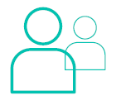
I want to connect to the transmission system
We will support the liquidity of the energy market by providing an efficient process for connection to our network, and be more responsive to the needs of our customers
Meet the needs of consumers and network users
Our draft proposals
Embed the improvements resulting from our Customer Low Cost Connections project, enabling standard connections for less than £1m in under 12 months
Deliver information systems and people capability for an improved end-to-end customer experience
Make best use of the existing network and simplify the regulatory process for substitution of unused capacity
Deliver more capacity where necessary, informed by robust options analysis
RIIO-2 total
£12m
Per annum
£2.4m
Consumer benefits
Making it easier for new sources of gas to connect supports liquidity of the energy market, keeping costs low for consumers
Making it easier for lower carbon biogas and gas-powered vehicle refuelling stations to connect, assisting decarbonising the whole energy system with minimal disruption to consumers
Notes:
Our role in connecting / disconnecting different sources of gas supply and demand is fundamental to the level playing field of the competitive wholesale energy markets. It is also important for decarbonization, for example because of the role gas plays as a fuel for flexible electricity generation compensating for the intermittency of renewables.
We have detailed processes that we follow that have been agreed with customers and incorporated in the Uniform Network Code & we report our performance formally to Ofgem and on our website – so the rules we follow are well prescribed. It follows that the underlying role and core costs of running the connection and capacity teams (£2.4m per year) is little changed between RIIO1 and RIIO2
So what are we proposing?
Well, the feedback we have had from customers and new potential connectees such as developers of smaller green gas projects is that it our traditional connection processes geared around large users can be difficult to follow, cost too much and take too long. So our focus for RIIO-2 is about being more responsive to customer needs and making it easier for new types of projects to connect to our system.
We have undertaken a flagship innovation project known as CLOCC which stands for customer low cost connections and we intend to embed a suite of changes from this into business as usual for RIIO-2. for example off-the-shelf standardized designs for simple connections and reduced upfront connection fees, and acceptance of different specification gas
In tandem with this we will continue to invest in improved digital tools such as an online portal that enables customers (of all types both large and small) to self-serve and track the progress of connection applications and offers using 24/7 self service functionality. This is intended to cut down paperwork, reduce administration and save time
We also deal with applications for capacity on the network which could lead to physical reinforcement of the network to provide new incremental capacity. Where possible we will seek to accommodate capacity requests by substitution of unused capacity from one part of the network to another. It is inherently uncertain what future customer requirements may emerge so this area is covered by an uncertainty mechanism: we will only incur such costs dependent upon customer commitments – we’ve not built any anticipatory element of spend into our base RIIO-2 plan.
So in summary our plan ensures we continue to provide the facilitation role for the industry that enables diverse sources of domestic and international gas to access the GB gas market – which in turn underpins competitive gas prices for GB consumers.

Slide 13
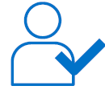
I want all the information I need to run my business, and to understand what you do and why
We will provide data and insight to the industry allowing stakeholders to operate their businesses efficiently and effectively
Meet the needs of consumers and network users
Our draft proposals
Enable competition and foster innovation by sharing our data openly wherever possible
Collaborate and share data with network companies to build a whole system view
Invest in our people and capabilities allowing us to support more information sharing
Provide more transparency around our financial and operational performance
RIIO-2 total
£65m
Per annum
£13m
Consumer benefits
Our information and insights provide value for consumers by ensuring that the wholesale market runs smoothly and promoting competition

Slide 14

I want you to be efficient and affordable
We strive to keep our impact on consumers bills low and we work with our customers to keep energy affordable
Meet the needs of consumers and network users
Our draft proposals
Commit to 4% efficiency on our total capex in RIIO-2
Build 7.4% operational cost efficiency from our RIIO-1 UK efficiency programme
Commit a further 5.6% operational cost efficiency across RIIO-2
Continue to benchmark, market test and use native competition throughout RIIO-2
Business support costs to deliver across our business plan
RIIO-2 total
£325m
Consumer benefits
By embedding efficiencies, focusing on the most efficient and effective solutions we will keep our costs low for consumers
We are balancing costs between current and future consumers to ensure fairness
Facilitation of the wholesale market has a positive impact on the whole energy cost for consumers.
Per annum
£65m

Slide 15
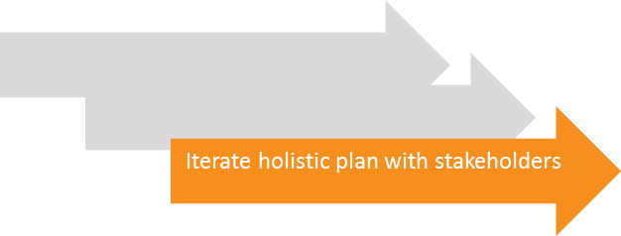
We will continue the dialogue with our stakeholders as we build the next iteration of our plan
Next iteration plan to RIIO2 Challenge Group and Stakeholder User Group – 1 Oct
Final plan to RIIO-2 Challenge Group and Stakeholder User Group – 9 Dec
Engage closely on our network capability framework to ensure our plan delivers the network capability needed now and into the future
Explore the potential implications of the government’s commitment to Net Zero by 2050
Carry out nationally representative quantitative domestic consumer research to test acceptability of our proposals
Reflect feedback from our independent stakeholder user group and the RIIO2 Challenge Group
Discuss with Ofgem projects that may meet the criteria for competition
Reflect further on Ofgem’s RIIO2 decision document
Notes:
Thank you John. So that concludes our rather rapid overview of our draft RIIO2 business plan.
We are confident our draft plan is underpinned by solid foundations and thank you again for all your input to getting us to this positive place. We want to continue the dialogue with you as we continue to iterate our plan towards the final version we submit to Ofgem in December this year.
During the summer we want to talk to you to make sure the plan delivers the network capability you need now and into the future. We also want to explore further our role in meeting the government’s commitment to net zero – the potential role and activities we should be undertaking to keep options open for the future pathway. We will carry out engagement with consumers, to see if our proposals hit the mark and provide more information to a range of customers and consumers so they can understand the potential implication of the plan on them. And we will continue to embrace the enhanced engagement process, acting on challenges from our independent SUG and the RIIO2 challenge group to drive improvements in our final plan.
We anticipate these things may impact on the plan content, including consumer and customer bills. We will keep you informed of our progress and continue to welcome your input and feedback throughout the coming months to ensure our plan delivers for you now and into the future.
We would now like to take the time for you to ask any questions.

Slide 16
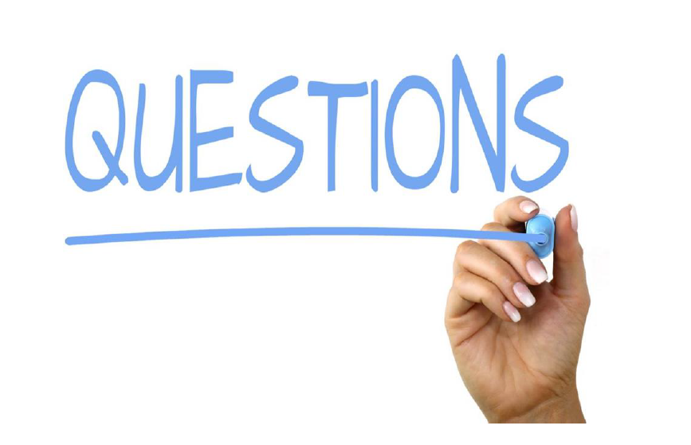
Get in touch with our Stakeholder Manager
Charon.Balrey@nationalgrid.com
Notes:
Phil
We would now like to take the time for you to ask any questions
Question to get started:
1. You talk about the recent Net Zero commitment, what do you see are you role in this and how does your plan reflect it?
Respondee – Adelle
2. How is your plan impacted by the new FES 19 which has just be published?
Repsondee - Alex
Phil CLOSE:
thank you for taking the time to join us today. Please do get in touch if you would like to discuss anything further with us or have any feedback you would like to make. We will be dropping round a short survey after today’s webinar, which we would be very grateful if you could complete to let us know what you think.

