Slide 1

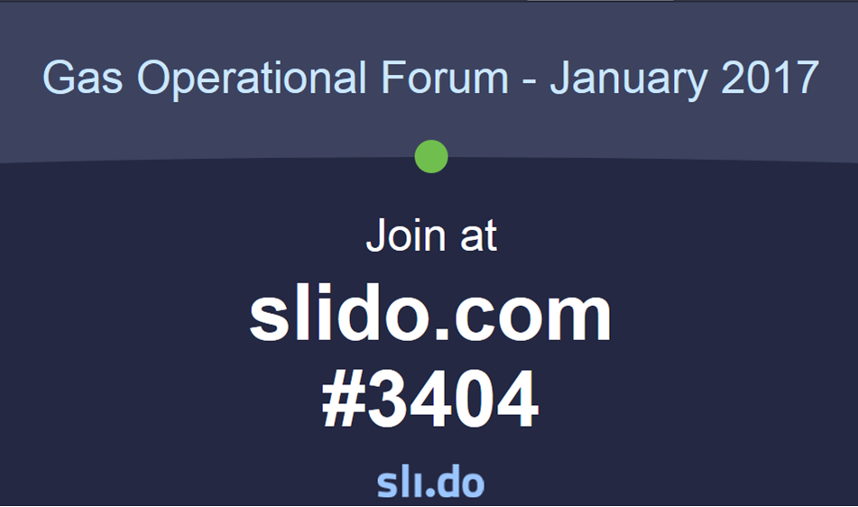
SLIDO – Interaction Tool
Gas Operational Forum – October 2017
Log on wifi Open Network:
RadissonBlu
Join at
Slido.com
#gasoct
Please ensure you register at the table at the back of the room
Please ensure you register at the table at the back of the room
Notes:
Also as per last month’s Operational Forum, we will continue to use the SLIDO application. So SLIDO is a fantastic and simple tool that you ‘the audience’ can use during the forum. It enables you to ask live questions during the presentation and provide feedback on your overall satisfaction of the forum & the content presented. Please follow these 3 easy steps on arrival:
Open your internet Browser via your mobile device (please note WIFI password will be provided)
Go to slido.com
On the homepage simply join the event using the code: #octgasforum

Slide 2
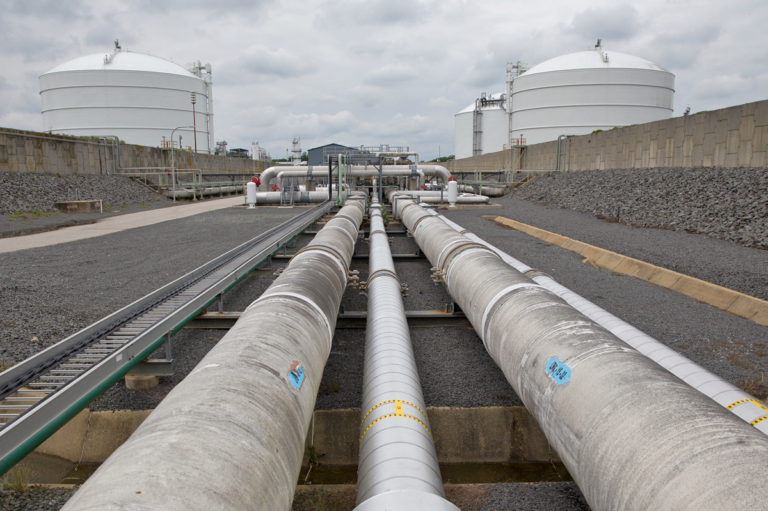


Gas Operational Forum
19th October 2017 09:30AM
Radisson Blu Hotel, 130 Tottenham Court Road, London

Slide 3

Health & Safety Brief
No fire alarm testing is planned for today.
In the case of an alarm, please follow the fire escape signs to the evacuation point.
At the rear of the hotel by Fitzroy Court

Slide 4
Agenda
09:30 - Previous Ops Forum Actions
09:35 - Operational Overview
  Supply Breakdown
  Demand Breakdown
09:45 – Winter Outlook Report
09:55 – Future Energy Scenario Framework
10:00 - UNC Modifications/Topics from Transmission Work Group
10:10 - Reviewing Communication Process
10:15 – Change Programme (GB REMIT, MIPI DR TEST, MIPI STATISTICS)
10:30 – Break
10:45 – Customer & Stakeholder Feedback
11:15 – AOB
11:30 - Close

Slide 5
Actions From Previous Forums
Discussion Topic | Action | Due Date
Gas Quality Consultation | NG to provide details of next Gas Quality Consultation and summarise covered content. | October Ops Forum
Operational Overview | Following discussion, it was agreed that NG would seek to re-categorise the storage figures as these are currently presented in a number of slides as one category (MRS & LRS combined). | October Ops Forum
Update on UIG | NG to explore recent re-nomination behaviour and update industry at a future Operational Forum. | October/November
Xoserve Service Desk | Following session NG has promised to collate all feedback provided during the session and update customers at next Operational Forum. | November Ops Forum

Slide 6
ACTION Update: Re-nominations
ACTION: NG to explore recent re-nomination behaviour and update industry
National Grid maintain an overview of shipper behaviour and take action when this leads to inefficiency in the market, actions range from formal letters to ad hoc phone calls.
Examples of recent behaviour monitoring undertaken:
Monitoring and contacting shipper’s at non-IP’s to challenge behaviour with regard to NIFR.
Ongoing discussions with DN’s regarding accuracy of NDMA forecast.
In light of concerns on re-nominations NG have reinstated the functionality for NIFR at Bacton IP’s and will continue to develop our monitoring of the wider nominations area; we welcome feedback regarding improvements you’d like to see.
A more detailed update will be provided at the January Ops Forum in line with feedback received.
Notes:
NIFR rule = shippers can not re-nominate down if their new nomination is less than what was deemed to flow by that point in the day as based on 1/24th of the original nomination

Slide 7





Operational Overview
Operational Forum – October 2017
Karen Thompson

Slide 8
Gas Supply Breakdown
1st August 2016 to 30th September 2017 vs Previous Year
Notes:
(Norweign and Uk CS are up, LNG down from last year (substancially down) MRS are used to make the difference of LNG)
LNG average flow 17.76mcm/d in the period Apr to 30th Sept 2017 compared to 29.04mcm/d in the same period last year; this relates to increased competition in the LNG market, and therefore a reduction in cargos seen to the UK which drove lower flows.
Easington Terminal has increased from an average flow of 34.30mcm/d in the period Apr to 31st Aug 2016 to an average flow of 41.55mcm in Apr to 31st Aug 2017. This increase has been due to an increase in Norwegian continental shelf flows via Langeled.

Slide 9
Gas Supply Breakdown
1st April 2017 to 30th September 2017 vs same period over the previous 6 years
UKCS
Norwegian
LNG
Interconnectors
Storage
Notes:
IUK in Export mode – further details shown on the demand slides.
Bacton Interconnector average Imports <1mcm/d in the period Apr to 30th Sept 2017 compared to 3.0mcm/d in the period Apr to 30th Sept 2017 . Minimal BBL imports were seen during the 2017 period.

Slide 10
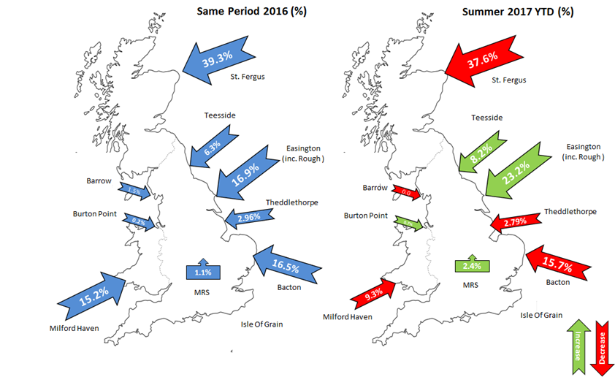
Gas Supply Map
1st April 2017 to 30th September 2017 vs Same Period Last Year
To be updated
Notes:
Barrow 0% during the period 1st April 2017 to 30th September 2017 is correct as no flows occurred. Barrow flows returned from 9th October 2017 to 10th October 2017 and has now again ceased flow to the NTS. There is a new REMIT Notification until 17th October 2017 which means that Barrow could flow between 0mcm to 2.5mcm during this period.

Slide 11



NTS Supply Summer (mcm): 1st April 2017 to 30th September 2017
Entry | Min | Max | Avg | Summer Actual Range Apr 2016 – Sep 2016 | Comments
 | 53.1 | 110.7 | 92.8 | 45- 107 | Easington Terminal has increased from an average flow of 31.26mcm/d in the period Apr to 30th Sept 2016 to an average flow of 42.60mcm in Apr to 30th Sept 2017. This increase has been due to an increase in Norwegian continental shelf flows via Langeled. LNG average flow 17.76mcm/d in the period Apr to 30th Sept 2017 compared to 29.04mcm/d in the same period last year; this relates to increased competition in the LNG market, and therefore a reduction in cargos seen to the UK which drove lower flows. Bacton Interconnector average Imports <1mcm/d in the period Apr to 30th Sept 2017 compared to 3.0mcm/d in the period Apr to 30th Sept 2017 . Minimal BBL imports were seen during the 2017 period. Barrow Terminal has been on outage since mid February.
 | 27.2 | 108.5 | 73.8 | 44 - 111
BBL | 0.0 | 2.5 | 0.1 | 0 - 23
IUK | 0.0 | 0.0 | 0.0 | 0 - 5
 | 5.0 | 43.7 | 17.7 | 5 - 62
 | 0.0 | 68.8 | 10.5 | 0 - 39
Entry | Min | Max | Avg
Actual Supply | 131.4 | 305.6 | 194.9
Actual Supply Exc. Storage | 130.6 | 240.7 | 184.5

Slide 12
Gas Demand Breakdown
1st August 2016 to 30th September 2017 vs Previous Year
Notes:
The sharp increase in the NDM Category mid Sept 2017 was associated with a period of colder weather.
Lower demand this year - Planned IUK outage scheduled between 14th and 28th June 2017. Power Demand down this year compared to last year due to more renewable generation capacity (Solar/Wind etc), and UK generation sources were generating electricity for transmission to France due to French Nuclear issues. This baseload demand not seen this year hence demand lower.
IUK Exports during the period April – 30th Sept 2017 are significantly larger than the same period last year (average 38mcm/d vs 28mcm/d). This we believe is due to Rough storage facility being unavailable meaning supply volumes have been diverted to IUK exports.
Storage Injection during the period April – Sept 2017 is lower than the same period last year this is due to the reduction in Rough injections.

Slide 13
Gas Demand Breakdown
1st April 2017 to 30th September 2017 vs same period over the previous 6 years
Notes:
= IUK Exports during the period April – 30th Sept 2017 are significantly larger than the same period last year (average 38.7mcm/d vs 28mcm/d). We believe this is due to Rough storage facility being unavailable meaning supply volumes have been diverted to IUK exports.

Slide 14
Gas Supply / Demand Interconnectors
1st September 2016 to 30th September 2017
Notes:
Moffat Export Flow increased due to the reduction in the Corrib Gas Field which had been associated with a Gas Incident; this ended on 10th October 2017 following which Moffat saw a reduction in exports.
IUK Export into October 2017 continued at low levels [~15mcm] until 11th October 2017 when a significant increase in export occurred [~30mcm].

Slide 15
Gas Consumption for Power Generation
1st September 2016 to 30th September 2017 vs Same Period Last Year
Notes:
- There has been more volatility in Powerstation demand during the period April – 30th Sept 2017 than the same period in 2016, resulting in a lower min and a higher max demand. We believe this is due to both the increase in renewable generation sources and reduction in coal generation sources meaning gas is the primary flexible generation source.

Slide 16
NTS Demand Summer (mcm): 1st April 2017 to 30th September 2017
Exit | Min | Max | Avg | Summer Outlook Range Apr 2017 – Sep 2017 | Summer Actual Range Apr 2016 – Sep 2016 | Comments
 | 49.1 | 171.6 | 79.8 | 32 – 140 (NDM) | 47- 183 | IUK Exports during the period April – 30th Sept 2017 are significantly larger than the same period last year (average 38.7mcm/d vs 28mcm/d). We believe this is due to Rough storage facility being unavailable meaning supply volumes have been diverted to IUK exports. There has been more volatility in Powerstation demand during the period April – 30th Sept 2017 than the same period in 2016, resulting in a lower min and a higher max demand. We believe this is due to both the increase in renewable generation sources and reduction in coal generation sources meaning gas is the primary flexible generation source.
Ireland | 2.9 | 19.4 | 8.4 | 7 - 9 | 2 - 16
 | 7.4 | 13.0 | 9.4 | 18 - 26 (DM + Ind) | 6- 15 (DM + Ind)
 | 17.8 | 75.6 | 48.4 | 8 - 81 | 24 - 72
 | 0.0 | 47.2 | 9.9 | 7 - 9 | 0 – 66
 | 0 | 59.3 | 38.7 | 0 - 46 | 0 – 56
Exit | Min | Max | Avg | 2017 Summer Outlook Range
Demand exc. IUK & SI | 91.9 | 262.1 | 146.0 | 76 - 241
SND exc. IUK & SI | 100.0 | 236.0 | 144.0
IUK

Slide 17
Storage Stocks: LRS
Position as at 30th September 2017
Notes:
Chart displays data by Gas Year (Oct – Sep)
Restrictions at Rough Storage site mean no injection has taken place since June 2016.

Slide 18
Storage Stocks: MRS
Position as at 30th September 2017
Notes:
Chart displays data by Gas Year (Oct – Sep)

Slide 19
Capacity Neutrality: 1st April 2017 to 30th September 2017
Revenue / Costs | Apr 17 to Sep 17 | Apr 16 Sep 16 | Comments
WDDSEC/DAI Entry Capacity Revenue | -£421,512 | -£339,811 | * Entry Capacity Overrun Revenue data not yet available for September 2017
Total Entry Constraint Management Operational Costs | £293,495 | £0
Entry Capacity Overrun Revenue | -£1,469,424* | -£521,054
Non-Obligated Sales Revenue (Entry only) | -£1,287 | -£2,624
Revenue from Locational Sells and PRI Charges | £0 | £0
Net Revenue | -£1,598,728 | -£866,489
To be updated
APX Market Prices (p/th)
Min / Max
Net Balancing Costs
 | SAP | SMPB | SMPS
Apr 17 to Sep 17 | 26.1 - 49.3 | 27.3 – 50.4 | 24.9 - 48.1
Apr 16 to Sep16 | 21.0 - 37.7 | 22.2 - 39.0 | 19.9 - 36.6
 | Imbalance | Scheduling | OCM | Net
April 2017 to Aug 2017 | £15,158,315 (CR) | £1,714,887 (CR) | £9,574,369 (DB) | £7,298,832 (CR)
Notes:
WDDSEC/Day Ahead Interruptible revenue is where shippers have paid more than the reserve price (which is set at Zero) for short term capacity
Non-Obligated sales is where we have released capacity above the baseline on a long term basis
We have slightly more so far this financial year
Constraint management - We continually monitor forecast supply and demand conditions through network analysis. In 2016/17, our network analysis identified a constraint risk in a certain part of the Network under certain supply and demand conditions. As a result, we agreed a turn-down contract at an ASEP.
Overrun – generated when shipper flow on the NTS without capacity in place. Currently more revenue that a year ago

Slide 20
Energy Balancing: 1st April 2017 to 30th September 2017
NGG Balancing Actions | Apr 17 to Sep 17 | Apr 16 to Sep 16 | Comments
Buy Actions | 83 (84%) | 23 (33%) | Buy actions remain significantly higher than Sell actions in FY 2017; this being at disparity to FY 2016 where Sell Actions exceeded Buy Actions. There have been 16 Sell actions so far in Summer 2017 [Apr: 14, May: 2]. There have been 83 Buy actions so far in Summer 2017 [Apr: 2, May: 2, June: 17, July: 16, Aug: 23, Sep: 23].
Sell Actions | 16 (16%) | 47 (67%)
Buy Actions [Volume: Gwh] | 1495 | 433
Sell Actions [Volume: Gwh] | -377 | -970
Number of Balancing Actions | 99 | 70
NGG set Default Marginal Prices [SMPB: Average %] | 10% | 5%
NGG set Default Marginal Prices [SMPS: Average %] | 1% | 6%

Slide 21



Winter Outlook Report
Operational Forum – October 2017
Karen Thompson

Slide 22
Winter Outlook Report 2017/18 Headlines G&E
First delivery year of the Capacity Market
The electricity margin has increased compared to last year – De-rated margin 10.3% (6.2GW) Underlying basis
Gas demand will be slightly lower than forecast last year
Diverse and flexible sources of gas supply to meet demand
Notes:
The Winter Outlook Report provides our current view of security of supply for both the gas and electricity systems for winter 2017/18. It is designed to inform and enable the industry to respond so we can effectively manage the system.
For electricity…
This year is the first delivery year of the Capacity Market which has changed the way we calculate the electricity capacity margin. Historically, we have expressed the system margin as a gigawatt (GW) figure, and as a percentage of the transmission system demand. National Grid’s focus has traditionally been on the transmission system because only a relatively small proportion of total generation was connected to the distribution system. This year we are publishing the percentage margin on an underlying demand (UD) basis. This is used for the CM target capacity recommendation in our annual Electricity Capacity Report. It treats transmission connected generation and distribution connected generation in a consistent manner.
For comparison, we will explore the margin analyses on a transmission demand (TD) and underlying demand basis shortly.
Both normalised and ACS demand can be met in all weeks across the winter under all interconnector scenarios.
For gas…
GB benefits from diverse and flexible sources of gas supply. We expect GB to be well supplied with gas this winter, with sufficient surplus to meet our 1 in 20 peak day demand.
We expect gas demand for winter 2017/18 to be slightly lower than in winter 2016/17, the biggest change we expect to see will be in a reduction in gas use for electricity generation.
We continue to see changes to GBs gas supply and how it is used within day. This changing landscape has an impact on how we configure and operate the transmission system,. We continue to work with the industry to make sure that we can continue to manage within day variations in gas supply and demand.

Slide 23
Gas Outlook
Operational Forum – October 2017
Karen Thompson

Slide 24
Gas key messages
Demand is expected to be lower than winter 2016/17
Demand for electricity generation is expected to be high but lower than last year’s actual
Sufficient diverse and flexible supplies of gas to meet demand
Beach supplies continue to be stable
Notes:
We expect gas demand for winter 2017/18 to be lower than the demand for winter 2016/17. Gas for electricity generation is expected to be lower than we experienced last winter. Total generation in GB was higher than forecast for winter 2016/17 as a result of lower than expected imports of electricity from France.
We expect gas fired generation will be cheaper than coal fired generation and so gas will run above coal in the electricity generation merit order.
Less gas will be exported through IUK.
Sufficient gas to meet demand.
We expect beach supplies to continue to be stable.
UKCS - this winter’s forecast is higher than last year, although we don’t expect flows to reach the high levels of last year.
Norway – we are expecting supplies from Norway to be similar to winter 2016/17.
LNG-. No indication that diplomatic issues in Qatar will interrupt LNG imports.
Continental supplies – we expect flows via BBL to be lower this winter due to the end of long term contracts, although they could potentially purchase short term capacity if the price spread is big enough. We expect strong flows from IUK, reduced exports due to forward price differential.
Storage- We welcome the return of Rough for part of the winter , withdrawing from now until possibly January. We expect to see continued cycling of storage from MRS.

Slide 25
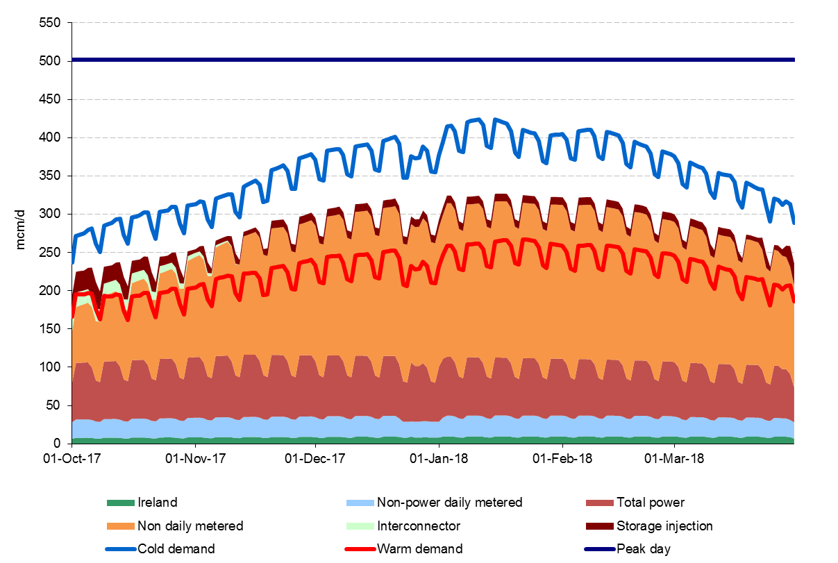
Gas demand is expected to be lower than last year
Notes:
Please note, this slide includes animation.
Our forecasts for any given period, more than a few days ahead, assume that the weather will be neither hotter nor colder than the long term average, a condition known as seasonal normal. This graph illustrates a cold and warm demand.
These lines represent the upper and lower limits within which demand might be expected to vary from the seasonal normal solely as a result of variations in the weather. The non-daily metered sector, shown in orange, is by far the largest, and also the only one to show significant weather sensitivity. .
Our 1 in 20 peak demand is the national demand calculated for a weather condition that might be expected only once in 20 years. The forecast 1 in 20 peak for 2017/18 is 502mcm/day, significantly higher than the cold demand curve. The last four winters have all been warmer than the long term average, but we do not infer from this that winter 2017/18 will also be warm. We plan for the winter assuming that the weather will be seasonal normal, but we are prepared for colder conditions.

Slide 26
Sufficient gas supply is available to meet demand
Notes:
Focusing on our security assessments,our cold day assessment is used in the margins assessment. For winter 2017/18, the cold day demand forecast is 419 mcm/day. The non-storage supply forecast is 354 mcm/day, to which 92 mcm of storage can be added, giving a total of 446 mcm/day. The forecast cold day supply is comfortably in excess of the cold day demand.which is used to inform the Margins notice.
In the case of a 1 in 20 peak day we would expect supplies to be much higher than the cold day assessment. Here we can also see the supply and demand forecast for a 1-in-20 peak day. The margin of supply over demand here is 116 mcm/day.
The N-1 test, is based on the loss of the largest piece of gas supply infrastructure, and whether forecast supply can meet demand in the event of its failure. To verify the n-1 test , using this winter’s margin of 116mcm/d if the loss of supply from the loss of the largest piece of infrastructure is lower than the margin, then the n-1 test is passed.

Slide 27
Storage
Long-range storage
Return of storage withdrawal capability from Rough.
In the process of transferring from storage facility to production facility.
Intention is to produce all recoverable cushion gas.
We forecast withdrawals to last from early October through until the end of January.
Medium-range storage
Supplies from MRS are dynamic rather than seasonal ranging from no flow to maximum flow, from all facilities, at times of high gas demand or price.
Facilities are capable of being constantly replenished to ensure maximum supplies throughout periods of high demand.
Last winter MRS responded well to market conditions providing flexibility in response to restrictions at the long-term storage facility, Rough.
Notes:
In June CSL made the decision to close LRS facility Rough.
This winter we see Rough return to withdrawal capability.
Historically LRS provided additional seasonal supply hence the greater volume for storage.
Does not have the capability of rapid cycling as MRS.
MRS is the more dynamic of the 2 types of storage being capable of replenishing stocks during periods of low demand to ensure maximum supplies throughout periods of high demand.
Rough’s intention is to produce all recoverable cushion gas from its wells.
Steady withdrawals forecast now until end Jan.
CSL in throes of transferring from storage facility to production facility.
Last winter MRS responded well to market conditions providing flexible response to restrictions at the long-range facility.

Slide 28
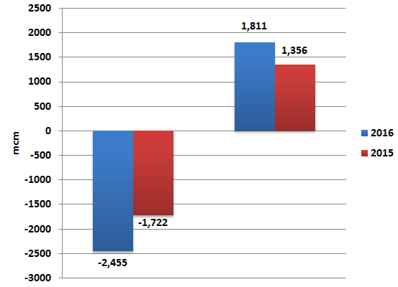
Medium-Range Storage
In any winter, non-beach supplies are expected to show the greatest variability and flexibility of all of the supply sources.
This versatility was predominantly demonstrated by MRS for last winter.
Injection and withdrawal volumes (mcm)
Notes:
Last winter, having no previous experience of a winter with restrictions at Rough, several questions were raised concerning storage behaviour; for example:
Would shippers continue to cycle medium-range storage between injection and withdrawal? Or,
Would there be a tendency to hold stocks in storage in anticipation of colder weather or higher prices?
What we observed was MRS responding to shifts in the supply/demand dynamics. We saw an increase in cycling, withdrawing high volumes in late November before refilling when demand reduced over the Christmas and New Year period. During this time, stocks reached levels close to those seen in October, at the onset of winter when levels are generally high. This serves to emphasise the flexibility that medium-range storage sites continue to offer the market.

Slide 29
Continuing the Conversation
You can find the Winter Outlook Report using the following link: http://www2.nationalgrid.com/UK/Industry-information/Future-of-Energy/FES/Winter-Outlook/
Join our mailing list to receive email updates on our Future of Energy documents.
http://www.nationalgrid.com/updates
Email us with your views on the Winter Outlook Report at marketoutlook@nationalgrid.com and we will get in touch.
Keep up to date on key issues relating to National Grid via our Connecting website: www.nationalgridconnecting.com
Or alternatively you can write to us at:
Future Outlook team
System Operator
National Grid House
Warwick Technology Park
Gallows Hill
Warwick
CV34 6DA

Slide 30
Safety Monitors
Operational Forum – October 2017
Karen Thompson

Slide 31
Safety Monitor Overview
The focus of the Safety Monitor is public safety rather than security of supply
Customers who cannot be isolated
‘protected by monitor’
‘keep supplied’
SAFETY MONITOR
SPACE
and
DELIVERABILITY
Customers who can be isolated
‘protected by isolation’
‘isolate safely’
Please provide any feedback to Toby Thornton – NTS Access Planning Manager (toby.thornton@nationalgrid.com)
31

Slide 32
UNC Modifications/Topics from Transmission Work Group
Operational Forum – October 2017
Karen Thompson

Slide 33
UNC Modification 0607S
Mod 0607S proposes to increase the CO₂ limit at the NSMP NTS entry point at St Fergus from 4% to 5.5%
- It also contains a provision for National Grid to review this increased limit in the event of similar requests being made
- Originally assessed as self-governance, an Ofgem decision is now proposed
- The workgroup report has been completed
- The Modification Panel meets on Thursday 19th October to decide whether to issue it for consultation
  The Modification Panel are due to meet on Thursday 19th October to decide whether to issue as a consultation.
Further information may be found at: http://www.gasgovernance.co.uk/0607
Notes:
Mod 0607S update
- This mod proposes to facilitate a time-limited increase to the CO2 limit for NSMP's terminal at St Fergus from 4.0% to 5.5%
- It also contains a provision for National Grid to review this increased limit in the event of similar requests being made
- Originally assessed as self-governance, an Ofgem decision is now proposed
- The workgroup report has been completed
- The Modification Panel meets on Thursday 19th October to decide whether to issue it for consultation

Slide 34
UNC Modification 0621
UNC Modification 0621 raised in June 2017 proposes changes to the gas transportation methodology and delivering compliance with EU Tariffs Code for 2019.
Proposing change to the calculation method for Entry & Exit capacity charges and the additional charges in the methodology delivering substantive change to the methodology. This is to deliver changes to the Gas Transportation Charging Methodology for improvements over the current framework and also deliver compliance with EU Tariffs Code.
Engagement with industry via NTSCMF, Tx Workgroup and separate Gas Charging review sub-groups continuing. Updated Mod to be published ahead of and discussed at NTSCMF on 25th October.
Expecting to deliver updated mod in October and workgroup report for January 18 as per UNC Panel timescales.

Slide 35
National Grid Gas Quality Consultation
National Grid has published a gas quality consultation via ENA and at http://www2.nationalgrid.com/uk/industry-information/gas-transmission-system-operations/gas-quality/
Industry views are sought on:
  Processes for agreeing gas quality limits at NTS entry points
  Potential National Grid gas quality services
The consultation is open until Friday 17 November 2017
We will report on the results in January 2018
For further information, please contact philip.hobbins@nationalgrid.com or by phone on 01926 653432

Slide 36
Reviewing Communication Process
Operational Forum – October 2017
John McNamara

Slide 37
Reviewing Communication Process: Initiative 1
National Grid Gas is seeking to improve electronic communication between the gas community
  In response to your feedback
  Provision of Fax is increasingly expensive and difficult to maintain
Starting with replacing Fax for Notifications followed by Settlements (ATD)
  Building on current processes and systems
  Needs to be a secure, accurate and efficient exchange of information
  A range of methods including email, file transfer and API (web service)

Slide 38
Reviewing Communication Process: Initiative 2
Some discussions have already taken place and this is a continuation of the process.
Our ambition is to design a flexible system
  Incorporate your way of working as much as possible
  Provide simplified standard proformas and protocols
  Providing assistance with creating EDSS file types
Moving towards this aspiration
  National Grid carried out a survey to customers, based on our contact list
  Expectations are that this will take some time to implement and will continue to communicate with you on progress.

Slide 39
Reviewing Communication Process: Initiative 3
This process will require your support in order to succeed
If you like to contact us for any discussions around the process or to move now to remove the fax process the contact to initiate or for any queries is:
Email Contact: simon.hill@nationalgrid.com
Telephone Contact: +44 (0)1926 656 590

Slide 40
GB REMIT
Operational Forum – October 2017
John McNamara

Slide 41
GB Remit – Project Closure
National Grid continues to host a free portal for GB that users are welcome to use for publishing Urgent Market Messages (UMM)
This is using the latest version of the Schema from ACER
Site has been live since 29/12/2016 and to date there have been no outages or loss of service
  Changes implemented since go live to, having listened to our customers:
    Multi Editing Capability within a company
    Single UMM XML Uploading
    UMM Display (Table and CVS Export)
The Project phase has now closed and is managed as a Business as Usual Process and thank you for all your input.
Contact mail for Account Set Up / Changes & queries: box.remit@nationalgrid.com

Slide 42
MIPI Disaster Recovery Test Plan
Operational Forum – October 2017
John McNamara

Slide 43
MIPI Disaster Recovery Test Plan
National Grid plans to carry out a full Data Centre Switch over from our Primary Site to our DR Site for MIPI (including GMRS)
Current Plan:
  Move from Primary Site to DR Site on Tuesday 14th November
  Run on the DR Site for the day of Wednesday 15th November
  Return to Primary Site from DR Site Thursday 16th November
The cut over process on Tuesday and Thursday will take place during office hours
  The exact detail timings of the outage period required is still being worked on and will be published via MIPI News Page in the build up to the day
  Will also alert you via ANS that we have put out a notice
  This is using the latest version of the Schema from ACER
Site has been live since 29/12/2016 and to date there have been no outages or loss of service
  Changes implemented since go live to, having listened to our customers:
    Multi Editing Capability within a company
    Single UMM XML Uploading
    UMM Display (Table and CVS Export)
The Project phase has now closed and is managed as a Business as Usual Process and thank you for all your input.
Contact mail for Account Set Up / Changes & queries: box.remit@nationalgrid.com

Slide 44
MIPI Disaster Recovery Test Plan
During the outage we will go to normal contingency process and GNCC will be publishing data via ANS
Messages will be sent out to inform you that the process for moving sites is starting
An ANS Message will go out to confirm we have completed and MIPI is fully available
National Grid and its Providers will carry out a number of QA checks to try and ensure the System has returned correctly
  All data will be recovered from during the outage period
  However if you do see any issues we have not identified please contact us: Box.operationalliaison@nationalgrid.com
Be aware that the Web Tier may be up accessible but may not be getting any Data Refresh

Slide 45
MIPI Statistics
Operational Forum – Oct- 2017
John Mcnamara
Notes:
Project completed

Slide 46
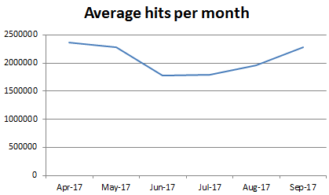
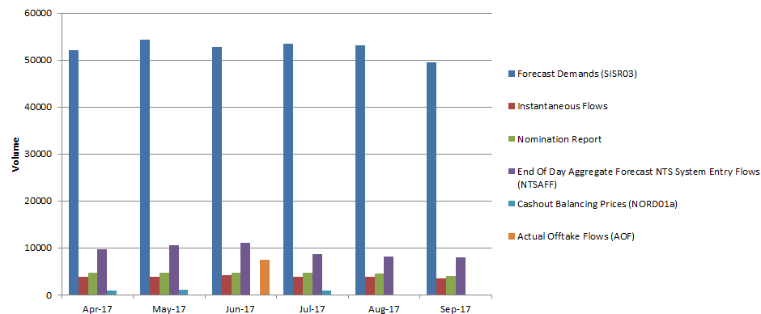
MIPI Performance – September Statistics
Average Hits Per Month Apr 17 – Sept 17
TOP 5 – Popular Reports
SDLT 4.14
Notes:
Average Hits Per Month -This shows the average hits per month against the web pages and api pulls
MIPI Load Speeds - This graph shows the average MIPI and GMRS web page load speeds in seconds. Target is below achieve below 5 seconds, On Average in May, MIPI load speeds have been load speeds of 2.2 seconds
TOP 5 Popular Reports - This graph shows the top 5 used reports, from MIPI, each month. Forecast Demand data still remains the most popular. Your feedback in the Shallow incentives agenda topic will be very useful.
Compliance & Obligated Reports - This graph shows the percentage of MIPI mandatory data published successfully on time. This is based on the identified obligated and incentivised reports only. On a few occasions GNCC did not publish data, impacting NORD01c publication.

Slide 47

Break
Remember to use SLIDO - Your feedback is really important to us!

Slide 48
Overview of Exercise Yield & Customer Feedback
Ops Forum 19/10/2017
Robert Gibson
Emergency and Incident Framework Manager National Grid Gas
gasops.emergencyplanning@nationalgrid.com

Slide 49
YIELD
NEC Obligation
Test Industry Emergency Procedure
Wide Range of Participants

Slide 50
Improvements on Feedback
Further Tested “Pre Emergency” Actions
Criticall failures reduced
Criticall messaging issues
Communications with BEIS

Slide 51
Yield Feedback
Industry feedback survey is open and closes 27th of October:
http://mailchi.mp/nationalgrid/nec-exercise-yield-feedback
Degree to which shippers participate in the exercise
Communications to shippers and directly connected consumers could be improved

Slide 52
Customer & Stakeholder Feedback
Operational Forum – Oct 2017
Vinny Thiara
Notes:
Project completed

Slide 53


Launch of National Grid ‘BETA’ Website
1
1. Visit the new ‘BETA’ website
2. Give us your feedback!
2
Notes:
Went live on Friday 6th October
Will run in parallel to existing website
We need your feedback!

Slide 54

Customer & Stakeholder Feedback – You Said, We Did.
“
The information on the website needs to be updated, a lot is very old.
All original website content has been reviewed and streamlined in new ‘BETA’ version of website.
NG WEBSITE
It’s not always easy to find things…
Implemented a more sophisticated search facility which has helped improve navigation.
NG WEBSITE
The website uses too much industry jargon.
Content leads have been asked to review their use of industry related jargon. This has hopefully led to a reduction seen on the new website.
NG WEBSITE
Responses to emails can be slow.
In response, SLAs have been put in place by various teams across Gas Operations.
GENERAL FEEDBACK
”

Slide 55
Customer & Stakeholder Feedback – Operational Forum
+ Forum now starts at 9.30am as opposed to 10.30am.
+ NG ensures that the agenda is sent out 7 day prior to event.
+ Greater National Grid representation at forums.
+ Changed the room layout to help encourage greater attendee participation.

Slide 56

Customer & Stakeholder Feedback – We’re working on it…
Operational Forum
Forum can drag on a little
Look to reduce the number of agenda items covered at each forum
Managing Relationships
C&S confused as to who they should be contacting in certain circumstances
Share up-to-date organisation charts at liaison meetings
National Grid Website – Ops Forum
Often difficult to find what I’m looking for
Webpage has been designed to allow users to find information more quickly and easily – improved usability

Slide 57

Customer & Stakeholder Feedback – Satisfaction Surveys
“…value your feedback…”
“…better understand your requirements…”
“…ensure we continually meet, and look to exceed expectations.”
Wish to take part? Get in touch:
Hayley.Johnson@NationalGrid.com
£10

Slide 58
AOB
Operational Forum – October 2017
Karen Thompson

Slide 59
Shaping the Future of the Gas Transmission Have your say!
Dates and locations: Monday 30th October London & Friday 3rd November - Edinburgh
Topics covered:
  Current/short term focus:
    How we’re performing and what we should be focusing on in the short term
    Compressor strategy – meeting customer needs whilst becoming compliant with environmental legislation
  Longer term:
    What does agility mean to you and how would it help your business?
    Market attractiveness and accessibility – What potential blockers are their for you in our commercial products/services/ frameworks and what does good would look like
    Innovation - Gain insight on FOG thoughts around decarbonisation tools, i.e. heat, gas in transport, CCS and hydrogen
    Valuing Risk – How we value risk when developing our asset health work. Is this right and what are your output priorities
    Planning the network – how we currently plan the network and what scenarios you’d like to us model
Why you should attend:
  Detailed engagement plans will be agreed with stakeholders at the events on each key topic
  Insight gained will feed directly in to our current and future business plans
To register:
  30th October: https://www.eventbrite.com/e/shaping-the-gas-transmission-network-of-the-future-have-your-say-tickets-37870867785
  3rd November: https://www.eventbrite.com/e/shaping-the-gas-transmission-network-of-the-future-have-your-say-tickets-38141139174

Slide 60
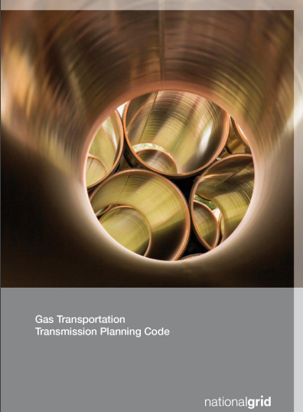
Gas Transmission Planning Code Update
On 26th September, Ofgem approved our proposed changes to our Gas Transmission Planning Code document
These changes were required to reflect the changes made to our network planning processes, following the completion of our Gas Planning & Operating Standard Project
These include changes to how we will assess the impact of “foreseeable” within-day variations in supply and demand in our network capability assessments, plus how we will ensure that the NTS has sufficient resilience for “unforeseeable” within-day variations
The current version of our Gas Transmission Planning Code can be found here:
http://www2.nationalgrid.com/UK/Industry-information/Developing-our-network/Gas-Transportation-Transmission-Planning-Code/
Ofgem’s decision letter can be found here:
https://www.ofgem.gov.uk/publications-and-updates/decision-approve-further-changes-proposed-national-grid-gas-plc-transmission-planning-code-2017

Slide 61
Gas Operating Margins – Consultation
On the 10 October, National Grid Gas opened a 4 week consultation for you to review and provide feedback with respect to its template Gas Operating Margins 2018/19 Agreements.
The Contract Services team have developed the OM Agreements to incorporate any learning from service providers in the previous tender round, whilst ensuring consistency and alignment across the agreements.
The list of documents below are uploaded to National Grid’s website on the following link under the “Tender Documentation” tab: http://www2.nationalgrid.com/uk/industry-information/gas-transmission-system-operations/balancing/operating-margins/
  Industry Consultation Letter 2017
  TEMPLATE Gas Capacity Agreement (Storage) 2017
  TEMPLATE Gas Delivery Agreement (LNG Storage) 2017
  TEMPLATE Gas Delivery Agreement (Demand Reduction_Supply Increase) 2017
Please submit your feedback by the deadline of Tuesday 7 November to: tahir.mahmood@nationalgrid.com

Slide 62



2017 Winter Webinars – NOW LIVE!
REMIT
Emergency Exercise
SO Key Documents
MIPI Common Queries
NOW LIVE
Available at: http://www2.nationalgrid.com/UK/Industry-information/Gas-transmission-operational-data/Webinars/ For more details, please contact: Box.operationalliaison@nationalgrid.com
62

Slide 63
Future Operational Forum Dates 2017
Month | Date
November | Thursday 23rd November 2017
Future Agenda Items
Xoserve Service Desk | Capacity Mod 616
Nominations | NDMA Accuracy Report
Future Energy Scenarios | Trading/Balancing
For any queries or proposed agenda items please contact the Operational Liaison Team:
Box.operationalliaison@nationalgrid.com
63

