Slide 1
Understanding our climate change risk
March 2022

Slide 2
Contents page
01 | Why does this matter? | 03
02 | How did we approach it? | 06
03 | What have we learned? | 14
04 | Exploring more | 28
05 | Next steps | 31

Slide 3
01
Why does this matter?

Slide 4
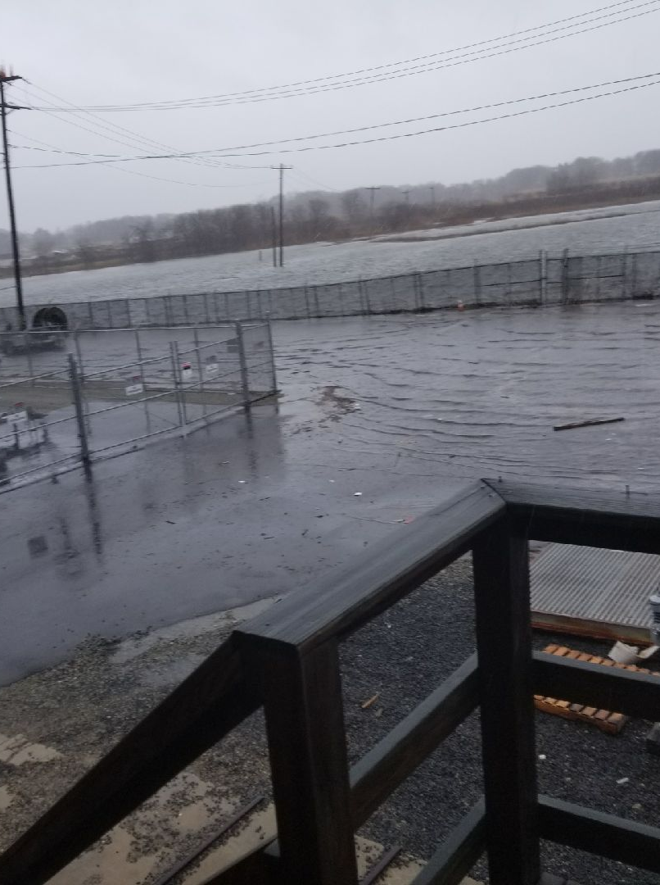
Introduction
National Grid added climate change as a principal risk in the company’s risk profile in 2020, and has committed to implement the recommendations of the Task Force on Climate-related Financial Disclosures in full.
Project objectives
    A consistent assessment of physical climate change risks to assets across the UK and US business, both now and at future intervals
    An interactive geographical visualisation tool to show risks for 2 °C and 4 °C scenarios and several timeframes
We need clear guidance upon which we can form a long-term strategy for climate adaptation. There are a lot of uncertainties. We think our assets and systems will be okay until 2050, but after that we don’t know.
Notes:
Broader context for the project includes:
National Grid’s observations of the changing weather and experience of physical climate impacts, such as increased intensity and frequency of storms on the US East Coast
Recognition of a requirement to implement a pro-active approach to the management of climate risks
More widespread disclosure of climate risks within the energy sector
Increasing requirement from regulators to address climate risk assessment and adaptation planning requirements, such as COMAH and Ofgem
Growing interest from investors for more information about the risk of stranded assets (from all causes) and TCFD recommendations generally
Industry and business expectations for climate-related scenario planning and integration of climate risks with strategy, operations and asset management

Slide 5
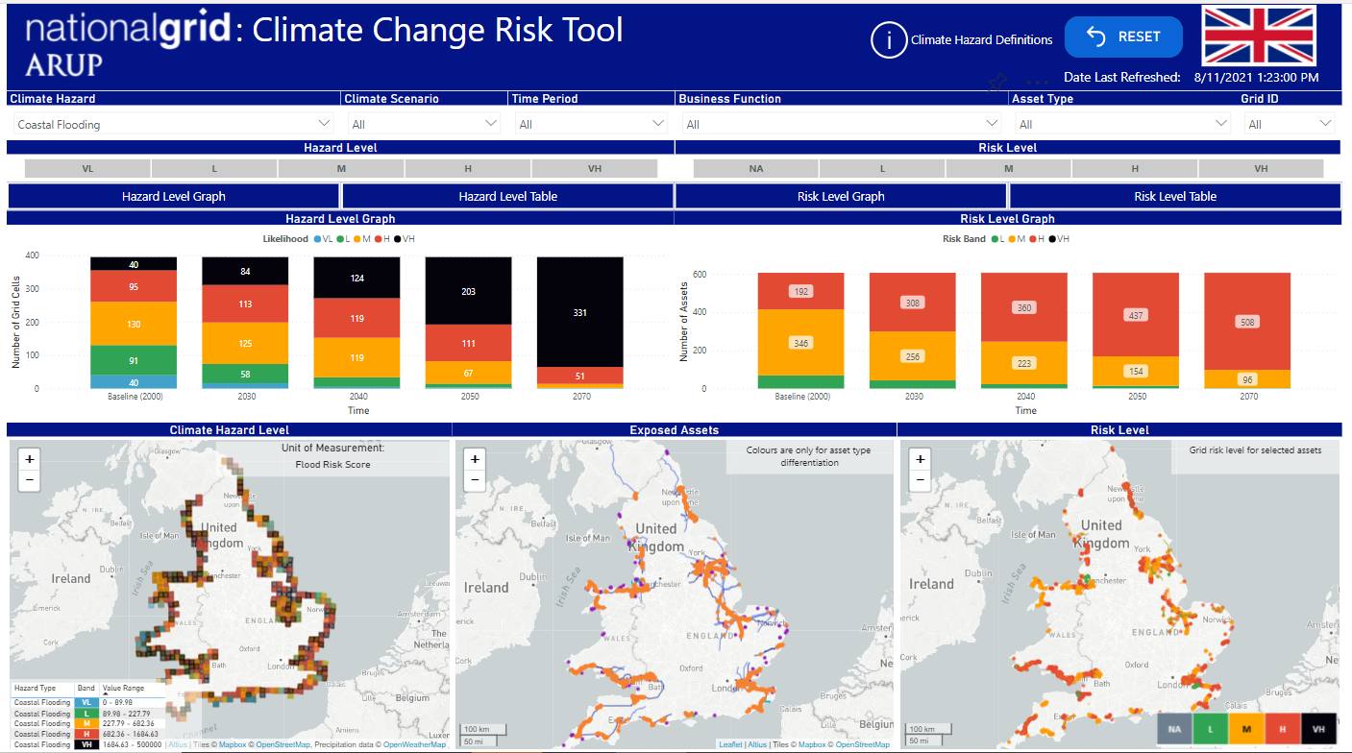
Key features
A step change in National Grid's understanding of risks from climate hazards to our asset base.
  Assets from 9 business functions across National Grid
  Future climate data for two emissions scenarios and several time periods throughout this century
  Climate hazards defined with threshold-based indicators tailored to National Grid infrastructure
  Assessed at a spatial resolution of approximately 12 km in UK and 7 km in US
UK |  | US
9 | Hazards | 9
12 | Asset types | 16
217 | Grid cells | 622
27,958 | Individual assets | 6,505,378

Slide 6
02
How did we approach the analysis?

Slide 7
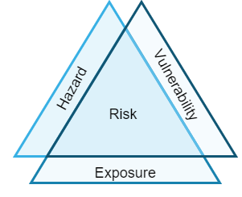
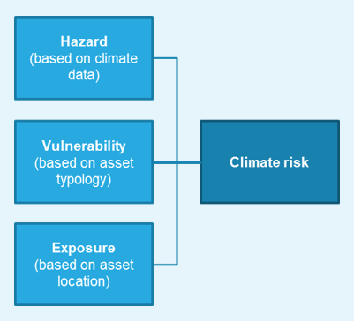
Analytical framework
Risk as a combination of hazard, vulnerability and exposure
Climate risk is defined as the potential for a climate event to result in harm (damage) to National Grid’s assets.
Risk is determined as a function of three components: ​
Hazard: a climate event which can cause damage to assets and infrastructure. Estimated from spatial climate data. ​
Vulnerability: asset sensitivity to physical harm from climate hazards. Based on general characteristics of asset types.​
Exposure: asset location relative to hazard location.​ From spatial asset data.
The analytical framework allows a high-level understanding of the potential risk posed by different hazards to different types of assets. ​
The assessment can inform a wider understanding of overall system vulnerability to the changing climate.
Framework does not currently include criticality, adaptive capacity or other aspects of risk.
The analytical framework adopted is based on the conceptual risk framework set out by the Intergovernmental Panel on Climate Change (IPCC) in their 5th Assessment Report

Slide 8
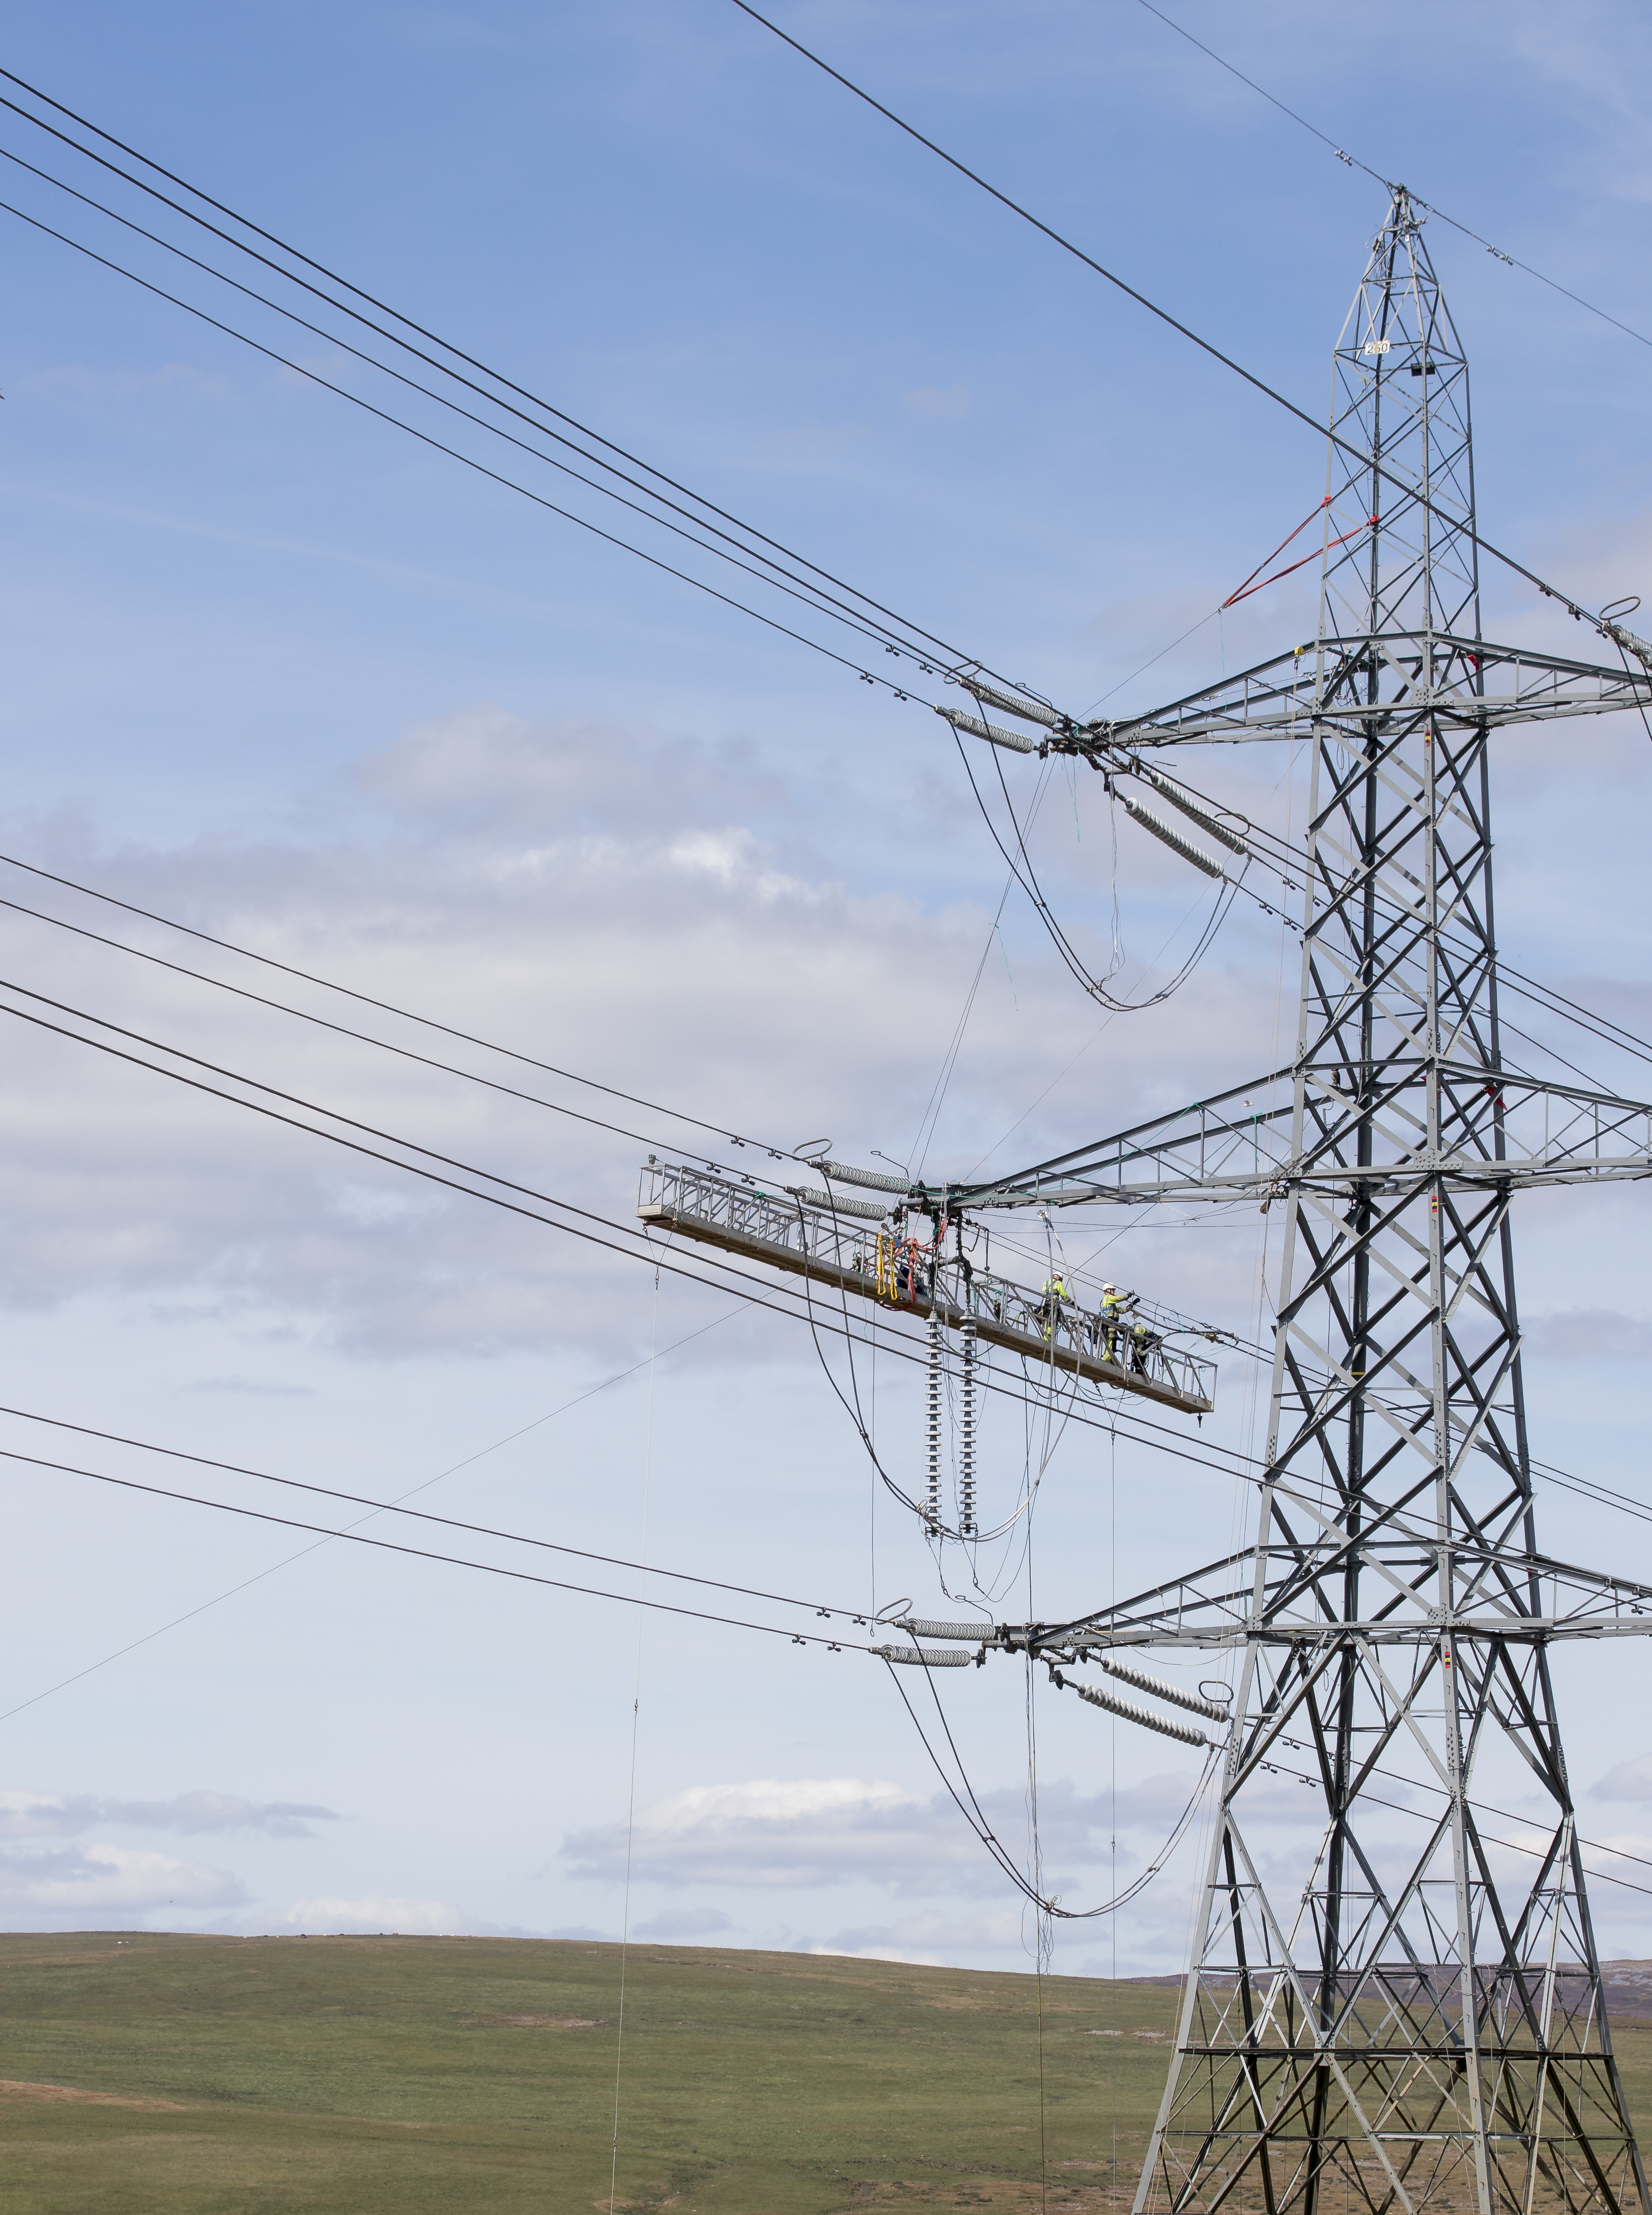
Asset exposure
Regulator, offtake (UK), take (US) and compressor stations
Gas pipeline network
Gas valves
Gas terminals​
LNG and CNG storage stations​ & LNG importation terminal​
Gas meters
Overhead electricity transmission infrastructure
Electricity transmission towers
Overhead electricity distribution
Electricity distribution poles
Underground cables
Transformers
Manholes
Vaults
Electricity substations
Converter stations
Generation assets​
Offices/Service Centres
Source data on asset type and georeferenced location was assembled
Assets mapped to the geospatial reference grid set by the climate data
Individual asset is exposed if the climate hazard occurs in the same grid cell
Notes:
Asset catalogue
Given the scope of the risk assessment and the large number of asset types and locations covered by NG operations, the use of asset data was streamlined.
For each asset, information on its georeferenced location and its asset type was assembled to generate an extensive asset catalogue.
Table shows the asset types used in the risk assessment. This includes both point and linear infrastructure, on ground, below ground and overhead
Exposure assessment
In this study the exposure of an asset to a climate hazard is determined based on its location and whether that location is susceptible to the specific hazard being considered (e.g. coastal flooding would not apply to inland locations). Exposure is indicated as a simple ‘yes’ / ‘no’ for each asset and hazard type and location.
In order to identify exposure, individual assets were matched to the geospatial reference grid aligned with the climate hazard assessment.

Slide 9









Climate hazards
 | Threshold
Coastal flooding | Frequency of occurrence of coastal flooding and future impacts due to sea level rise
River flooding | Frequency of occurrence of riverine flooding and future impacts due to increase in extreme rainfall precipitation
High temperatures | Number of days per year when maximum daily temperature is above 30 °C (86 °F) for the UK, 95 °F (35 °C) for the US
Low temperatures | Number of days per year when maximum daily temperatures is below 0 °C (32 °F) for the UK, below 10 °F (-12 °C) for the US
Heatwave | Number of times per year when both maximum daily temperature above 30 °C (90 °F) and minimum daily temperature above 20 °C (70 °F) for 3 days
High winds | Number of days per year when maximum daily wind gust is above 34 m/s (76 mph)
Compound events | Number of days per year when both maximum daily wind gusts above 25 m/s (~60 mph) and precipitation over 25 mm (1 inch) in the same day (split for summer and winter seasons).
Freeze thaw | Number of days per year when temperature cycles above and below 0 °C (32 °F) in the same day
Lightning | Frequency of lightning events
Notes:
The climate hazard assessment includes nine hazards.
For each climate hazard a threshold has been defined to identify when the weather event has the potential to cause damage.
The climate hazards and relevant thresholds were selected based on a review of past work (e.g. workshops, reports) and consultation with NG key stakeholders.
Table lists the climate hazards considered, their definition, thresholds used for the indicator and the rationale for the selection.

Slide 10
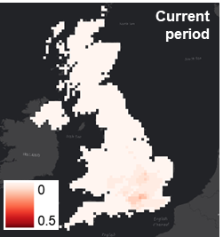
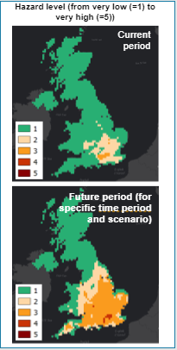
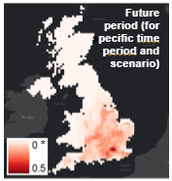
Climate hazard assessment
  Uses climate baseline and projection data
  Regional data sources
    Higher spatial resolution than global
    Align with latest national climate assessments in UK and US.
  Different levels of skill in climate models to represent different variables (e.g. wind vs temperature)
Climate data
Climate indicator
+ confidence and uncertainty
Climate hazard level
Baseline climate data
Climate indicator values for baseline
(e.g. number of days per year when threshold exceeded)
Climate hazard levels for baseline
(very low to very high)
Future climate data
(anomaly)
Climate indicator values for future time periods and scenarios
Climate hazard levels for future time periods
(very low to very high)
Notes:
Climate baseline and projection data are used in the climate hazard assessment. Priority has been given to those data sources that provide a high spatial resolution, represent most up to date data and aligns with ongoing work at NG.
A range of data sources were reviewed as part of the discovery and design stages based on the following considerations:
Consistency of data sources across regions
Consistency of data sources across hazards
Spatial resolution
Most up to date, suitable and reliable data
Alignment with ongoing work at NG
Regional sources were preferred to global sources because they offer better spatial resolution and align with the latest national climate assessments in the UK and US, respectively.
The analysis of climate data for current and future climate is subject to limitations that must be kept in mind in the interpretation of the results, the main ones to highlight are:
Climate change projections provide information on climate variables not the hazards themselves.
Level of detail in the available data varies per hazard and location, e.g. limited up-to-date data available for lightning as this hazard is not currently included in the UKCP18 or NCA4 dataset.
There are different levels of confidence from the climate science community in the skill of the climate models to represent different variables. For example, climate models may be less skilful in representing localised wind or extreme rainfall.

Slide 11
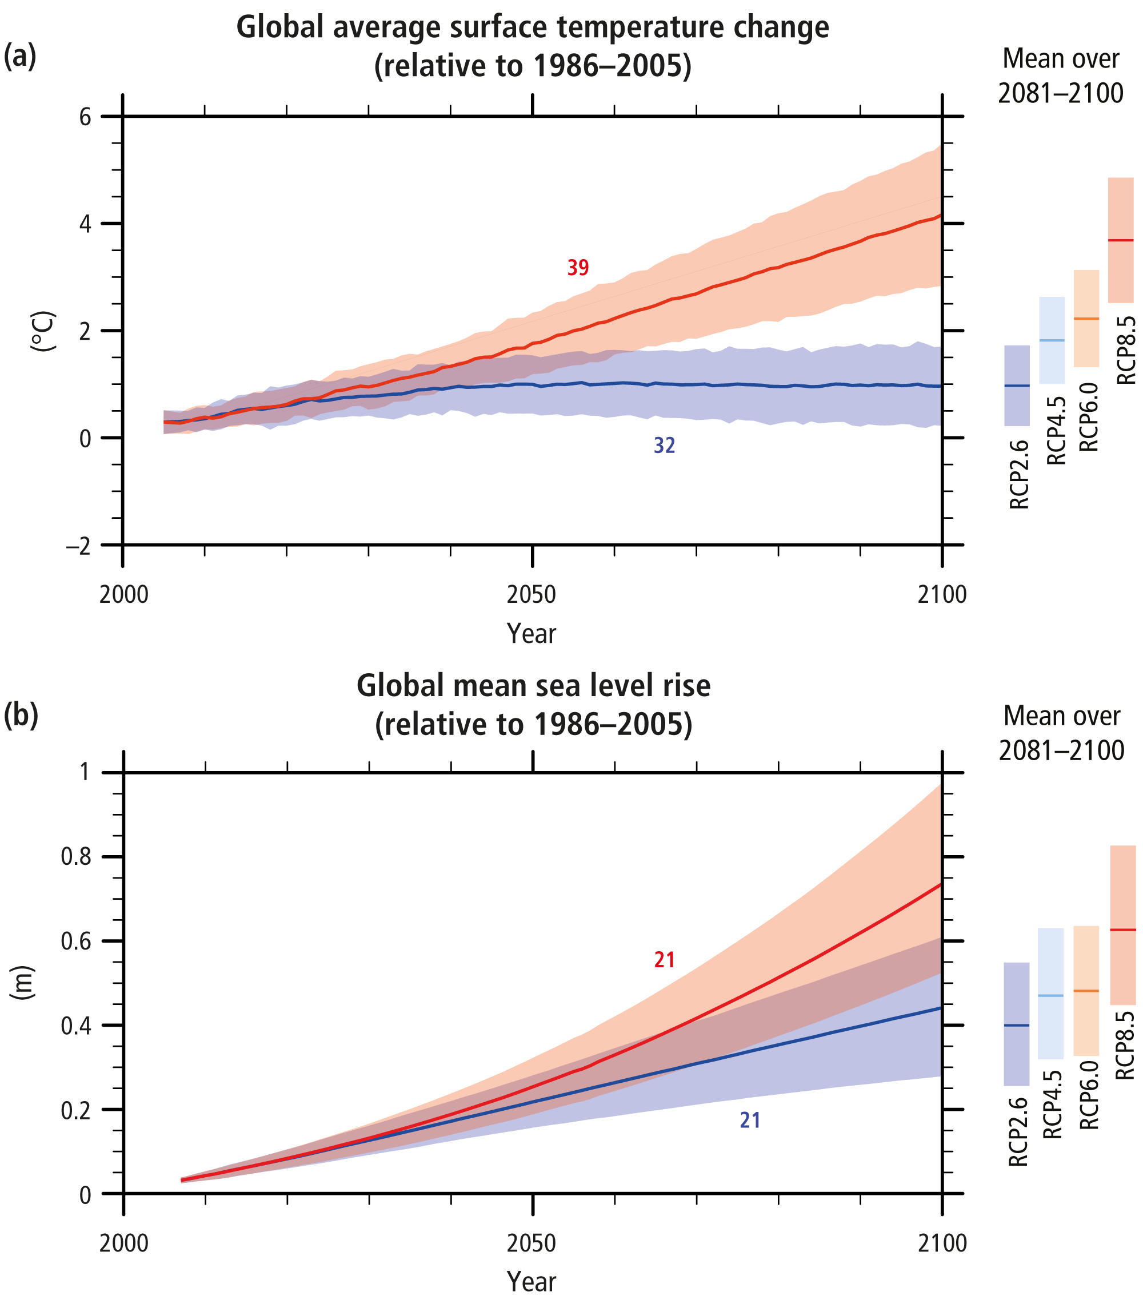

Climate scenario assessment
Time periods
  Baseline:
  1976-2005 for US
  1981-2010 for UK
  (time periods used in the respective national climate assessments)
  Future:
  2030s, 2040s, 2050s, 2070s
  30-year time windows from which climate statistics can be calculated
Emissions scenarios
  IPCC’s Representative Concentration Pathway (RCP) scenarios
4°C scenario is represented by RCP8.5
(very limited reduction in global GHG emissions; increase in average global temperature of 3.2 – 4.5 °C by 2100)
2°C scenario is represented by RCP4.5
(minimum ambition in the “Paris Agreement” to limit global emissions; increase in average global temperature of 1.7 – 3.2 °C by 2100)
Climate hazard levels for baseline period (very low to very high)
Climate hazard levels for future time periods (very low to very high)
Notes:
Selection of time periods
The selection of the time periods for the analysis was based on the requirements for the project and agreed with the National Grid steering group.
Time periods - Defined as a 30 year time window from which climate statistics can be calculated.
These are:
For the baseline (current) climate the analysis uses the same time periods used in the national climate assessments (i.e. NCA4 for US and UKCP18 for UK) 1976-2005 for US and 1981-2010 for UK.
For the future, the analysis uses time periods for which climate projections are available in both UK and US datasets. These are: 2030s, 2040s, 2050s and 2070s.
Selection of emission scenarios
The assessment uses the IPCC’s Representative Concentration Pathway (RCP) scenarios. The RCPs provide a uniform global framework for exploring potential climate changes and related impacts.
For the purposes of this analysis, a 4°C scenario is represented by RCP8.5 (this could be considered a “business as usual” scenario with very limited reduction in global GHG emissions leading to an increase in average global temperature of 3.2 – 4.5°C by 2100.)
A 2°C scenario is represented by RCP4.5 (this could be considered a scenario aligned with the very minimum ambition in the “Paris Agreement” to limit global emissions to 2°C: in RCP4.5 global temperature increase is limited to 1.7 – 3.2°C by 2100.)
For the UK, only limited climate data for RCP4.5 is available in the UKCP18 projections.
Uncertainty levels for climate hazard assessment
L
Climate model outputs show agreement on trend and the difference between 10th and 90th percentile and the best estimate (50th percentile) is not considered significant (the 90th percentile is less than twice the value of the 50th percentile).
M
Climate model outputs may show agreement on trend but the difference between 10th and 90th percentile and the best estimate is considered significant.
H
Climate model outputs do not show agreement on trend and the difference between 10th and 90th percentile and the best estimate is considered significant

Slide 12
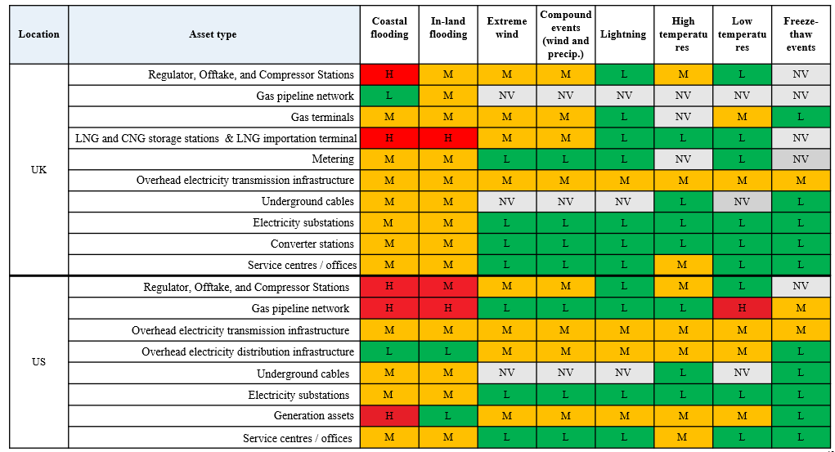
Vulnerability assessment
A high-level, qualitative assessment per asset type
Potential impact on each asset type, were the hazard to be experienced
Data
Vulnerability
assessment
Vulnerability score
Not vulnerable (NV) - No damage or disruption expected
Low (L) - Minimal physical damage to asset or minimal reduction in function as a result of the defined hazard indicator.
Medium (M) - Medium physical damage to asset or substantially reduced function or capacity as a result of the defined hazard indicator.
High (H) - High damage to asset or severe disruption as a result of the defined hazard indicator.
Literature review
Vulnerability scores assigned to each asset type - hazard combination
Climate hazard definitions
UK and US considered separately
Engagement with asset experts
Consultation with asset experts
Confidence levels were also associated to each score
Notes:
This vulnerability assessment is a high-level, qualitative assessment based on asset types. Each asset type (e.g. electricity substations) was assigned a qualitative vulnerability score for each of the hazards.
This score is derived from a review of general design characteristics and past experience for each asset type relevant to climate hazards. Characteristics included, for example, knowledge of whether the asset is above or below ground, its functionality, and the standards it is designed to.
The vulnerability scores were determined through a combination of expert judgment and literature review, including feedback from National Grid experts; review of internal National Grid reports (including UK Adaptation Reporting Power report); review of relevant external, published literature; and interviews with subject matter experts.
The vulnerability assessment is thus a matrix linking climate hazards (as defined by the selected climate indicators) to asset types to indicate the potential impact on that asset type were the hazard to be experienced.

Slide 13
Climate risk assessment
The hazard (very low to very high) and vulnerability (low to high) are combined using a risk matrix
  Risk is only estimated where an asset is exposed to the hazard in view, determined by geospatial colocation within a grid cell.
  Risk is calculated at the resolution of the grid and then assigned to assets within each cell.
Vulnerability | H | M | M | H | H | VH
 | M | L | M | M | H | H
 | L | L | L | L | M | M
 |  | VL | L | M | H | VH
 |  | Hazard
Notes:
The findings from the hazard (very low to very high), vulnerability (low to high) and exposure (yes/no) are combined using a risk matrix to obtain an estimate of the risk level.
Exposure is not explicit within this matrix since it is considered in a precursor step: risk is only estimated where an asset is exposed to the hazard in view, determined by geospatial colocation within a grid cell.
The risk matrix categorises risk as low (L), medium (M), high (H) or very high (VH) depending on the hazard and vulnerability scores. It was based on existing matrices in use (such as within ARP reports), but there was no standard 3 x 5 matrix widely used.
This version was defined in consultation with the National Grid Steering Group and provides a balance between high and low risks. VH risk is only assigned where an asset type has high vulnerability to a particular hazard and that hazard frequency falls into the VH band. More or less conservative versions of the risk matrix could be applied within the assessment.
Risk is calculated at the resolution of the common grid to enable combination of the hazard assessment (resolution defined by available climate data) and vulnerability assessment (assigned to asset types present in each grid cell). Hence, assets with the same vulnerability score are assigned the same risk score per hazard within each grid cell.
Risk has been estimated for each relevant hazard- asset combination for the baseline and future time periods and relevant emissions scenarios (when data is available).

Slide 14
03
What have we learned?

Slide 15



Key Findings
Most hazards are projected to increase in frequency in future, with high temperatures and coastal flooding of particular concern.
Risks from low temperature and freeze-thaw decrease in future, but cold extremes will still occur.
Lightning is a potential issue, but there are large uncertainties.
High winds and compound events show little clear change across the time periods and scenarios.
Risks from river and coastal flooding stand out as significant for all asset types in baseline and future climate.
Risks from high temperature and heatwaves are seen to increase significantly over time for many asset types.
By 2070s, almost all assets by the coast may be at high risk from coastal flooding.

Slide 16
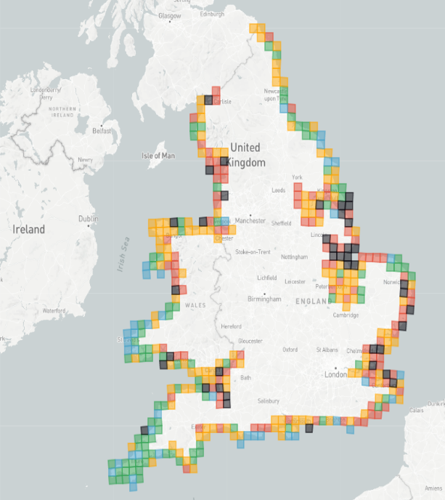
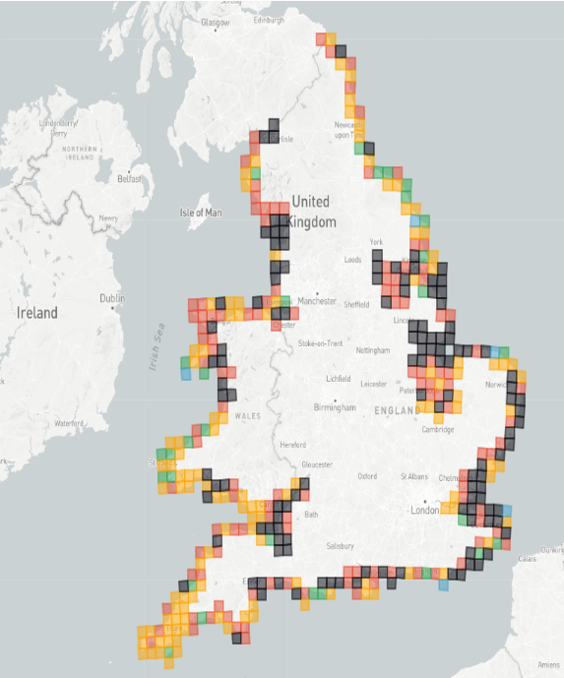
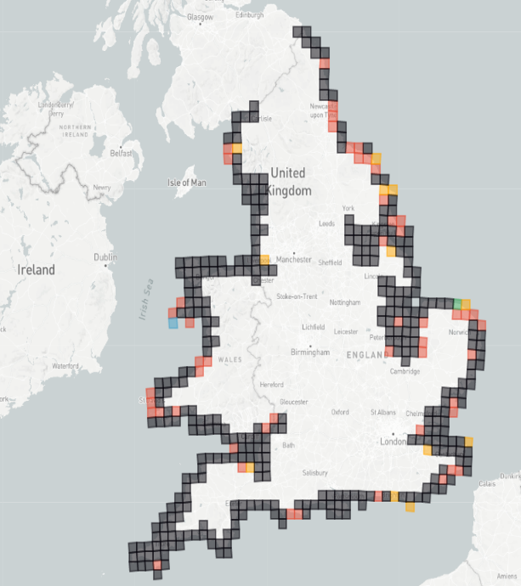

Coastal Flooding – Hazard Assessment
Climate hazard: UK
Confidence: Medium
Uncertainty: Low to medium
Summary
Several locations already have high or very high hazard level for coastal flooding in the baseline.
Sea level rise will increase the probability of coastal flooding. Results indicate the probability of flooding at least doubles by 2050.
By the end of the century and for RCP8.5, the flood hazard level is expected to be very high for most locations.
The 2070s show a greater increase than the 2040s.
Baseline period
2040s RCP8.5
2070s RCP8.5
High | 24%
Very High | 10%
High | 13%
Very High | 84%
Weighted average coastal flood occurrence (weighted score depending on grid area at flood risk) for the baseline period, 2040s and 2070s for RCP8.5

Slide 17
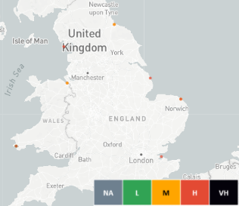
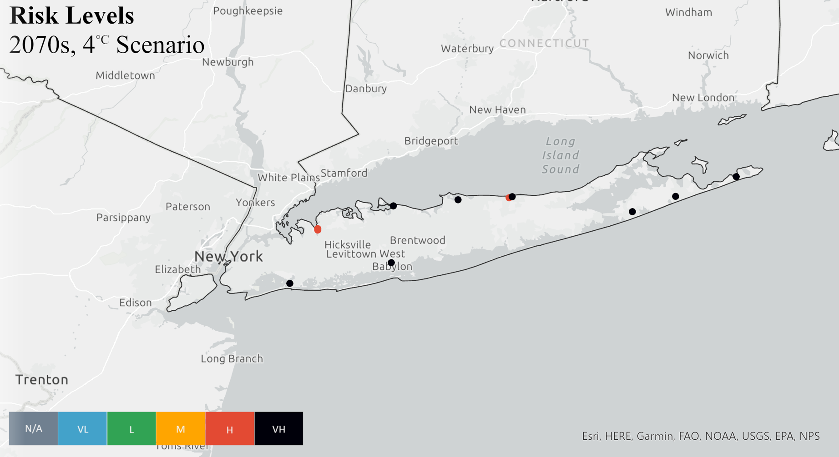
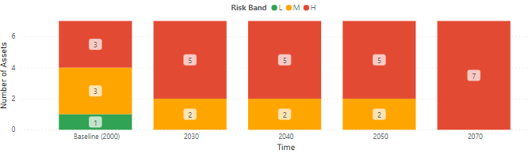
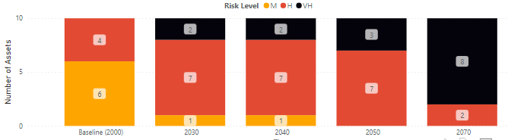
Coastal Flooding – Risk Assessment
UK example: Terminals
US example: Generation
Coastal flooding – in the baseline many coastal assets have medium-high risk of coastal flooding.
In the future, all the terminals are in coastal areas so are at high risk.
Time period | L | M | H | VH
Baseline | 14% | 43% | 43% | 0%
Future (2070s) | 0% | 0% | 100% | 0%
Coastal flooding - in the baseline many coastal assets have medium-high risk of coastal flooding.
In the future all generation assets in coastal areas are at high risk or very high risk.
Time period | L | M | H | VH
Baseline | 0% | 55% | 36% | 0%
Future (2070s) | 0% | 0% | 18% | 73%
Risk levels
2070s, 4C scenario
Example of risk results for terminals and coastal flooding in the UK
Example of risk results for generation
and coastal flooding in the US for 4C scenario

Slide 18
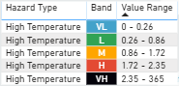
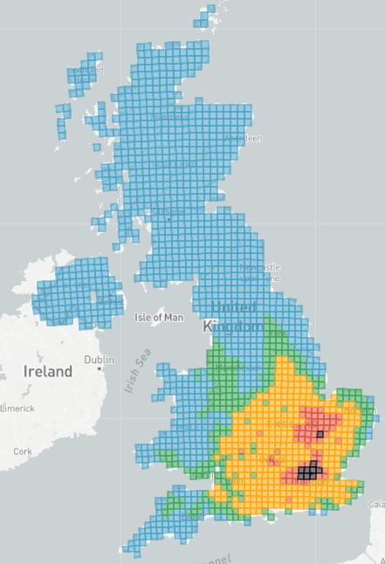
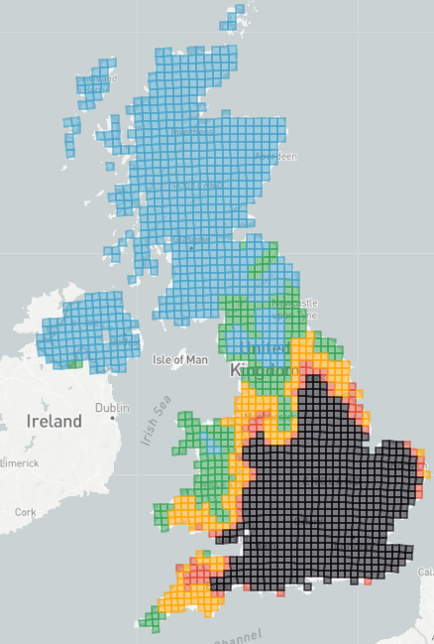
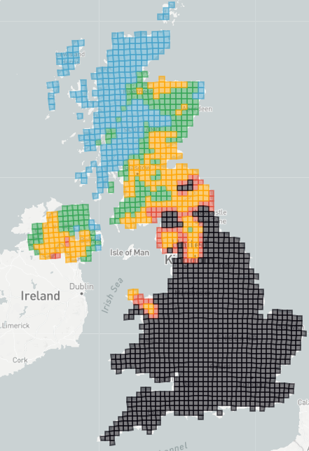
High Temperatures – Hazard Assessment
Climate hazard: UK
Confidence: High
Uncertainty: Low to medium
Summary
Temperatures above 30 ºC are rare, seen less than once every five years in most areas, more frequently in South East England, and up to three days per year in London.
The future increase is significant.
By the 2070s and RCP8.5 scenario, nearly all areas see 30ºC more than two days per year.
Baseline period
2040s RCP8.5
2070s RCP8.5
Average annual number of days per year when maximum daily temperature is above the 30 °C, 2040s and 2070s for RCP8.5

Slide 19




Highlighted priorities – UK
Key findings are based on percentage of assets at high or very high risk in the 2070s under the 4°C scenario (RCP8.5)
Gas Transmission (UK)
Compressor
stations
Offtake stations
LNG
Pipelines
Terminals
For the larger increases (more than 30 percentage points) projected between baseline and future, the relevant hazard icon is highlighted in red.
Notes:
Different future priorities for different business functions:
based on percentage of assets at high or very high risk in the 2070s under RCP8.5, compared to baseline climate
Electricity Transmission (UK)
Top 3 hazards to overhead lines and towers: high temperatures (98%, 9%), river flooding (48%, 36%), lightning (96%, 37%)
Underground cables face high risk from two hazards: river flooding (57%, 46%), coastal flooding (35%, 13%)
Top 3 hazards to substations: river flooding (56%, 45%), coastal flooding (33%, 14%), heatwaves (13%, 0%)
Gas Transmission (UK)
Top 3 hazards to compressor stations: high temperatures (83%, 13%), river flooding (53%, 37%), coastal flooding (17%, 4%)
Top 3 hazards to offtakes: high temperatures (79%, 9%), river flooding (51%, 39%), coastal flooding (22%, 9%)
Avonmouth LNG facility risk to both coastal and river flooding moves from high in baseline to very high in future
Pipelines face high risk from only one hazard: river flooding (47%, 36%)
Terminals face high risk from two hazards: coastal flooding (100%, 43%), river flooding (71%, 71%)
Ventures (UK)
Top 3 hazards to converter stations: high temperatures (100%, 0%), coastal flooding (100%, 50%), river flooding (83%, 67%)
Gas meters face high risk from two hazards: river flooding (55%, 40%), coastal flooding (29%, 10%)
Facilities (UK)
Office locations face high risk from two hazards: high temperatures (100%, 20%), river flooding (40%, 40%)

Slide 20
Responding to climate risks
Risk levels align to broad categories of recommended next steps towards adaptation.
Change in risk level over time means that a stepwise plan for resilience efforts could be outlined for particular hazard-asset combinations or for geographical areas.
Risk level | Response category
Very high | Take action now towards enhanced resilience
High | Undertake further assessment to identify options
Medium | Plan for additional research
Low | Maintain a watching brief
As high temperature and heatwave hazards show a rapidly increasing frequency of occurrence, the resilience of vulnerable infrastructure to these hazards is recommended for further review.
Coastal areas are highlighted for attention due to potential coincidence of multiple hazards and the dominance of coastal locations for some asset types.
Notes:
The risk levels can be aligned to broad categories of recommended next steps towards adaptation.
The change in risk level over time means that a stepwise plan for resilience efforts could be outlined for particular hazard-asset combinations and/or geographical areas.
Very high risk
Take action now towards enhanced resilience
Urgent action required to understand potential risk in more detail and implement suitable measures to reduce risk
High risk
Undertake further assessment to identify options
Action required to understand potential risk in more detail and define suitable measures to reduce risk
Medium risk
Plan for additional research
A plan for how the risk might be explored in more detail should be put in place
Low risk
Maintain a watching brief
No action required at this stage, risk needs to be reviewed and monitored regularly

Slide 21
04
Exploring more

Slide 22
Interactive Visualisation – PowerBI
Filters for Climate hazard, Climate scenario and Time period
Click to reset all filters
Filters for Business function, Asset type or Grid ID
Climate hazard level filter
Risk level filter
Toggle between hazard level graph and table
Toggle between risk level graph and table
Hazard level graph
Displays the number of grid cells assigned to each hazard level (Very Low, Low, Medium, Medium High, Very High) for selected climate hazard, climate scenario and time period.
Hazard level table
Table displays hazard level by grid cell for selected climate hazard, climate scenario and time period.
Risk level graph
Displays the number of assets assigned each climate risk level (Low, Medium, High, Very High) for the selected climate hazard, climate scenario, time period and asset type.
Risk level table
Table displays risk level by grid cell for selected climate hazard, climate scenario, time period and asset type.
Risk Level map
Interactive visualisation of risk level (NA, L to VH) for selected asset type and hazard. Risk is determined at grid cell level, based on hazard level and asset type vulnerability, and assigned to all assets in the cell.
Climate Hazard Level map
Interactive spatial visualisation of climate hazard level by grid cell for selected hazard, scenario(s) and time period(s).
Hazard level legend
Provides the values of the selected climate hazard indicator that define the hazard levels (VL to VH)
Exposed Assets map
Spatial visualisation of assets exposed to the selected climate hazard. Colours show different asset types only.
Risk level legend
Risk level may be indicated as Not Assessed (NA) if the selected asset type is not vulnerable to the selected hazard.

Slide 23
Limitations in the assessment
This is the first time that a comprehensive assessment of physical climate risks has been undertaken across all National Grid business functions.
There are some limitations in the study.
1. Spatial resolution
> Information is at grid cell level, driven by the resolution of the climate data.
Site-level asset decisions should consider site-specific factors.
2. Incomplete climate data
> Some assets could not be included
3. Limited set of hazards
> Other climate-related and secondary hazards may be important.
4. Lack of consistent risk metrics across asset types
> The relative risk to one asset type compared with another is not possible to define at this stage.
5. Inadequate treatment of high impact low probability weather events
Notes:
1. This is a high level strategic view of risk across the business information is at a grid cell level drive by the resolution of available climate data. Site level asset management decisions should consider multiple site-specific factors, including local topography, individual asset characteristics and known local constraints.
In reality, flood risk is highly localised and varies at a much finer spatial scale than the grid resolution of this assessment.
2. Temperature related hazards have some “edge” cells missing due to the baseline dataset used. Assets in cells missing climate data were excluded from the assessment.
3. A larger group of climate-related hazards may be important. As with high temperatures there may be a related increase in wildfire hazard. Similarly, erosion risks driven by flooding have not been captured.
4. The relative risk to one asset type compared to another is not possible to define at this stage as vulnerability assessment does not have a common measure of potential for harm to asset types.
5. Relatively infrequent high winds and storms are known to cause significant damage, but are not highlighted in the results as a particularly high risk because the assessment considered the frequency of occurrence, not a quantified measure of potential damage or disruption costs.

Slide 24
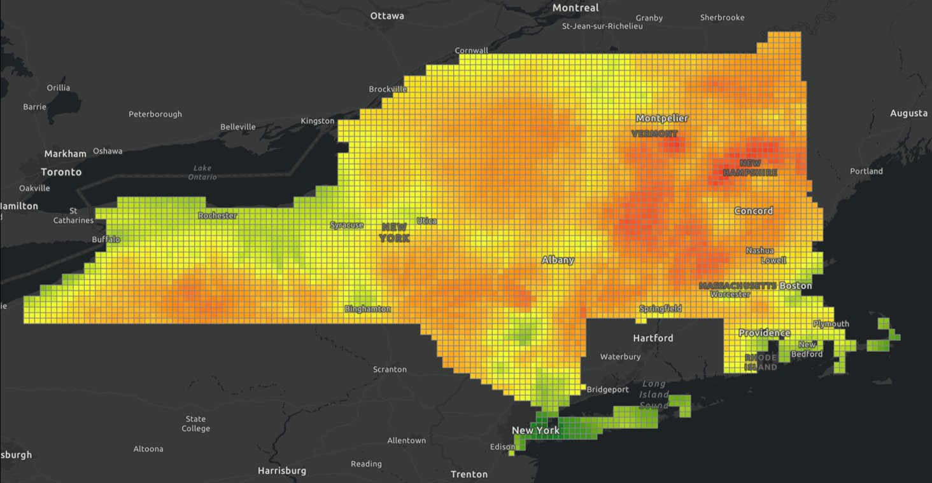
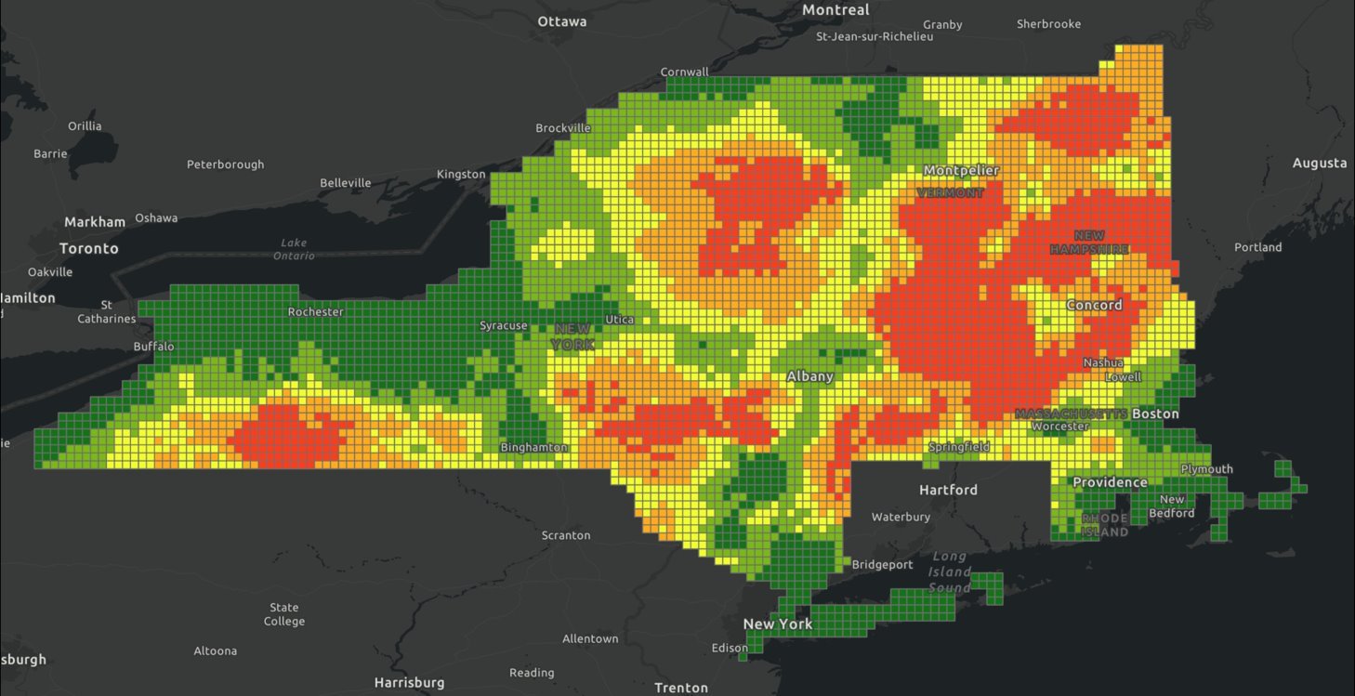
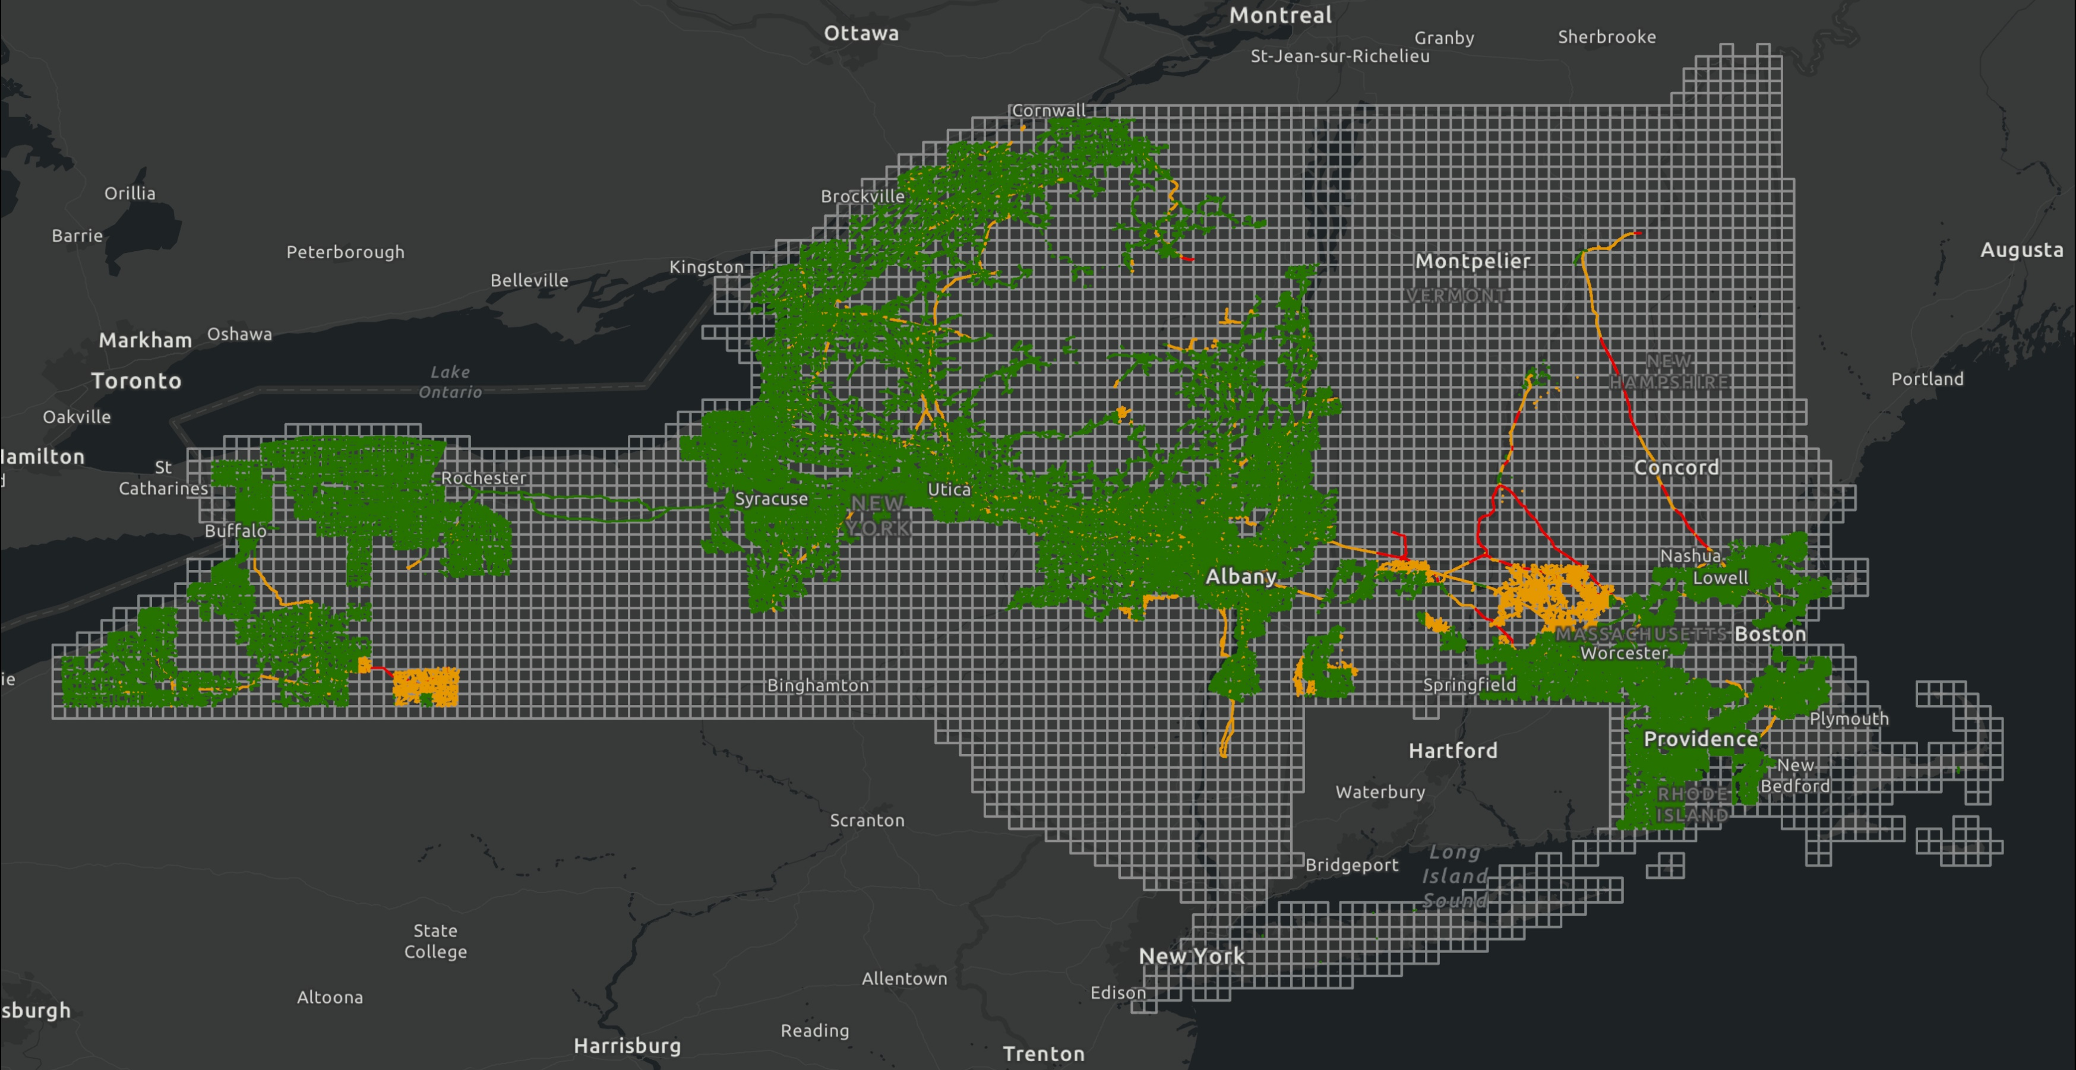
GeoPackage Data
Manipulation of the GeoPackages in GIS software programs allows users to interrogate the data in many ways, tailored to the particular questions and interests they may have.
(a) bespoke interaction with climate hazard indicators
(b) application of discrete hazard bands
(c) exploration of risk-assessed assets
(a)
(b)
(c)

Slide 25
05
Next steps

Slide 26
FY22 – 3 key focus areas
1. Business action planning
2. Climate Change Tool Development
3. External engagement

Slide 27

1. Business action planning
Each business has a quantified action plan in place by end of FY22 to mitigate their climate change risk over the next 5 years:
Considered for RIIO T2 reopeners and incorporated in RIIO T3 planning
Reported on through quarterly Climate Change Risk Steering Group

Slide 28
2. Climate Change Tool Development
CCRT successfully embedded in the business
2 degree C scenario included in UK version of tool
Socio – economic data overlayed in the tool
3. External engagement

