Slide 1



Quarterly System Entry Capacity (QSEC)
March 2017

Slide 2
Introduction
Given the long term nature of QSEC National Grid is concerned that all shippers, whether intending to bid or otherwise, take appropriate steps to inform themselves before the 2017 auction opportunity
This material is intended to be a small step in assisting this

Slide 3
Introduction
Entry Capacity Auctions – Our Role
  Schedule auctions in accordance with UNC
  Issue Invitation Letters in accordance with UNC, Licence, Transportation Charges Statement and Entry Capacity Substitution Methodology Statement
  Allocate/Reject bids in accordance with UNC, Licence, Incremental Entry Capacity Release Methodology
  Publish results – Gemini/National Grid Website
  General Auction (operational) related queries – Capacity Auction Teams, National Grid

Slide 4
Introduction
What we can do:
  Try to answer operational queries
  May give pointers on issues to consider
What we can not do:
  Give advice on bidding strategy

Slide 5
Introduction
In line with current UNC obligations National Grid plans to complete the 2017 QSEC auction (bidding) by the end of March 2017
Invitation letter issued a minimum of twenty eight calendar days before the first annual QSEC invitation date (first bid window)

Slide 6
Introduction
This information is intended to be a small step in assisting potential bidders – please do not rely solely on any information/data contained within this presentation
You should refer to the 2017 QSEC auction invitation letter published by National Grid before you intend to bid

Slide 7
Introduction
Section 1 Introduction of PARCAs
Section 2 QSEC Auction and Retainer Process process
Section 3 Incremental Release – NPV Test
Section 4 The IECR Model
Section 5 Gemini & Website Overview
Section 6 Useful Contact Information

Slide 8

Section 1
PARCAs

Slide 9
Introduction of the Planning and Advanced Reservation of Capacity Agreement (PARCAs)
On 5th December 2014 Ofgem approved UNC Modification 0465V “Introduction of the Planning and Advanced Reservation of Capacity Agreement”
On the same date Ofgem also directed changes to National Grid’s Licence to implement PARCAs
On 11th December National Grid published formal consultations on the Capacity Release Methodology Statements and Capacity methodology Statements on support of PARCAs

Slide 10
Impact of PARCAs on QSEC
The delivery of incremental capacity is now through PARCA contracts rather than capacity signals
Capacity is reserved early in the PARCA process and then allocated once all planning activities have been completed
The only incremental capacity which is available through QSEC is that which can be fully met through substitution
Substitution has a lead time of 24 months
Non-obligated capacity can still be released if the quantity of capacity requested exceeds the quantity available

Slide 11
Section 2
QSEC 2017 Auction and Retainer Process

Slide 12
Firm System Entry Capacity Definition
Entry Point Specific
Daily Access Right
  No Within-Day Profile
Specified Maximum Quantity
  Overrun Charge if Flow More at the end of the Gas Day
Firm Product
  National Grid Buys-Back if Necessary
  Shipper Pays Regardless of Use

Slide 13
Minimum Quantity Offered
Licence Driven
Long Term Auctions (Capacity Year +2 to CY+16 inclusive)
  90% of NTS Baseline plus previously offered unsold Incremental Obligated
Shorter Term Auctions
  Unsold Obligated capacity, 10% Withheld Capacity (plus unsold previously offered Incremental Obligated)

Slide 14
Firm System Entry Capacity Definition
Capacity offered for 1-Oct-18 to 30-Sep-33
Capacity offered in 3 month strips known as Sub-Transaction periods (or quarters)
2017
QSEC
Transaction Period
Mar-17
Oct-18
Oct-20
Sep-33
*IECR Applied
from here

Slide 15
Substitution Obligation
National Grid will undertake substitution process during the 2017 QSEC auction
The Entry Capacity Substitution Methodology Statement (ECS) (version 8.0) is available on the National Grid website via http://www2.nationalgrid.com/UK/Industry-information/Gas-capacity-methodologies/Entry-Capacity-Substitution-Methodology-Statement/
Substitution is the process of permanent substitution unsold baseline capacity from one of more Aggregate System Entry Point (ASEP)’s to allow release of incremental capacity at another ASEP
National Grid must consider substitution prior to investment (deemed efficient process)

Slide 16
Substitution Methodology - Retainers
Users will be able to exclude capacity at potential donor ASEPs from being treated as Substitutable Capacity without having to buy or be allocated the capacity. To do this Users are able to take out a ‘retainer’. Capacity retainers are described in paragraphs 27 to 32
A retainer reserves capacity at an ASEP for any User to obtain at a later date through either a QSEC or an Annual Monthly System Entry Capacity (AMSEC) auction(s).

Slide 17
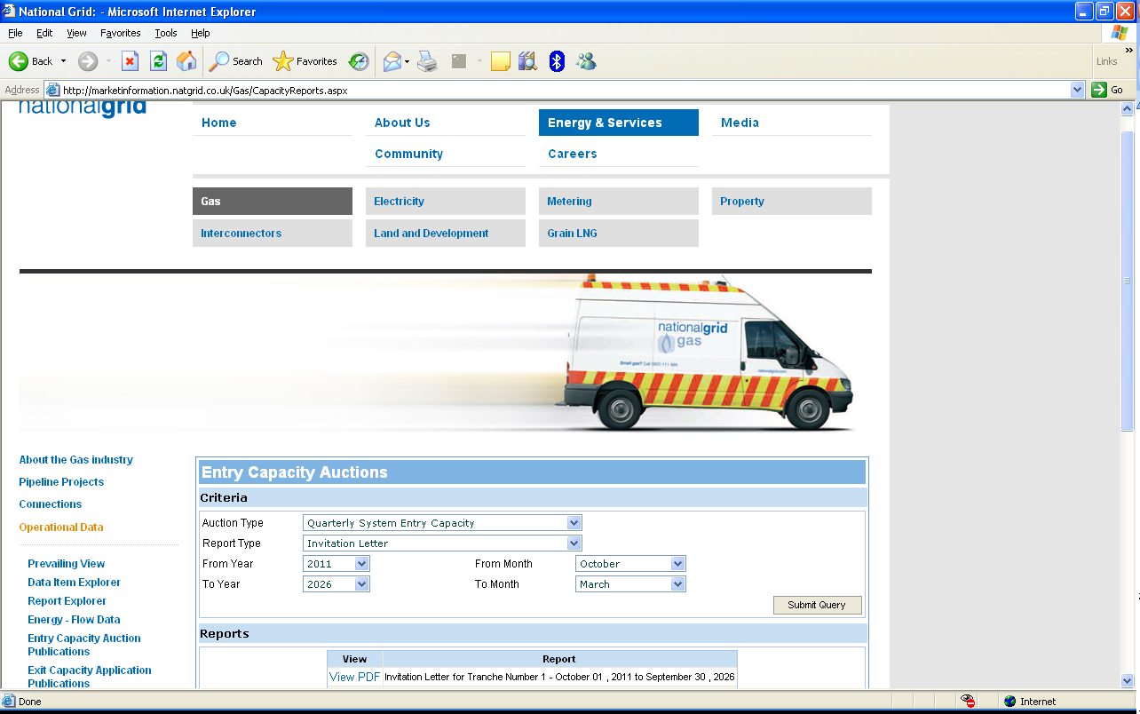
Substitution Methodology – Retainer Invitation
Retainer Invitation Notice published on the National Grid website via http://marketinformation.natgrid.co.uk/Gas/CapacityReports.aspx

Slide 18
Substitution Methodology – Retainer Invitation
Key points:
  Substitutable Capacity (kWh/day) per ASEP is published in table 1
  T&C acceptance proforma is published in appendix 1
  Retainer application form is published in appendix 2
  Terms and Conditions are published in appendix 3
Capacity retainer windows will be open 08:00 to 17:00 on both 24th and 26th January 2017
Users able to submit retainer applications during the windows via fax to +44 (0)1926 654059

Slide 19
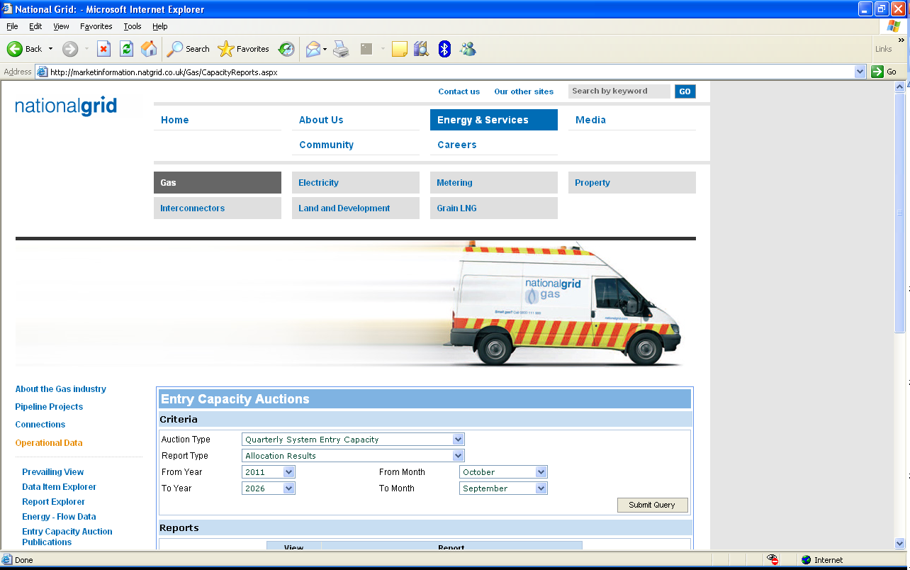
Substitution Methodology – Retention Information
By 8pm on both 24th and 26th January aggregate results will be published via the National Grid website:
For each ASEP where one or more retainers has been granted:
  The aggregate quantity covered by those retainers
  The adjusted maximum retainer quantity

Slide 20
Substitution Methodology – Retention Charges
A NTS Entry Capacity Retention Charge shall apply to any retainer agreement
The Gas Transmission Transportation Charging Statement is published via http://www2.nationalgrid.com/UK/Industry-information/System-charges/gas-transmission/charging-statements/
In accordance with the Gas Transmission Transportation Charging Statement a charge rate of 0.2922p/kWh applies to all granted retainers at all ASEPs
The retention charge will be payable via an ad-hoc invoice raised within two months of the QSEC auction allocations being confirmed; i.e. in July for a March auction

Slide 21
Substitution Methodology – Retention Charge Refunds
A retainer is intended to retain capacity at an ASEP for Users to obtain at a later date
If retained capacity is subsequently booked at the ASEP where the retainer was taken out, the charge may be refunded. Conversely, in the event that the retained capacity is not obtained later the charge would not be refunded

Slide 22
QSEC – Uniform Network Code Obligations
Prior to the auction date:
  Publish the reserve and incremental prices 60 days before the first day of the auction.
    Published by the Transmission Charging & Revenue team. See the Statement of Gas Transmission Transportation Charges’ published 20th January 2017.
  Invitation issued 28 days before the first day of the auction and specifies information in line with UNC Section B 2.2

Slide 23
QSEC Auction Invitation Letter – Content
The QSEC auction invitation letter includes:
  The dates of the interim bid windows
  The available NTS Entry Capacity for each ASEP (kWh/Day)
    Baseline at reserve price
    Incremental NTS Entry Capacity
  The reserve price for each ASEP (p/kWh/Day)
  The incremental step prices for each ASEP (p/kWh/Day)

Slide 24
QSEC Process
Demand driven price
10 business day bid window (interim bid windows)
Bids posted / modified / withdrawn 08:00 to 17:00 each day
Auction can close early if prices stabilise
National Grid publishes up to 21 price steps at each ASEP
Shippers bid volume

Slide 25
QSEC Bid Capture Rules
Shipper set-up validation (shipper preferences)
Minimum bid quantity of 100,000 kWh
Bids at higher price must have lower or equal volume to those at lower prices

Slide 26
QSEC Interim-bid-window processes
Information published after 17:00 each day:
  Aggregate bid quantities at each price step for each quarter and ASEP
  The prevailing Stability Group for each ASEP/quarter.

Slide 27
QSEC Stability Measure
QSEC auction can close early if Stability Groups remain unchanged between interim bid windows
If the Stability Group changes 4 times or less between two bid windows at any quarter/ASEP combination then the auction has reached stability and will close. Users will be notified in this event. (UNC TPD B2.2.19)

Slide 28
Price Steps & Quantities
Baseline Defined in Licence
Price Step (P₀) - Unsold 90% Baseline + any unsold obligated incremental
  From Transportation Model
Price Steps (P₁ to P₂₀) – Incremental capacity available
  From Transportation Model
  Up to 150% of baseline capacity
Incremental prices for each (P₁ to P₂₀) are based on the long run incremental cost of providing additional capacity above obligated level

Slide 29
QSEC Auction Summary – Allocation Rules
Where demand is less than or equal to supply at price step P0 all bids will be allocated in full.
In respect of any ASEP where a quantity of incremental capacity is demanded, National Grid will determine the net present value (NPV) of the revenue from bids for the incremental capacity (based on relevant cleared price for each quarter)
Determine supply volume. Actual Available NTS Entry Capacity – UNC TPD Section B 2.6.5.
If aggregate bids exceed supply volume at supply level price step, move up demand curve to find first price step where demand is < = to supply level (this is the cleared price)
Pro-ration occurs at P20 if aggregate bids at P20 level exceed supply level

Slide 30
Allocation Exceptions
If the total bid quantity allocated is less than the minimum bid quantity demanded then the bid will be rejected.
If all bids at a price level are rejected due to (i) above then move down a price level and apply allocation rules again.
The difference between the allocations at the allocation price level and the available capacity at the available supply price level is identified as Unsold Capacity for each ASEP and Sub Transaction Period.

Slide 31
At Baseline, Demand Less Than Supply
Supply
Demand
Max Bid
Available
Price
Price
Capacity
(kWh)
Step
(p/kWh)
(kWh)
Cleared Price = P₀
All bidders pay 0.0198p/kWh
Allocation = 1341kWh/day
Unsold = 1kWh
1532
P
5
0.0229
1263
1494
P
4
0.0222
1223
1456
P
3
0.0214
1286
1418
P
2
0.0212
1318
1380
P
1
0.0204
1341
1342
P
0
0.0198
1341

Slide 32
At Baseline, Demand Exceeds Supply
Supply
Demand
Max Bid
Available
Price
Price
Capacity
(kWh)
Step
(p/kWh)
(kWh)
Cleared Price = P4
All bidders pay 0.0222p/kWh
Allocation = 1286kWh/day
Unsold = 56kWh
1532
P
0.0229
1223
5
1494
P
0.0222
1286
4
1456
P
0.0214
1386
3
1418
P
0.0212
1471
2
1380
P
0.0204
1498
1
1342
P
0.0198
1596
0

Slide 33
QSEC Auction Summary –
Post Allocation Reporting
National Grid allocate QSEC bids no later than two months following the date of auction closure, after which:
Will notify Users (within Gemini) of
  Accepted quarterly capacity bids
  Amount of Quarterly NTS Entry Capacity which the User is registered as holding

Slide 34
QSEC Auction Summary –
Post Allocation Reporting
Publish to all by Entry Point and Sub Transaction period the following:
    Volume of entry capacity allocated (baseline and incremental)
    The relevant clearing price
    Total amount of revenue to be derived
    Highest price accepted
    Lowest price accepted
    Weighted average price accepted
    The number of users that submitted successful bids
    The amount of obligated capacity which remains unsold

Slide 35
Section 3
Incremental Entry Capacity Release – NPV Test

Slide 36
Published Information
Available from the website
  http://www2.nationalgrid.com/UK/Industry-information/Gas-capacity-methodologies/Entry-Capacity-Release-Methodology-Statement/
  V3.0 effective from 1st November 2015
IECR Model
  Published on a best endeavours basis* (http://www2.nationalgrid.com/UK/Industry-information/Gas-transmission-system-operations/Capacity/Entry-capacity/)
  Allows shippers to conduct “what if” scenarios
  We may amend the model if we consider it necessary to conform to Licence / UNC and reserve the right to do so
  * We do not keep the version on the website continually up to date. It is retained there for assistance and updated in time for each auction and in line with latest changes. In particular the model that is published might not be the one that National Grid uses to assess incremental signals.

Slide 37
IECR Methodology
The basic outline of the IECR methodology is as follows:
Identify if a possible trigger level exists. This is the first quarter where the aggregated bids at a price step match or exceed the quantity on offer above the base quantity.
Observe the incremental bid quantities in the subsequent 31 quarters and allocate a quantity in each quarter at the lowest price step where demand is less than or equal to the trigger level quantity being assessed.

Slide 38
IECR Methodology (cont.)
Note the clearing price and calculate the associated incremental revenue for each quarter.
Conduct the NPV test across the revenue received in all 32 quarters (assuming at least 8 of the 32 quarters contain incremental bids) to determine if obligated incremental entry capacity will be released.

Slide 39
IECR Worked Example
Sample data used is from NPV example in IECR Methodology.
Step P₃ is highlighted (130GWh) as this will be the example trigger level.
Available (GWh) | Price Step | Price (p/kWh/day) | Estimated Project Value (£m)
150 | P₅ | 0.06 | 20
140 | P₄ | 0.05 | 16
130 | P₃ | 0.04 | 12
120 | P₂ | 0.03 | 8
110 | P₁ | 0.02 | 4
100 | P₀ | 0.01 | 0

Slide 40
IECR (1) - Identify a Possible Trigger Level
For each quarter, the trigger level is the highest price step where demand ≥ supply (i.e. aggregated bids ≥ offered quantity above p0)
This definition assumes that the bid quantities will descend as the price steps increase.

Slide 41
IECR (1) - Identify a Possible Trigger Level
The following table contains bids received for a selection of quarters Q1 and Q2 ignored as they contained no trigger points (Q3 contains the first trigger point).
Identify the highest price step for which demand ≥ supply.
Available (GWh) | Price Step | Price (p/kWh/day) | Q3 | Q4 | Q5 |  | Q9 |  | Q34
150 | P₅ | 0.06 | 120 | 120 | 110 | … | 100 | … | 100
140 | P₄ | 0.05 | 120 | 120 | 110 | … | 100 | … | 100
130 | P₃ | 0.04 | 130 | 130 | 120 | … | 100 | … | 100
120 | P₂ | 0.03 | 135 | 135 | 120 | … | 110 | … | 100
110 | P₁ | 0.02 | 140 | 135 | 130 | … | 120 | … | 100
100 | P₀ | 0.01 | 145 | 140 | 131 | … | 131 | … | 100

Slide 42
IECR (2) - Provisional Allocations
For each quarter determine the lowest price step where demand ≤ supply (i.e. aggregated bids ≤ offered quantity)
The clearing price for each quarter is equal to the price step associated with each allocated quantity.
Incremental revenue is calculated directly from the allocation and clearing price.

Slide 43
IECR (2) - Provisional Allocations
Provisionally allocate at lowest step where demand ≤ 130
Look to allocate as much demand as possible at the lowest price, up to the limit of the step being assessed (in this case, 130).
Available (GWh) | Price Step | Price (p/kWh/day) | Q3 | Q4 | Q5 |  | Q9 |  | Q34
150 | P₅ | 0.06 | 120 | 120 | 110 | … | 100 | … | 100
140 | P₄ | 0.05 | 120 | 120 | 110 | … | 100 | … | 100
130 | P₃ | 0.04 | 130 | 130 | 120 | … | 100 | … | 100
120 | P₂ | 0.03 | 135 | 135 | 120 | … | 110 | … | 100
110 | P₁ | 0.02 | 140 | 135 | 130 | … | 120 | … | 100
100 | P₀ | 0.01 | 145 | 140 | 131 | … | 131 | … | 100

Slide 44
IECR (3) – Determine Clearing
Prices & Calculate Revenue
Clearing prices are determined from the provisionally allocated quantities previously identified.
Revenue is calculated for 32 quarters (Q3 – Q34) so that the NPV of this revenue can be calculated over this time period.
(a) × (b) × (c)
100
Revenue =
 | Q3 | Q4 | Q5 |  | Q9 |  | Q34
Capacity to Release (a) | 30 | 30 | 30 | … | 20 | … | 0
Clearing Price (b) | 0.04 | 0.04 | 0.02 | … | 0.02 | … | 0
Days per Quarter (c) | 92 | 91 | 91 | … | 91 | … | 91
Incremental Revenue | 1.10 | 1.09 | 0.55 | … | 0.36 | … | 0

Slide 45
IECR (4) – NPV Test
Test if the net present value (NPV) of the future revenue from release of the identified trigger level is greater than 50% of the value of the project required to physically provide the trigger level capacity.
NPV is calculated over 32 quarters (including the release quarter) as defined in the IECR methodology statement.
If the test fails, then the provisional allocations, associated clearing prices and revenues for the next lowest price step (in the example 120GWh @ P₂) are calculated and subjected to the NPV test.

Slide 46
IECR (4) – NPV Test
From the example:
NPV of revenues = £6.1m
50% of project value to release 30GWh of incremental capacity = £6m
Therefore 6.1 > 6 → NPV test passed ü
 | Q3 | Q4 | Q5 |  | Q9 |  | Q34
Capacity to Release (a) | 30 | 30 | 30 | … | 20 | … | 0
Clearing Price (b) | 0.04 | 0.04 | 0.02 | … | 0.02 | … | 0
Days per Quarter (c) | 92 | 91 | 91 | … | 91 | … | 91
Incremental Revenue | 1.10 | 1.09 | 0.55 | … | 0.36 | … | 0

Slide 47
IECR (4) – NPV Test
If no trigger levels are found or none of those that are found pass the NPV test, then the next quarter is subjected to the entire process and the cycle will continue until every step of every quarter has been tested for an incremental signal.

Slide 48
Section 4
The IECR Model

Slide 49
Basic IECR Model Process
Identify if demand exists for incremental capacity at an ASEP.
Compare the Net Present Value (NPV) of the revenue associated with the incremental capacity to the estimated value of the investment required.
If the NPV of the revenue associated with the incremental capacity is more than half the project value (required investment), National Grid will seek approval to designate the incremental capacity as obligated incremental entry capacity, as defined by the Licence.

Slide 50
Changes in 2016
No major model process changes for 2017.
When published, the version for 2017 will be:
  Updated for new baselines and price steps.
  Updated with latest sold quantities.
All latest data loaded into the model has been audited to ensure accuracy and consistency.
(NOTE: IECR Methodology Statement recently amended to correct the NPV test example in Appendix 2.)

Slide 51
Limitations Of Current Model
Minimum Bids
  The model does not automatically deal with pro-rated bids that fall below the minimum bid
  These need to be removed manually

Slide 52
How to use the IECR Model
Part A: What the Model Does

Slide 53
IECR Model: High Level Process
Flow
Start at Quarter 1
Go to highest price step
Move to next quarter
Compare demand with supply
Record price signal & Incremental
YES
Demand Signal?
Compare NPV to 50% project value
YES
Price Signal?
NO
NO
Go to next price step down
Record demand signal

Slide 54
How to use the IECR Model
Part B: Finding Your Way Around

Slide 55
Model Worksheets
Model Control and Data
  Control
  Auction Result
  Licence Info
Model Outputs
  Permanent
  Demand
  Final Demand

Slide 56
Model Worksheets
Control
  Main control sheet allows running of the model
  Contains general parameters
    NPV Test parameters
    Baseline Data Tables
Auction Results
  Holds aggregate bid stacks by ASEP
Licence Information
  Holds capacity data (baseline and incremental)

Slide 57
Output Worksheets
These worksheets are created when the model is run by the user
Permanent
  Lists the quarters for which the NPV test has been passed
Demand
  Lists the quarters and steps for which demand exceeds supply (trigger levels), but the NPV test has not been passed
Final Demand
  Provides a table and chart of the capacity offered (including new incremental), capacity allocated, the price step and clearing price

Slide 58
How to use the IECR Model
Part C: Running the Model

Slide 59
Running the Model
Select an ASEP from the drop down list on the Control sheet
Go to the Auction Result sheet
  Enter an Auction Identifier
  Enter a bid stack in the cells that relate to the selected ASEP
Go back to the Control sheet
  Click on the IECR for Single ASEP button to generate the Permanent and Demand sheets
  Click on the Provisional Clearing Levels for Single ASEP button to generate the Final Demand sheet

Slide 60
Entering a Bid Stack
The bid stack needs to be entered in GWh in the range for the ASEP being examined
Bids need to take account of:
  The capacity under (90% of) baseline that is still unsold
  The size of the price steps associated with the ASEP
  The first quarter that incremental capacity will be released
  The NPV test is only applied across 32 quarters (8 years)
The model assumes that bids follow Gemini rules
  E.g. the quantity at price step P_{x+1} should not exceed the quantity at price step P_{x}

Slide 61
Example Output – Permanent sheet
NPV test passed in one quarter

Slide 62
Interpreting Results
The Permanent worksheet lists every quarter for which the NPV test has been passed
‘Inc. Volume Released’ is the highest step for which the NPV test has been passed
  Not necessarily the full amount that has been bid for
‘NPV of bids’ and the ‘NPV needed’ (to pass the test) are shown for comparison
The NPV test only needs to be passed in one quarter for the investment signal to be triggered

Slide 63
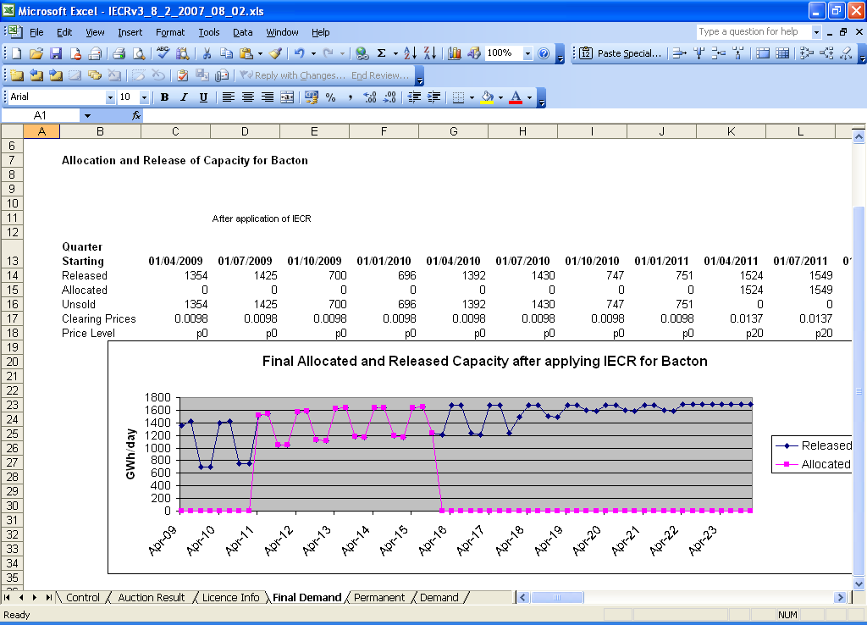
Example Output – Final Demand sheet
The bid stack needs to be entered in GWh in the range for the ASEP being examined

Slide 64
Support
The IECR model is provided voluntarily
We do not guarantee that the version we publish will be the version used to analyse investment signals
  However we expect that changes will be limited to bug fixes or corrections
Support is on a ‘best endeavours’ basis and is limited to the functionality of the model itself
National Grid cannot advise on bidding strategies

Slide 65
Section 5
Gemini and Website Overview

Slide 66
Overview of Bid Capture – Bidding Rules
Quarterly Firm NTS Entry Capacity
  Applied/registered by a User for each Day in a particular calendar quarter. UNC TPD B2.1.4(a)
User bid must specify:
  User ID / BA Code
  ASEP
  Calendar year & quarter
  Amount¹ (kWh/Day)
  Minimum amount¹
  Price level² (Step price i.e. P1) UNC TPD B2.2.6 (a-f)
¹Not less than the minimum eligible amount
²As set out in NG NTS’s Transportation Statement

Slide 67
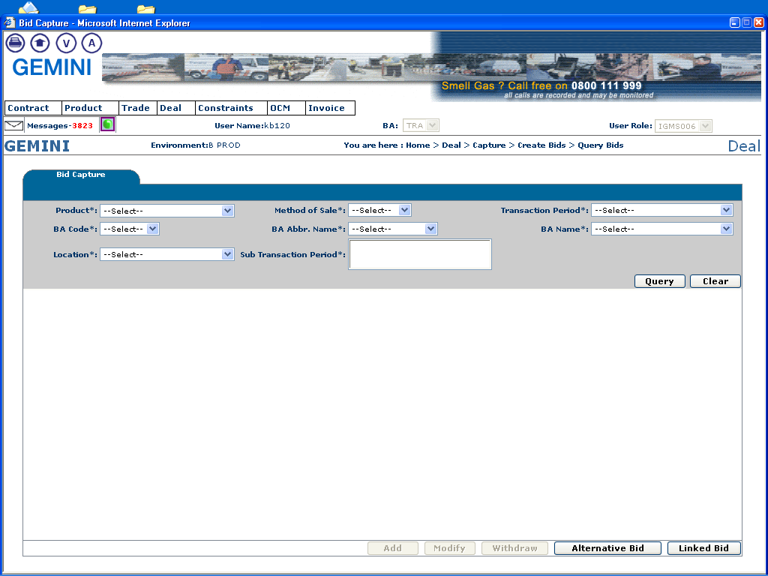
Overview of Bid Capture – Adding Bids
Home>Deal>Capture>Create Bids
  Ensure that the appropriate product, location and sub-transaction have been selected before entering a bid.
When these fields have been entered Gemini will allow the User to click on this button to add a bid.

Slide 68
Overview of Bid Capture – Modifying Bids
Home>Deal>Capture>Create Bids
When these fields have been entered Gemini will allow the User to click on this button to modify a bid.

Slide 69
Overview of Bid Capture – Modifying Bids
Home>Deal>Capture>Create Bids
When these fields have been entered Gemini will allow the User to click on this button to withdraw a bid.

Slide 70
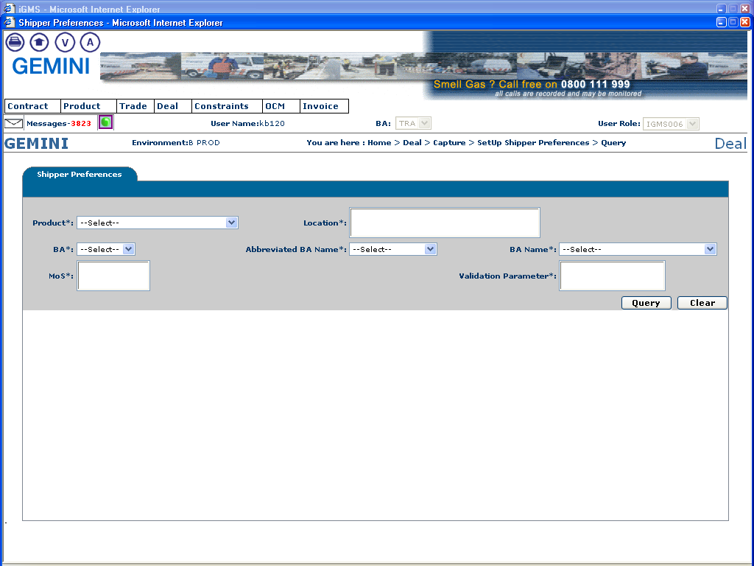
Overview of Bid Capture – Modifying Bids
Home>Deal>Capture>Set Up Shipper Preferences
  This allows the User to specify their own validation limits (both upper and lower) for capacity, price and value of a bid. Users should also be able to specify their limits for a combination of methods of sale (i.e. QSEC) and locations (ASEPs).
When these fields have been entered Gemini will allow the User to set or query their own preferences.

Slide 71
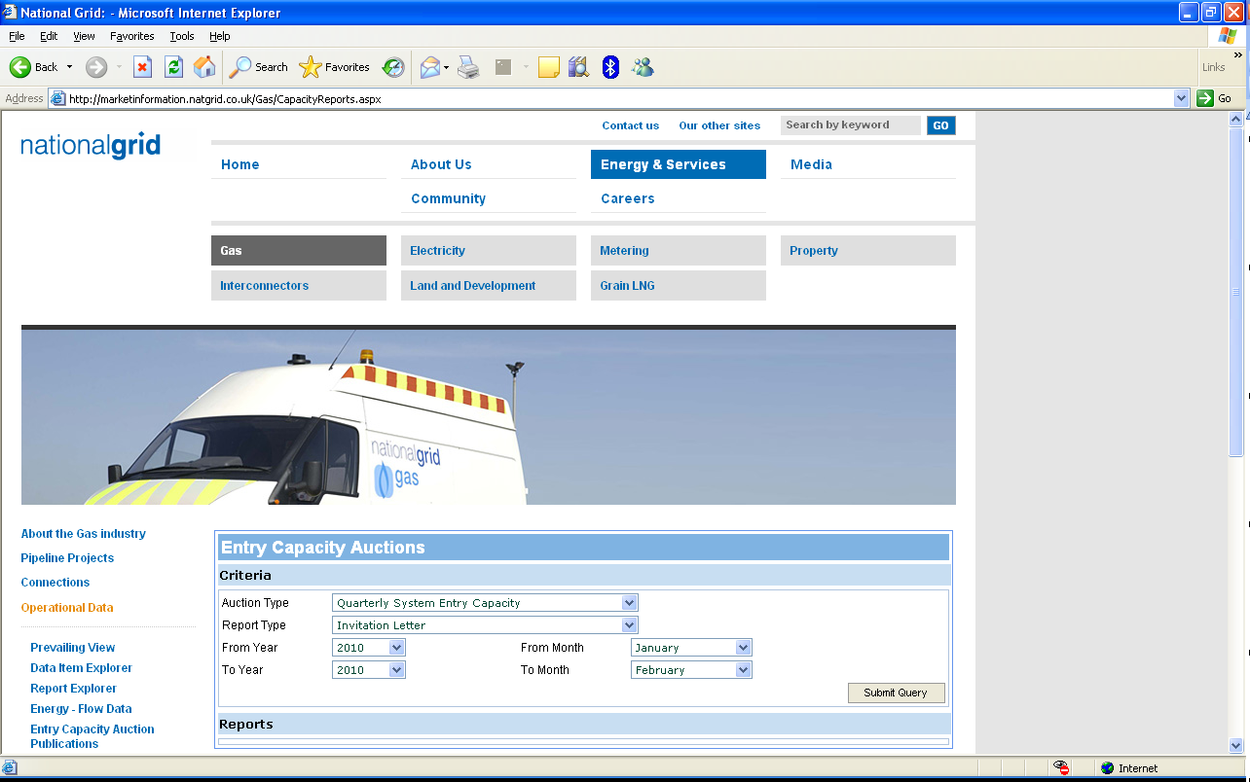
QSEC Invitation Letter
The QSEC invitation letter is issued
  Via email from Energy Network Association
  Faxed using National Grid’s ANS process
  In PDF format on National Grid’s website http://marketinformation.natgrid.co.uk/Gas/CapacityReports.aspx
  Select ‘Quarterly System Entry Capacity’ and ‘Invitation Letter’

Slide 72
Interim Bid Window Results - Gemini
After each IBW National Grid will notify Gemini Users of the cumulative amounts of Quarterly NTS Entry Capacity, no later than 20:00 hours
UNC TPD B2.14.1
  A Users submitted Quarterly capacity bids (in aggregate)
  At each price step, on such and earlier invitation dates, for each relevant Capacity Year.

Slide 73
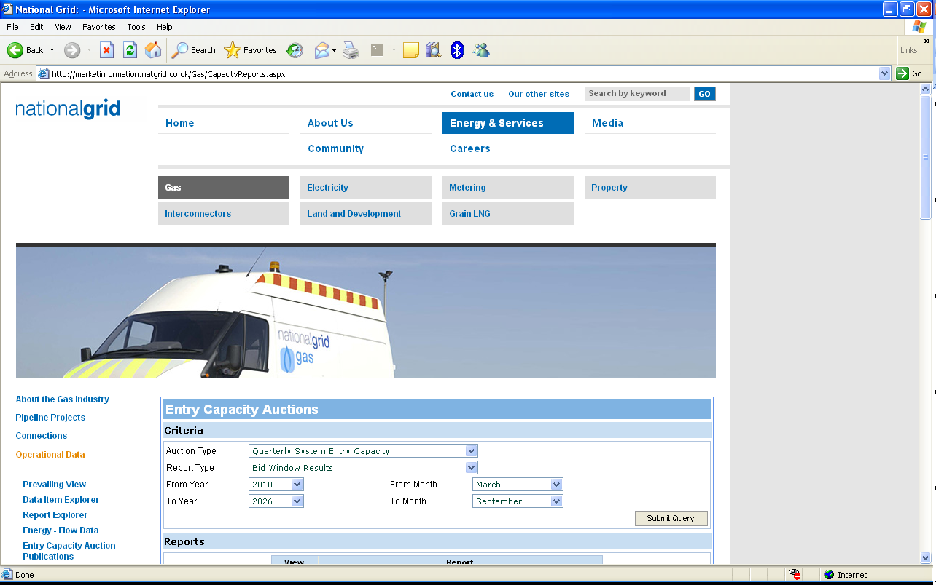
Interim Bid Window Results - Website
IBW Reports available in CSV & PDF format
  http://marketinformation.natgrid.co.uk/Gas/CapacityReports.aspx (select ‘Quarterly System Entry Capacity’ and ‘Bid Window Results’)

Slide 74
Allocation Results - Gemini
After allocation National Grid will notify Gemini Users of the following:
  By Entry Point and by quarter publish the following:
    Volume of entry capacity allocated (baseline and incremental)
    The relevant step price group
    Total amount of revenue to be derived
    Highest price accepted
    Lowest price accepted
    Weighted average price accepted
    The number of users that submitted successful bids
    The amount of obligated capacity which remains unsold
UNC TPD B2.14.2

Slide 75
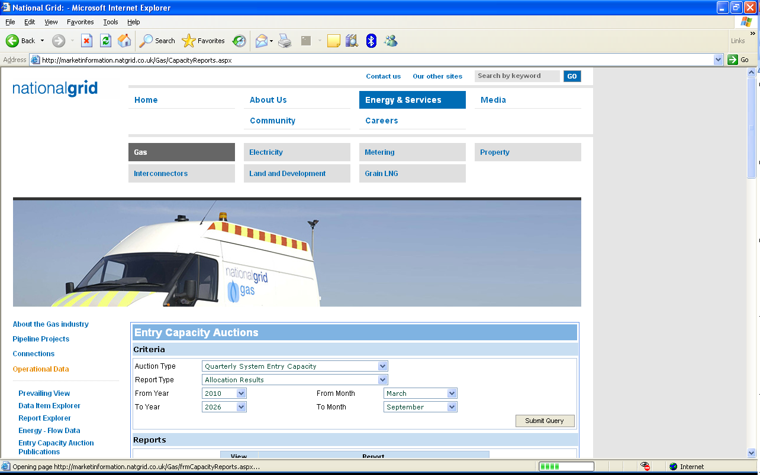
Allocation Results - Website
Report available in CSV & PDF format
  http://marketinformation.natgrid.co.uk/Gas/CapacityReports.aspx (select ‘Quarterly System Entry Capacity’ and ‘Allocation Results’)

Slide 76
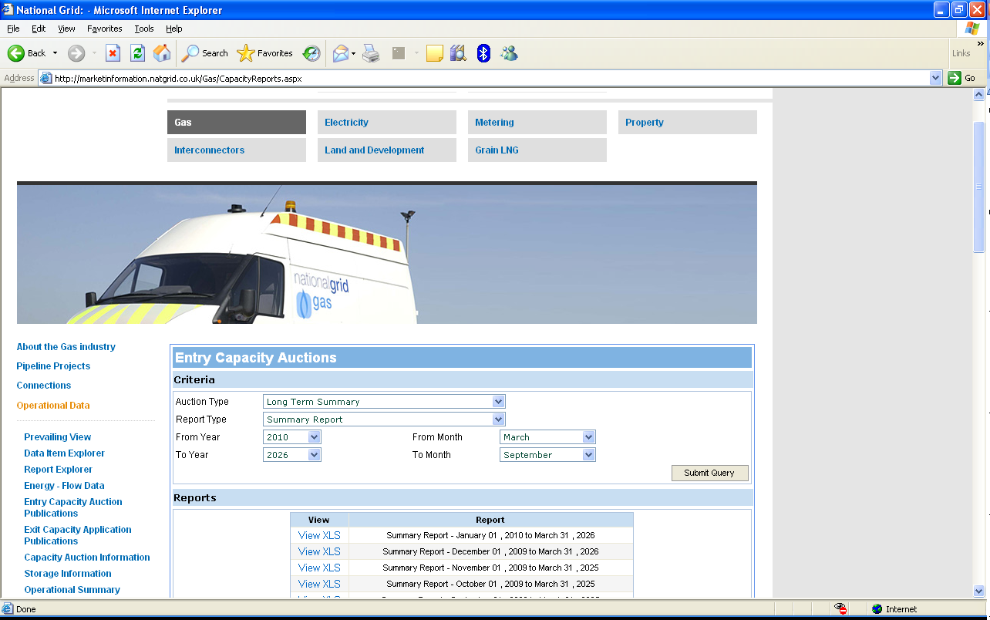
Long Term Capacity Summary Report
Website
    http://marketinformation.natgrid.co.uk/Gas/CapacityReports.aspx

Slide 77
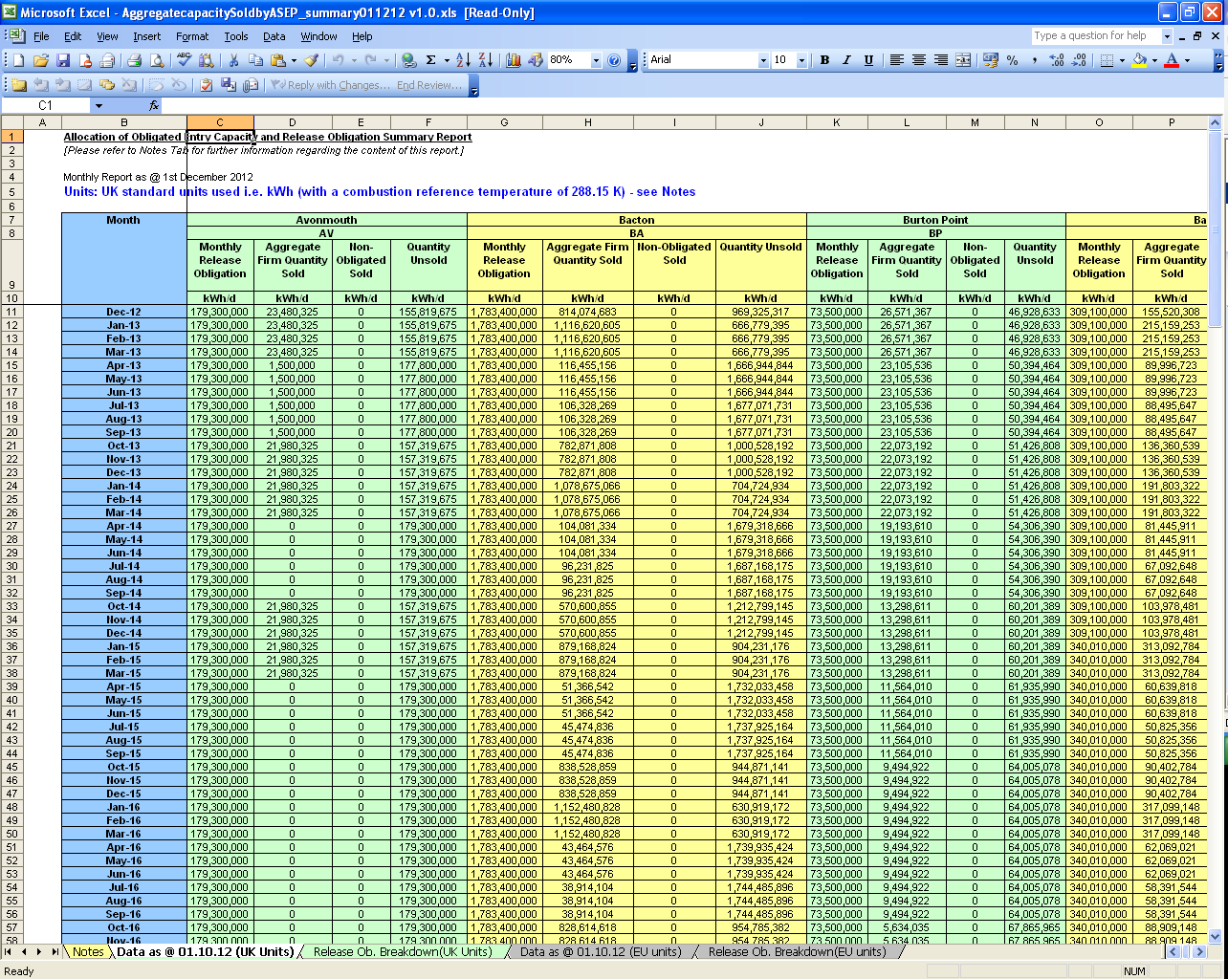
Long Term Capacity Summary Report
This report is updated on the first working day of each month and shows the Quarterly and Monthly NTS Entry Capacity sold and available in the QSEC, AMSEC and RMTNTSEC auctions.

Slide 78
Section 6
Useful Contact Information

Slide 79
Useful Contact Information –
National Grid Long Term Entry
Capacity Auctions
Long Term Entry Capacity Auctions (inc. RMTNTSEC)
  Bradley Charles Senior Capacity Auction Analyst
  Sarah Wheeler Capacity Auction Analyst
IECR Model
  Jon Dutton Gas Network Capability Manager
Team contact numbers:
  tel: +44 (0)1926 654057 fax: +44 (0)1926 654059
Team email address:
capacityauctions@nationalgrid.com

Slide 80
Useful Contact Information –
National Grid Contacts
Modifications
  Jenny Phillips (jenny.philips@nationalgrid.com)
    Gas Capacity and Charging Manager
New Entry Points – Gas Connections Team
  Jon Twomey, Gas Customer Manager (john.twomey@nationalgrid.com)

Slide 81
Useful Contact Information – xoserve
For Gemini E-Training contact
  Customer Lifecycle Team
    Email: customerlifecycle.spa@xoserve.com
Website
  www.xoserve.com

Slide 82
Useful Contact Information – Joint Office
Publish Industry Information Customer Lifecycle Team
    UNC mod proposals affecting QSEC auction
    QSEC Invitation Letter
    Website - www.gasgovance.co.uk
    Contact Telephone Number
      +44(0)121 623 2115

