Slide 1

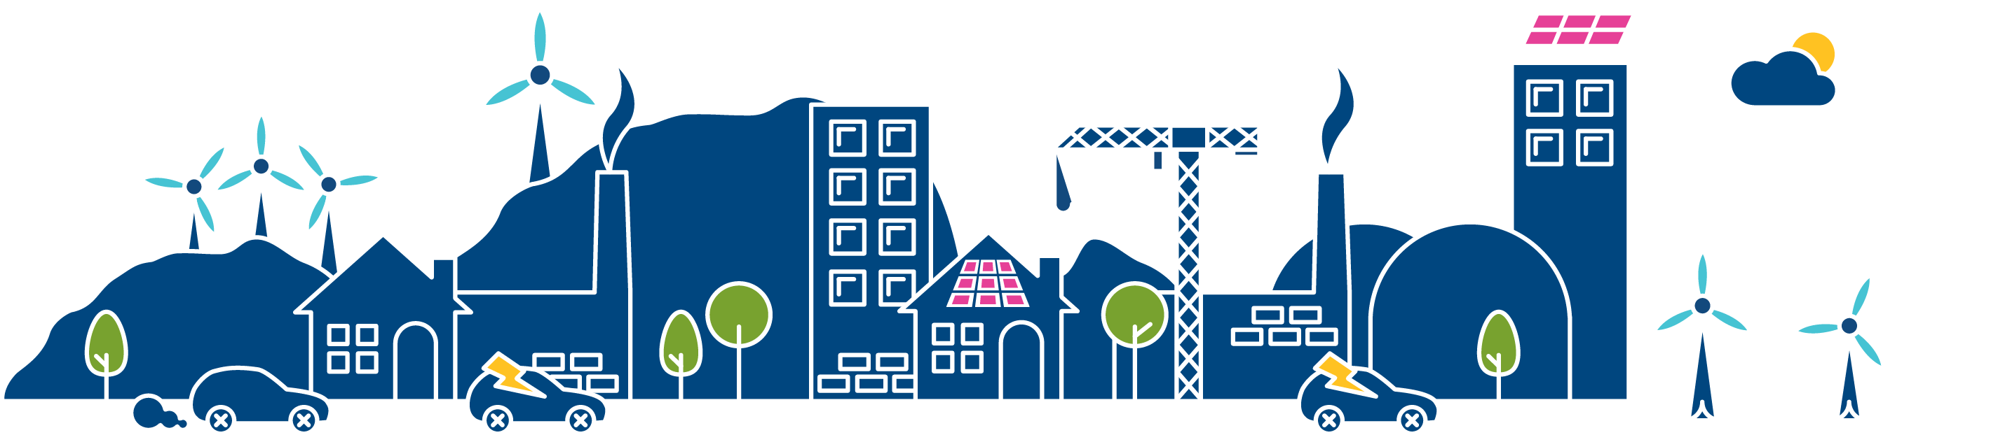
Future Energy Scenarios 2015
Overview
Nigel Fox
Strategy Development Manager

Slide 2
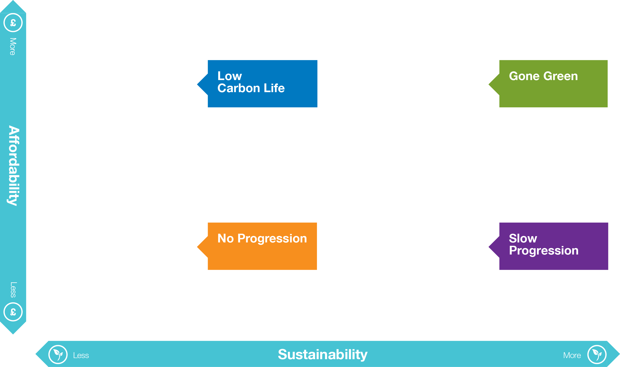
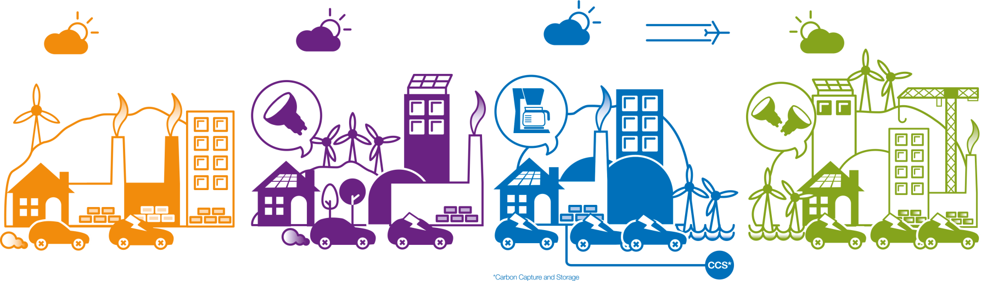

Looking back to 2014
Notes:
Looking back to last year, Stakeholders were positive about our 2014 scenarios and the majority suggested only minor changes.
The energy trilemma was used as the foundation for our work. Many stakeholders found this useful to provide a common narrative across the industry so it continues to be the basis of our analysis in 2015.
We presented our scenarios in a 2x2 matrix, and this approach received strong positive feedback. In 2014, Sustainability and Affordability were used as the axes descriptions and some stakeholders felt this could be clearer. For 2015, we have revised the axes to Green Ambition and Prosperity.
The most noticeable change has been to our Low Carbon Life scenario. Stakeholders told us it was difficult to understand as there were underlying inconsistencies in the rationale which made up the results. For 2015 we have re-worked this scenario, renaming it Consumer Power.

Slide 3
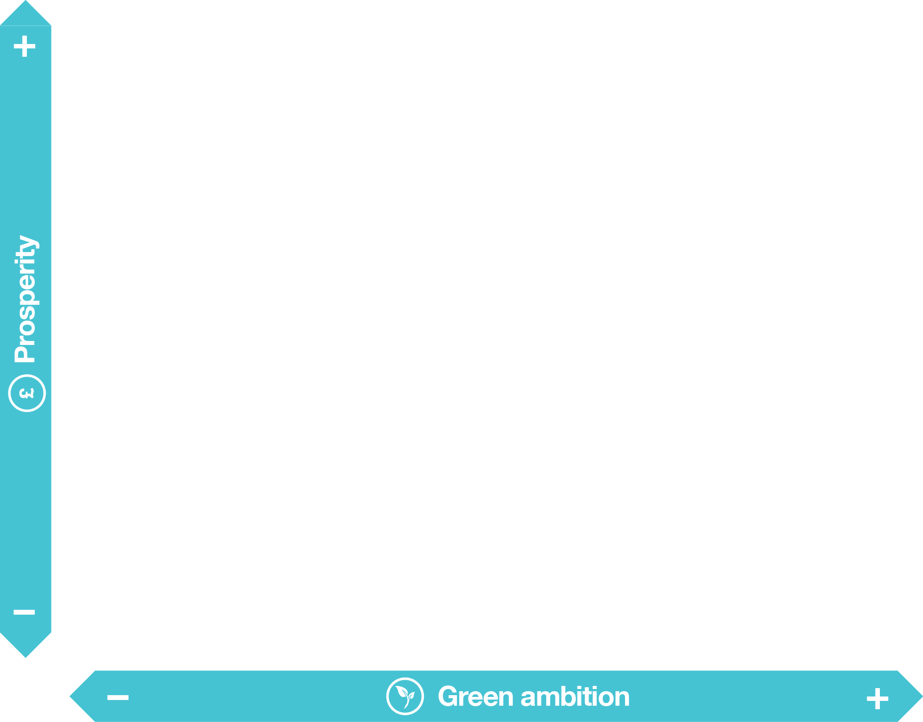
The 2015 scenarios
Evolution not revolution
Notes:
So in summary these are our 2015 scenarios…
Consumer Power - a world of relative wealth, fast paced research & development, and spending. Innovation is focused on meeting the desire of the consumer, who concentrates on improving their quality of life.
Gone Green - a world where green ambition is not restrained by financial limitations, there is strong policy and regulation enabling all carbon targets to be met.
Slow Progression – a world where slower economic growth restricts market conditions. Money that is available is spent focusing on low cost long term solutions to achieve decarbonisation….and
No Progression - a world focused on achieving security of supply at the lowest possible cost

Slide 4


No Progression
Low economic growth and inconsistent political signals with a lack of focus on environmental policies
Electricity prices are low
Notes:
This is a world of low economic growth and inconsistent political signals with a lack of focus on environmental policies.
Society is cost conscious and focused on the here and now
What limited innovation there is is focused on technology with high returns, hindering biomethane production and limiting shale gas developments.
Traditional forms of generation prevail.

Slide 5




No Progression
Focused on cost
Petrol vehicles
Keep appliances
Focus on the here and now
Notes:
As a Residential user…
Your primary driver is cost. You don’t spend time and money on green technologies.
Because of a lack of policy support, you don’t see many energy efficient products on sale and you choose to continue with the goods you know and trust.
You don’t replace your car or appliances unless they break and you are not engaged with smart meters or TOUTs.
You’ve still got your trusty gas boiler and if it breaks you’ll buy another one.
If you are looking for a new home you don’t seek out improved energy efficiency ratings and you have no idea what a Heat Pump is.
For the Industrial and Commercial user…
There’s no significant change for you because of the slow economic growth and inconsistent government policies
You have little inclination to switch to low carbon or renewable sources of energy, and the lack of innovation in these sectors means prices for this technology remain high
Because electricity prices are low, there are few incentives to reduce your energy use
As such you see no reason to upgrade your lighting, nor would you feel inclined to play in the demand side response market, even if it is available.

Slide 6
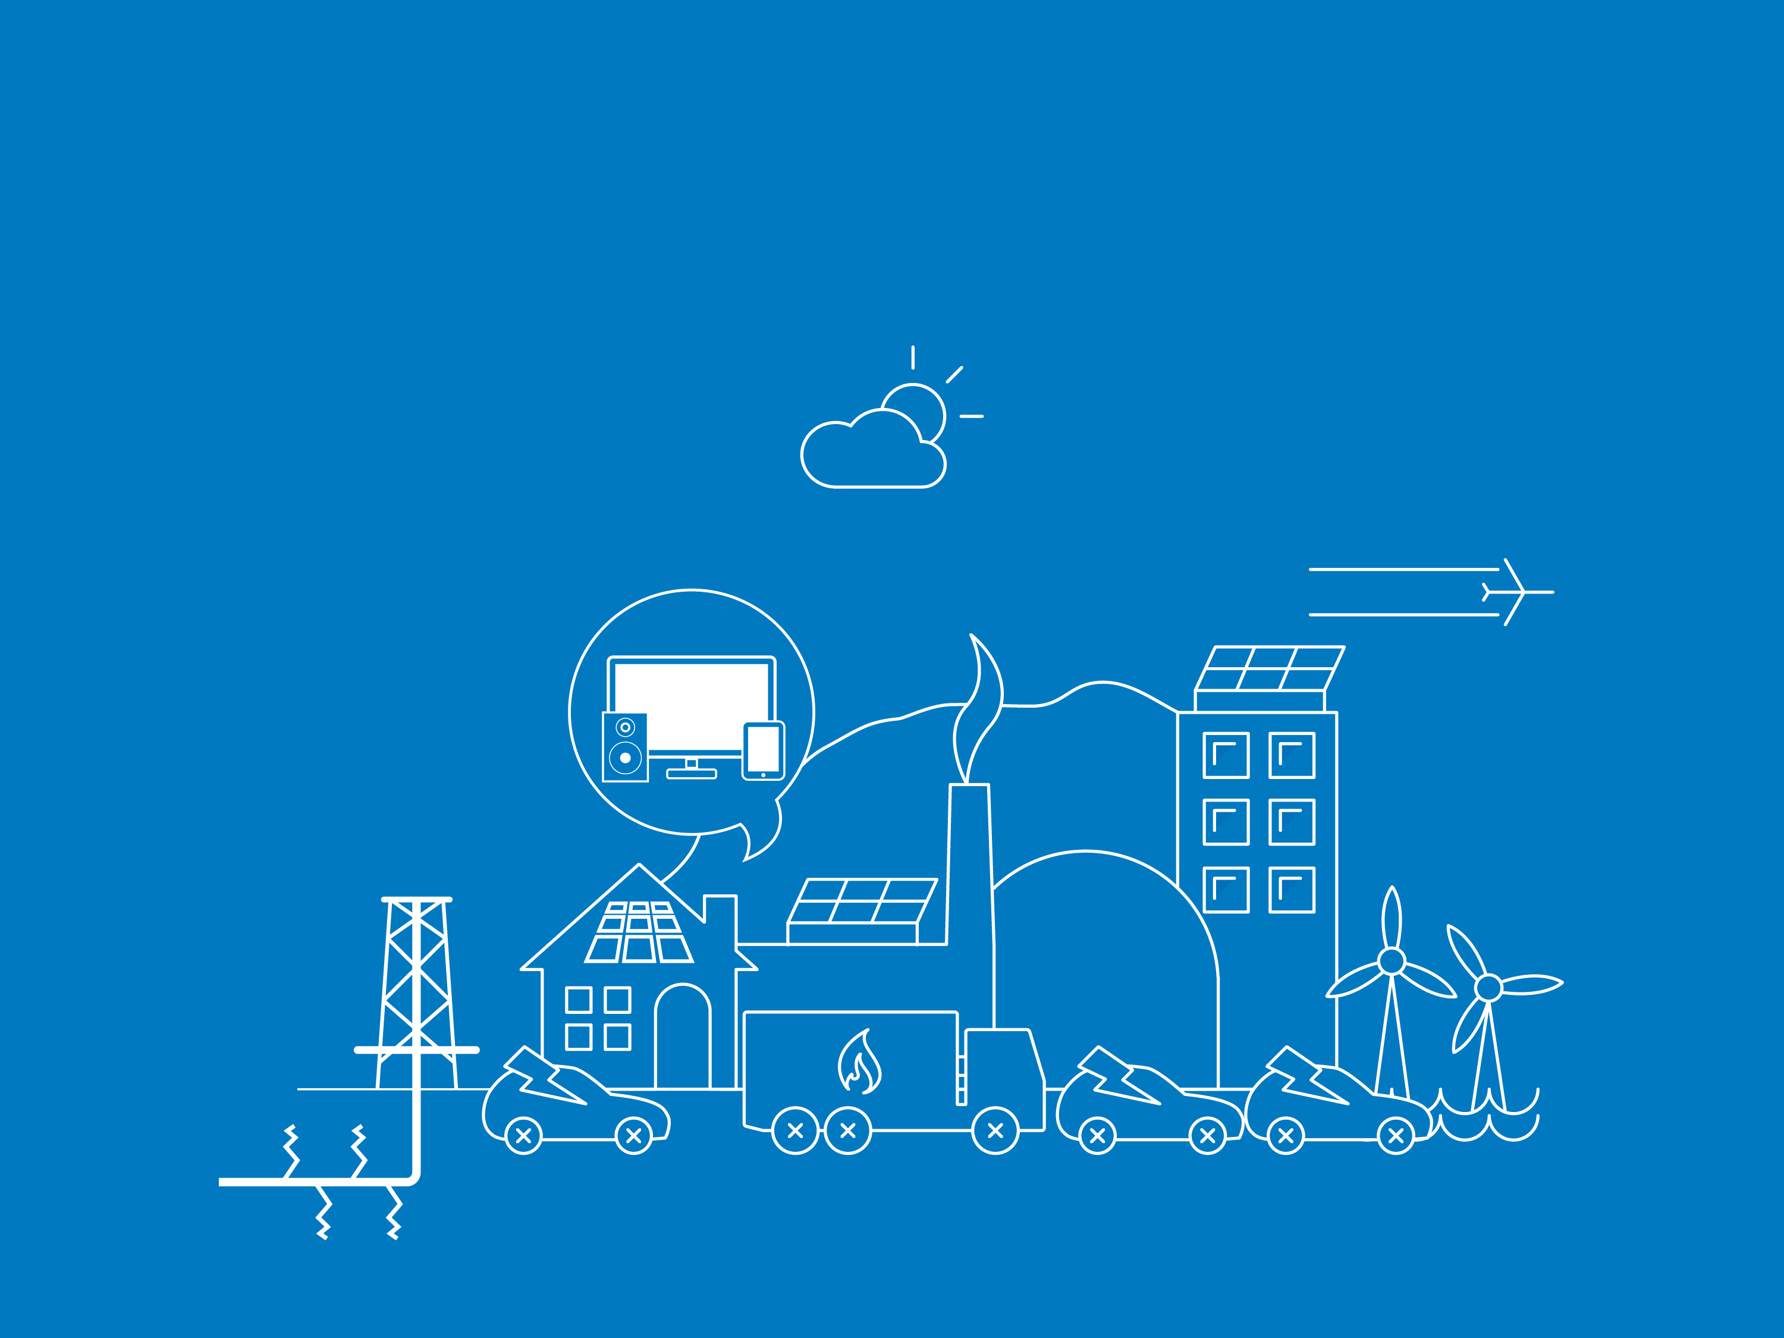

Consumer Power
Consumerism, where quality of life drives decisions
Money for government and consumers to invest
Notes:
Consumer Power is that world and is a world of Consumerism where quality of life drives decisions.
Government policy is focused on indigenous security of supply and low carbon technologies.
Economic growth ensures there is money for the government and consumers to spend and invest. And as a result innovation is high and continues at a fast pace
The primary fuel is gas, because it’s relatively cheap and this results in localised generation becoming prominent, including micro-combined heat and power units.
Although gas prices are low, government support makes investment in shale gas production high.
Energy demand is driven by consumer preferences, and the market responds by focusing on innovating to attract customers to new products.

Slide 7

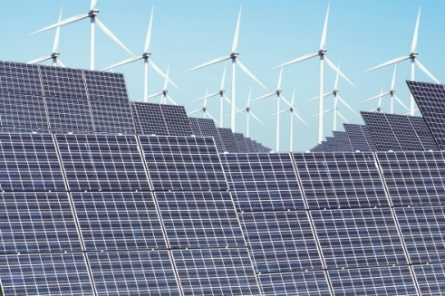


Consumer Power
Solar panels
Electric vehicles
Focused on spending
Consumption
Notes:
As a Residential user…
As a consumer in this world you spend your money on your family and yourself, enjoying the relatively prosperous economic growth.
You choose to invest in some smart appliances like a Home Energy Management System. But you also invest in a/c and a new EV, because they are new and luxurious and make everyday life easier for you.
If you have money available to invest, low gas prices make installing a micro-CHP unit in your home an economical decision, replacing your gas boiler.
You’ve installed solar PV, because its cheap and it’s a source of income.
For Industrial and Commercial users…
Your Heavy Goods fleet is comprised of natural gas vehicles as they are by far the most economical.
You install a combined heat and power unit to take advantage of the difference between gas and electricity prices and you reduce your electricity demand by switching to gas for heating and hot water needs.

Slide 8
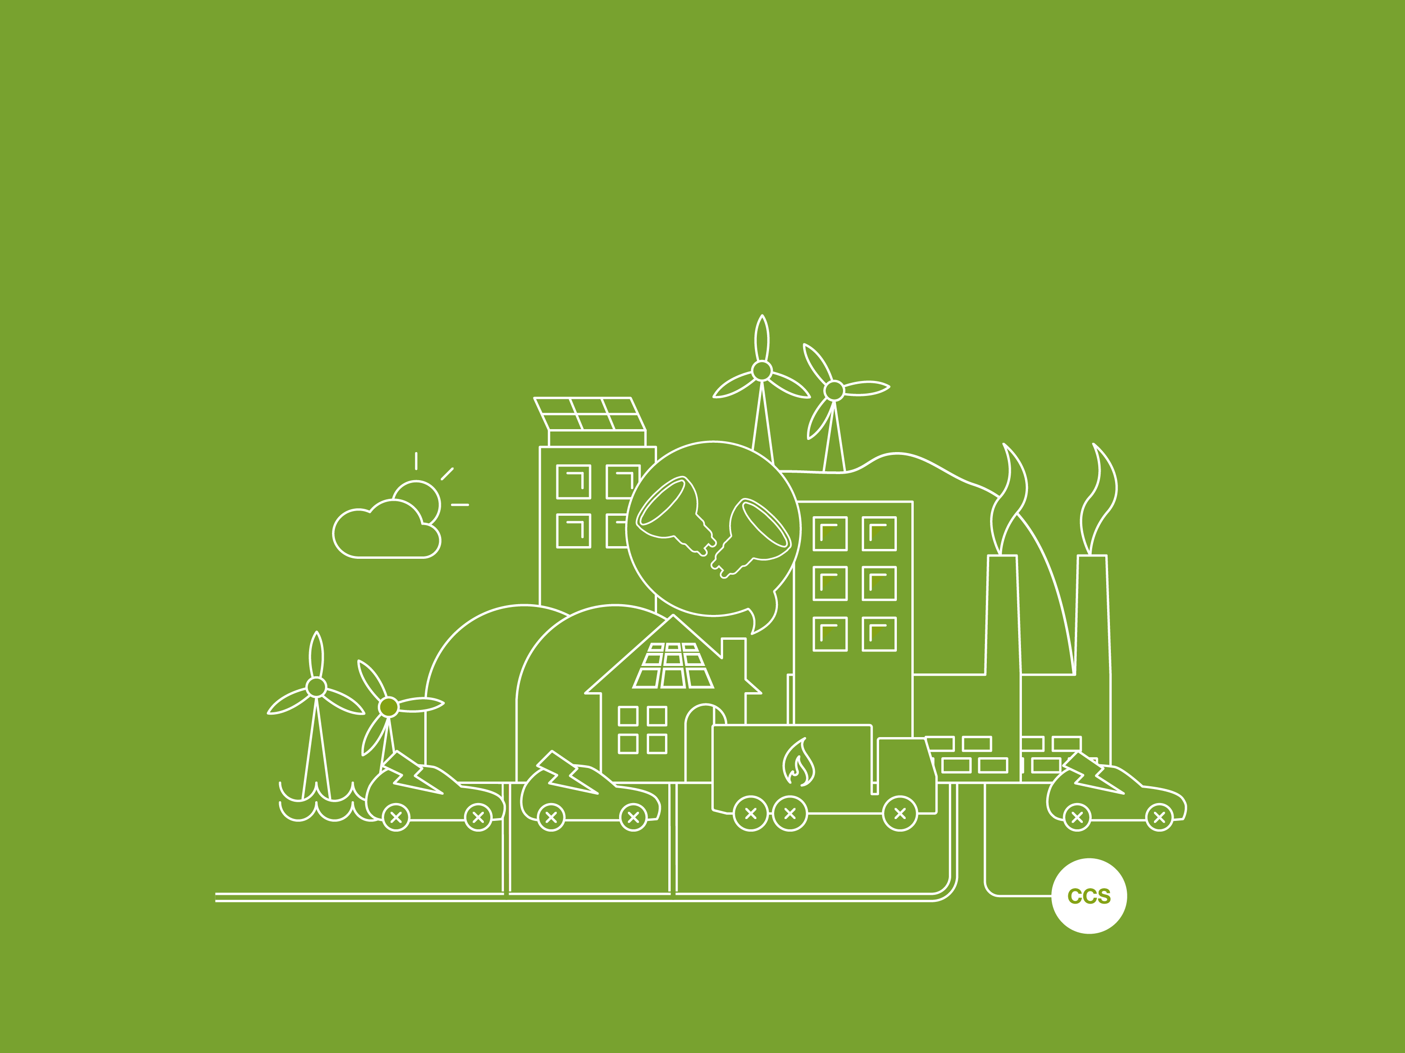

Gone Green
High levels of prosperity and high levels of green ambition
Power generation focused on decarbonisation
Notes:
Gone Green is that world, a world with high levels of prosperity, and high levels of green ambition across all sectors of the economy with long-term environmental energy policy including new policies to reduce emissions.
Power generation is focused on decarbonisation… and there are high levels of renewable generation and new technologies such as marine and CCS (Carbon Capture & Storage)

Slide 9
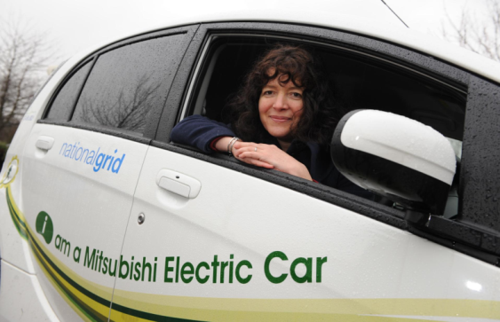
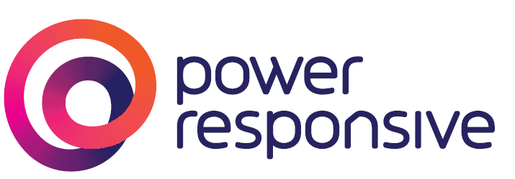
Gone Green
A+++
Solar panels
Energy efficiency
Demand side response
Electric car
Notes:
As a Residential user…
With one in six cars being an electric vehicle by 2035, you or someone in your close family will be driving an electric vehicle. At the weekends you substitute your car trips by taking a natural gas powered bus.
When buying a new home you see more energy efficient homes on the market, and after 2020 you can only purchase a Zero Carbon new home.
If you're not moving home you invest in as much insulation as your house needs to improve its energy efficiency rating.
You have greater control over your energy use, and a greater desire to reduce your demand, facilitated by smart meters and home energy management systems.
Your TOUTs will enable you to save money and energy by shifting your energy use away from peak times. You will have abandoned the use of halogen lighting in favour of LEDs.
You invest in a heat pump and the new estate nearby is heated by a district heat network where the heat is generated by a biomass CHP unit.
It’s likely you or a neighbour choose to invest in micro-generation, investing some of your higher disposable income in solar PV.
For Industrial & Commercial users…
Have investment capital available
Your Heavy Goods fleet progresses towards natural gas, as this is the most economic and environmentally friendly option for your business.
You’ve installed LED lighting and you consider a biomass fuelled CHP unit to generate your own clean electricity.
DSR is a way of life for your business, you provide services to increase your profitability and often move your energy when it makes business sense - you are a Power Responsive business

Slide 10
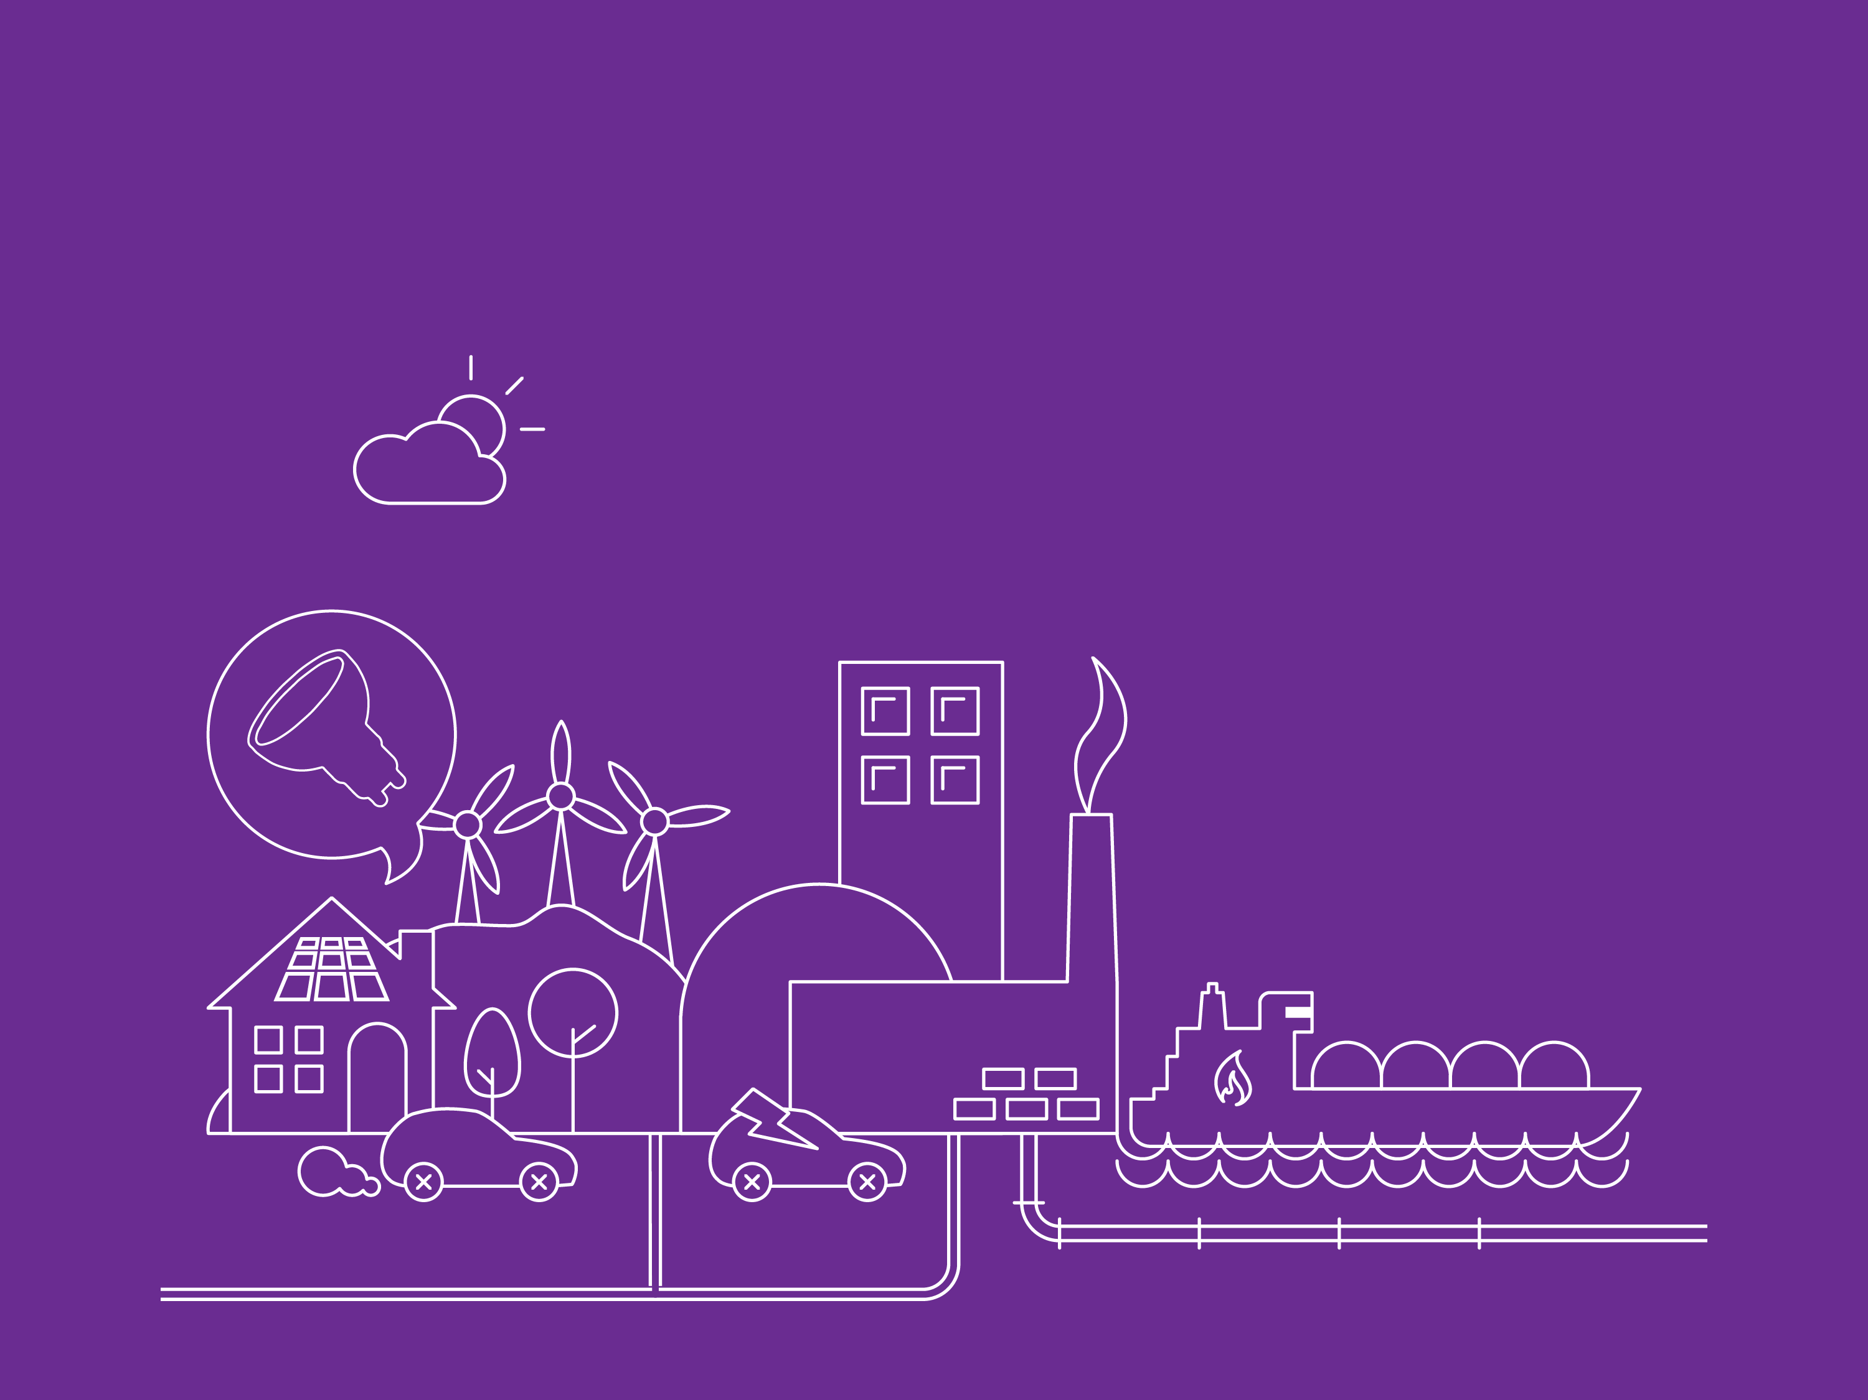

Slow Progression
All striving towards a Gone Green world
Focus on low cost environmental energy policies
Notes:
Slow Progression is a world where we and the government are all striving towards a Gone Green world, but the lower economic growth slows progress.
There is still harmonisation at a European level, but with a focus on low cost environmental energy policies. Renewable and low carbon build rates are hampered by the slow economic growth.
Thermal generation still prevails, with gas and nuclear favoured over coal.

Slide 11

Slow Progression
A
Solar panels
Energy efficiency
Demand side response
Hybrid car
Notes:
As a Residential user…
You want to reduce your impact on the environment and reduce your energy bill but have less money in your pocket.
You are willing to invest in solar PV when possible and you seek out cost effective ways to manage your energy use and consider time of use tariffs and home energy management systems where you can afford them.
Any new appliances you buy are more efficient, as this has become the only option following policy change. You do all you can to ensure your home is energy efficient, insulating your loft and cavity walls.
You would like to buy an electric car but can't afford one; hybrid cars offer a cheaper solution. The decarbonisation of public transport is a government priority, and you often choose to take the bus instead of drive.
Your heating system is likely to remain the same until 2030; there has been less innovation in low carbon heating which leaves heat pumps and micro-combined heat and power too expensive.
For Industrial & Commercial user…
The green focus of consumers, as well as environmental policies drive you towards improving your energy efficiency and investing in green technologies.
But the slower economic growth restricts you from investing when there are long pay back periods so you opt for smaller projects such as insulating buildings and LED lighting.
DSR is attractive and you're trialling a scheme to convince your MD.

Slide 12

Gone Green meets targets on time
Notes:
Slow Progression meets the targets but late
Gone Green is the only scenario to achieve all renewable and carbon targets on time
In this scenario:
By 2020, renewables supply 34% of electricity.
Wind is the largest contributor at 18% of total output.
Beyond 2020, low carbon electricity from a mix of renewables and nuclear underpins the electrification of heat and transport. Heat pumps provide an increasing contribution towards the targets and they are the largest provider of heat in 2050, but there is still an essential role for gas to provide top-up heat.

Slide 13
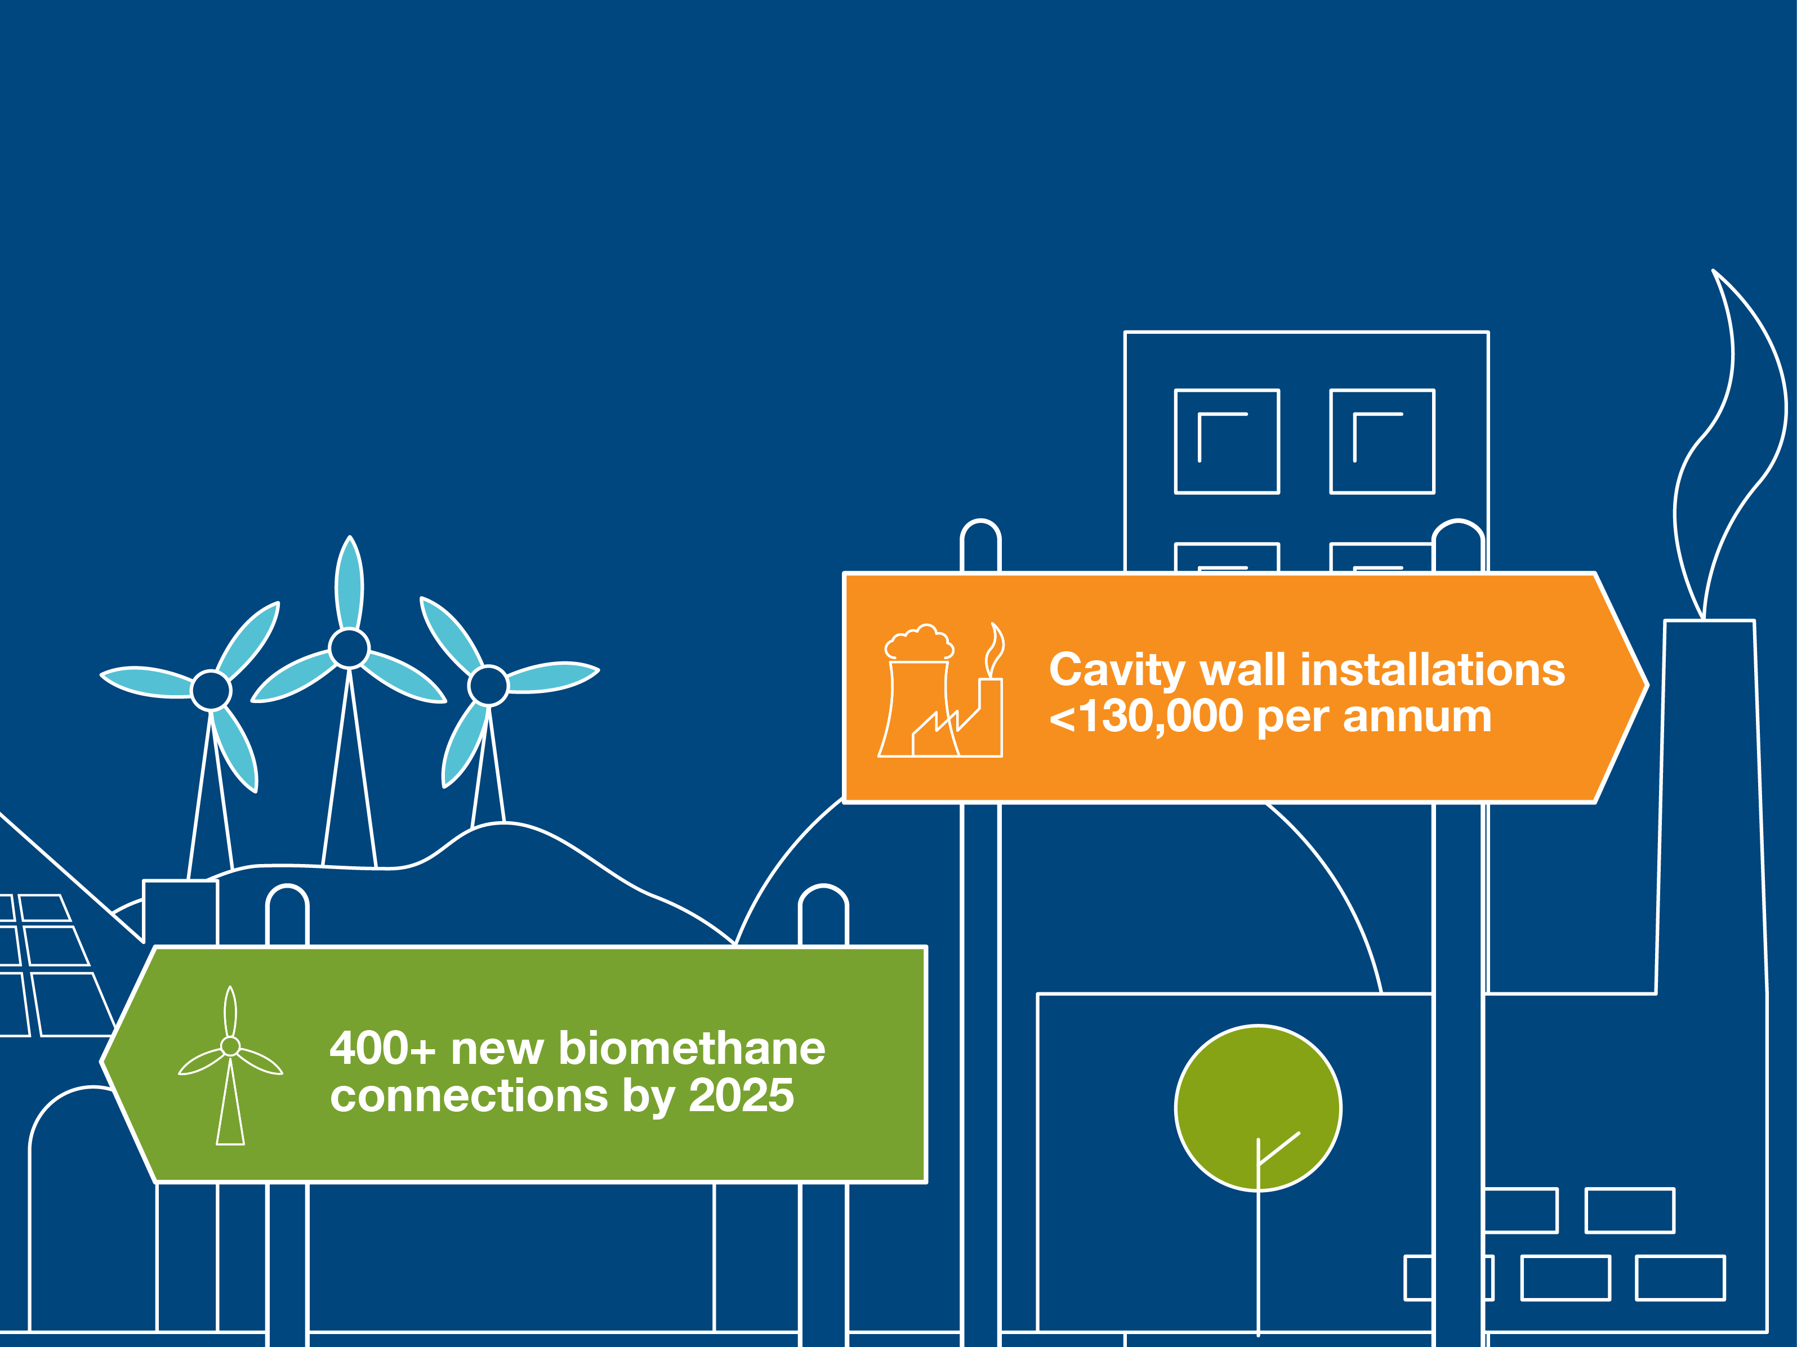
Signposts
Notes:
The “FES in 5 minutes” booklet details some of the markers to understand which pathway we’re on and heading towards.
For example if there are 400 biomethane connections by 2025, that’s a signpost for being on the Gone Green pathway.
But, if cavity wall installations don’t exceed 130k per annum, that’s a signpost for No Progression.

