Slide 1


Future Energy Scenarios 2015
Introduction
Roisin Quinn
Head, Energy Strategy and Policy

Slide 2





The 2015 key themes
Gone Green is the only scenario to achieve all renewable and carbon targets on time.
^{GB remains a net}
^{importer of electricity}
^{in three out of our}
^{four scenarios.}
^{Sufficient gas Supplies}
^{are available in all scenarios}
^{with significant uncertainty}
^{on the source.}
^{The scenarios highlight}
the increasing operability challenges the electricity
^{industry faces.}
Margins, whilst narrow, continue to be manageable until 2018/19 when the capacity market delivers new sources of capacity and margin pressures ease.
Notes:
Five key themes have emerged from this year’s analysis:
Of the four scenarios, Gone Green is where all renewable and carbon targets are met on time and in full.
Other scenarios may get there but late.
Renewable electricity is key to meeting 2020 targets. Beyond 2020, increased electrification of heat and transport is key to achieve targets.
GB remains a net importer of electricity in three out of four scenarios (exports are seen from the 2030’s in Gone Green due to the higher volumes of renewable generation). The level of installed capacity has increased due to a number of factors:
Ofgem’s confirmation of the cap and floor regime
EU aspirational targets has renewed interest in investment
Increased renewable generation across Europe strengthening the need case
There is sufficient gas supplies in all scenarios, both annually and at peak periods. The major variation between scenarios is the source of supplies, be it indigenous or imported gas. The precise mix of these sources will be determined by prevailing market conditions.
Electricity margins remain narrow but manageable until the Capacity Market delivers in 2018/19. This will bring forwards new sources of capacity, both generation and demand side response, and ease pressures on margins. Longer term, the investment case for thermal generation remains challenging due to increased volumes of low carbon generation and interconnectors.
Increasing amounts of generation connecting to the distribution systems, in particular solar power, will result in periods of low transmission level demand. Without action, this increase in generation will present balancing challenges for the system operator.

Slide 3
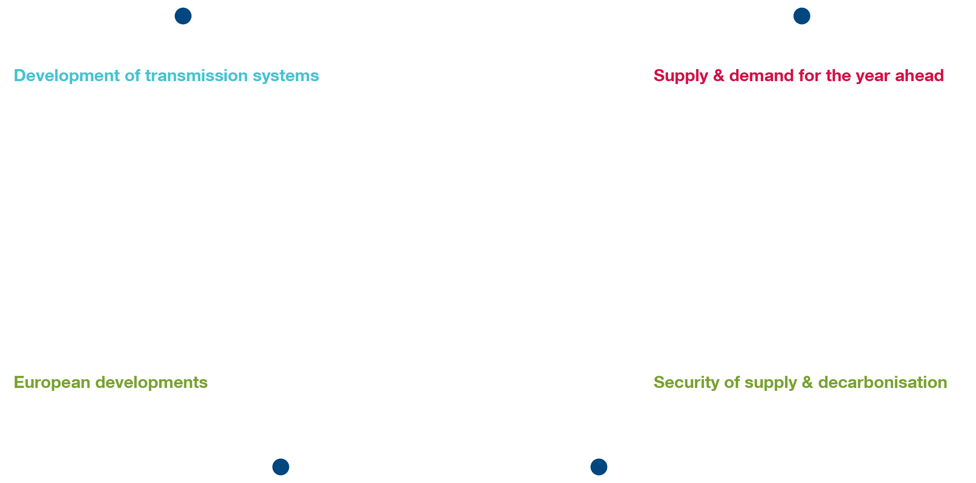
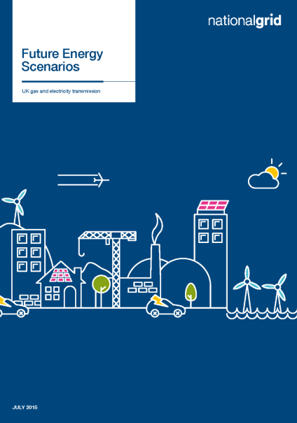
The value of scenarios
Notes:
Scenarios are not forecasts. They are valuable for many reasons:
A long term view is needed to understand the potential risk and rewards of investment, recognising that there is not one fixed pathway to the future.
Our scenarios focus on this longer term picture, rather than getting fixated on the short term. The FES set out credible evidence based pathways of what the future could look like.
Having this framework, helps us ask insightful questions, expect the unexpected and by understanding the impact of changes in the external landscape on our decisions, ultimately make better decisions which are more robust.
This view is supported by a number of other organisations, who develop scenarios or comment on them and the feedback we have received from our stakeholders throughout the year.
Within National Grid, we use the FES as the starting point to a number of key pieces of work and significant decisions…
They are the first step of the development of the transmissions system, as set out in the Electricity and Gas Ten Year Statements and the System Operability Framework.
Supply and demand reports, including the Winter and Summer Outlook Reports, are built upon the FES
They are the basis of our recommendation to Government on analysis for Electricity Market Reform
Our input to European documents, such as the Ten Year Network Development Plans for Gas and Electricity, is informed by the FES work.

Slide 4
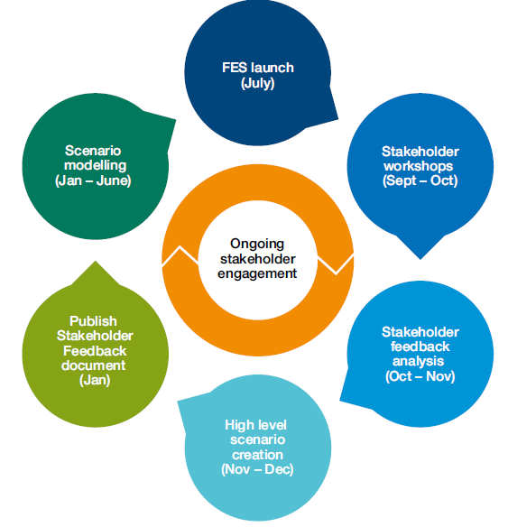
Annual FES development cycle
Notes:
We follow an annual process, starting with the launch event today and leading to the development and publication of next year’s scenarios.
We do engagement throughout the year. We will hold workshops for groups of stakeholders, have bilateral meetings, receive (gratefully) a lot of data and comments via email.
We then analyse the wealth of information
As part of this we start to prepare the framework of the scenarios, setting out the boundaries we will look to test and considering what evidence may be available to support a certain pathway being credible and robust.
This year was the first where we had a new licence condition. This requires us to submit to Ofgem (contained in the Stakeholder Feedback Document published in January):
Detailed description of proposed scenarios and any changes to the scenarios or the modelling which will underpin those scenarios
A document on the stakeholder feedback we received and how we have used it, and evidence of this engagement
We then complete detailed modelling work on demand, power supply, gas demand, gas supply
Finally we review and sense check the outputs

Slide 5

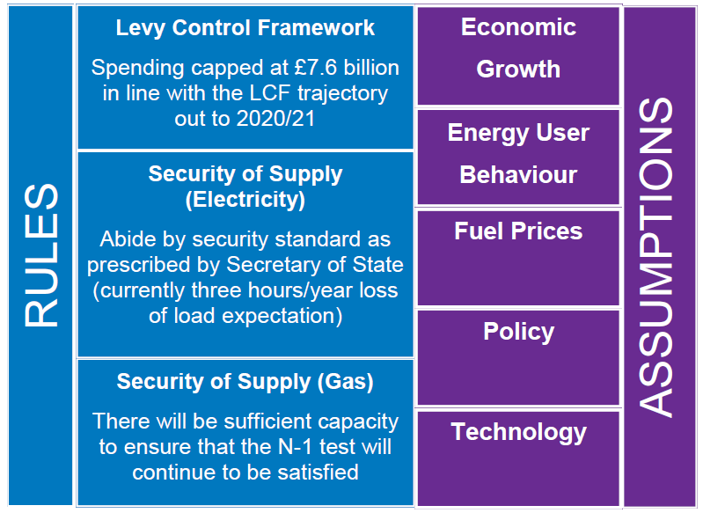

Continuous improvement
Notes:
We are always looking to improve, and add value to the debate and quality of decisions made as a result.
This year we spoke to over 230 organisations
The feedback was supportive of the scenarios, suggesting evolution rather than revolution. We have continued with four scenarios this year.
We have updated our models, most notably in gas demand, power economics and interconnectors.
We have stayed with three rules, formalising our assumption on gas security of supply. Our rules are:
Levy Control Framework – we won’t spend money that we don’t have
Security of supply on electricity – the reliability standard of three hours will be achieved.
Security of supply on gas – There will be sufficient capacity to ensure that the N-1 test will continue to be satisfied.
In response to feedback we have moved from 26 Axioms, to 5 primary assumptions of Economic Growth, Energy User Behaviour, Fuel Prices, Policy and Technology.

